Slide 1
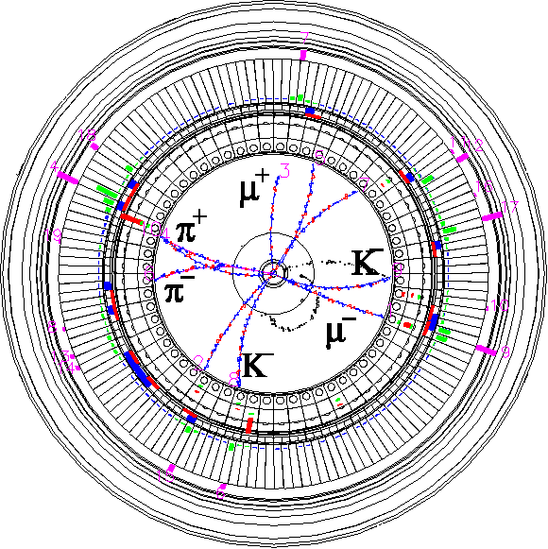


Improvement plan for machine protection
Makoto Tobiyama
KEK Accelerator Laboratory
(on behalf of SuperKEKB Accelerator Team)
Inter-University Research Institute Corporation High Energy Accelerator Research Organization (KEK)
大学共同利用機関法人 高エネルギー加速器研究機構 (KEK)

Slide 2
Malfunction of Beam Abort System
During 2025c run, HER's beam abort system issued a beam abort request via its own interlock.
  A beam abort trigger was issued, but as expected, the HER abort system did not activate, and the safety system executed the backup procedure of turning off the weak bending magnet.
  Due to this weak bending magnet being turned off, a significant portion of the beam was lost in the IR region.
  We need to review the backup system for the beam abort system.

Slide 3
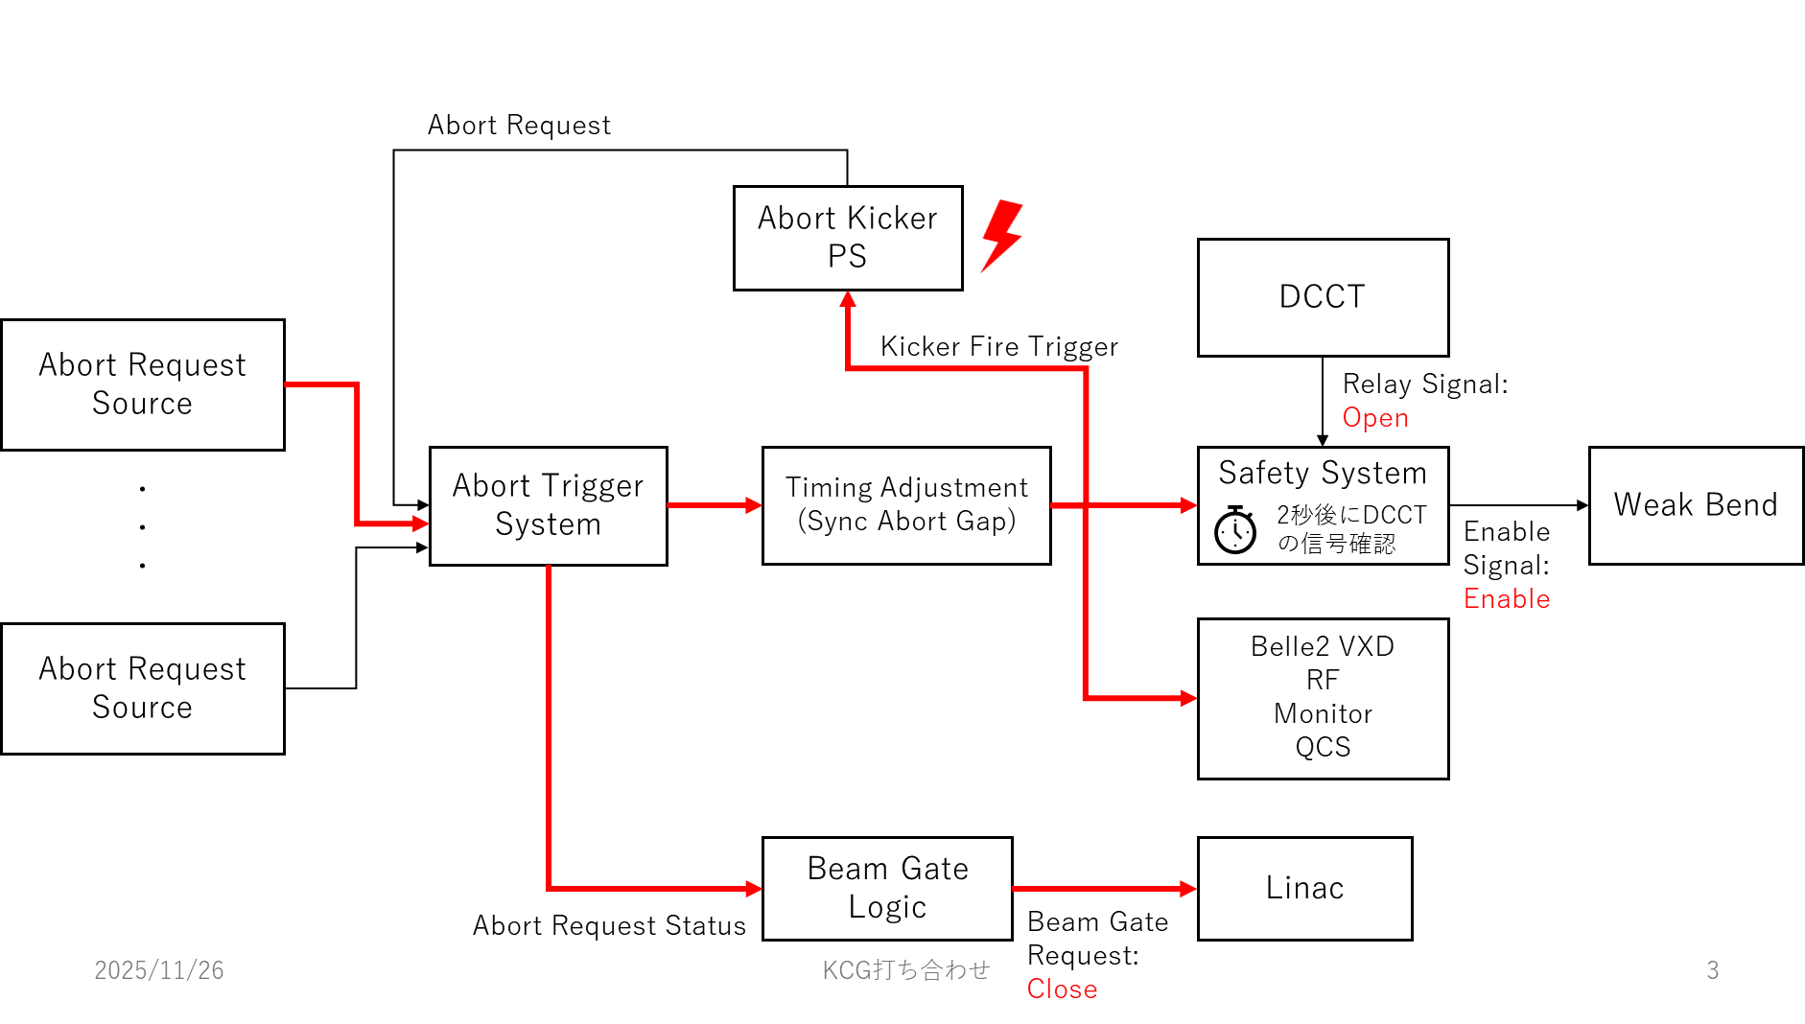
HER beam abort kicker malfunctioning
Normal condition

Slide 4
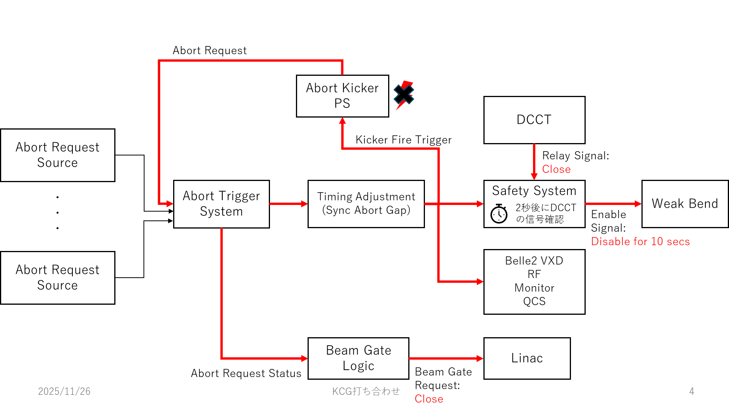
Abort kicker mulfunctioning

Slide 5
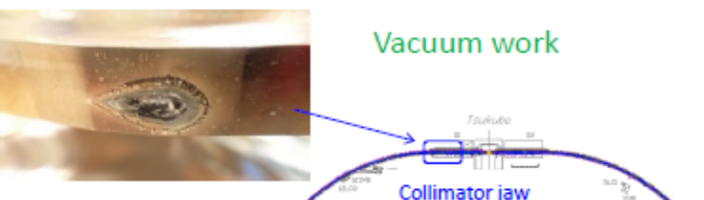
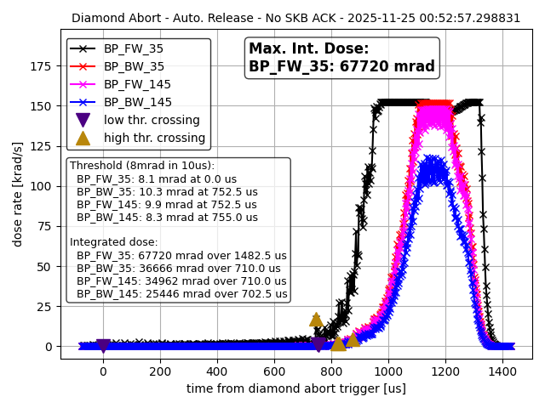
Due to weak-bends cutoff, a large beam orbit primarily in the horizontal direction emerged with a time constant of 0.1 seconds, resulting in catastrophic beam loss.
Simulation suggests more than 80% beam loss in the IR direction.
  Large xy coupling.
  Shrinked RF separatrix.
The QCS on the L side caused a quench in all magnets, taking about 7 hours to restore the liquid level.

Slide 6
(Temporally) countermeasure for both rings
When an abort kicker power supply malfunctions, do not issue an abort request.
  In principle, it will not be strongly needed to abort the beam due to the malfunctioning of the abort kicker PS.
Simultaneously with the power supply issue, we decided to send an HV shutdown request to Belle II, completed signal verification and operational confirmation at Belle II.
During this period, we will attempt to restore the abort kicker power supply. If restored, use the abort kicker to abort the beam correctly. If restoration fails, wait until the current decays sufficiently, then drop the beam via RF off or weak-bends.
Even if the abort power supply is in an abnormal state, kicking should be possible if the voltage drop is not significant.
  Changed the abort logic.

Slide 7
Weak bend (and maybe RF OFF) are extremely dangerous beam abort methods, so we are considering other approaches
  (A) Control weak bend (and horizontal steering magnets) to direct the beam to a radiator that can be damaged
    Simulation shows the beam will be crossing strong resonance lines such as 3rd slowly after By<90%.
    For the countermeasure, design a horizontal emergency bump at additional emergency radiators.
  (B) With RF OFF, direct the beam to a radiator located in a safe area
In either case, we are currently studying the beam trajectory with simulation. After confirming the orbit, we will check the orbit with the real beam (with a tiny beam current).

Slide 8
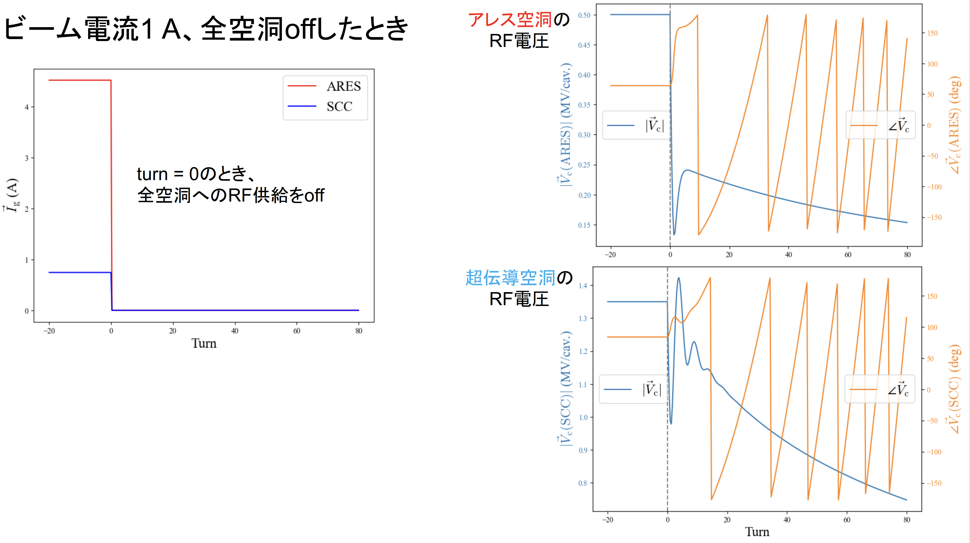
HER RF Off simulation (Yamaguchi Funakoshi)
Beam current 1A, All cavities off
ARES cavity
RF voltage
SCC cavity
RF voltage

Slide 9
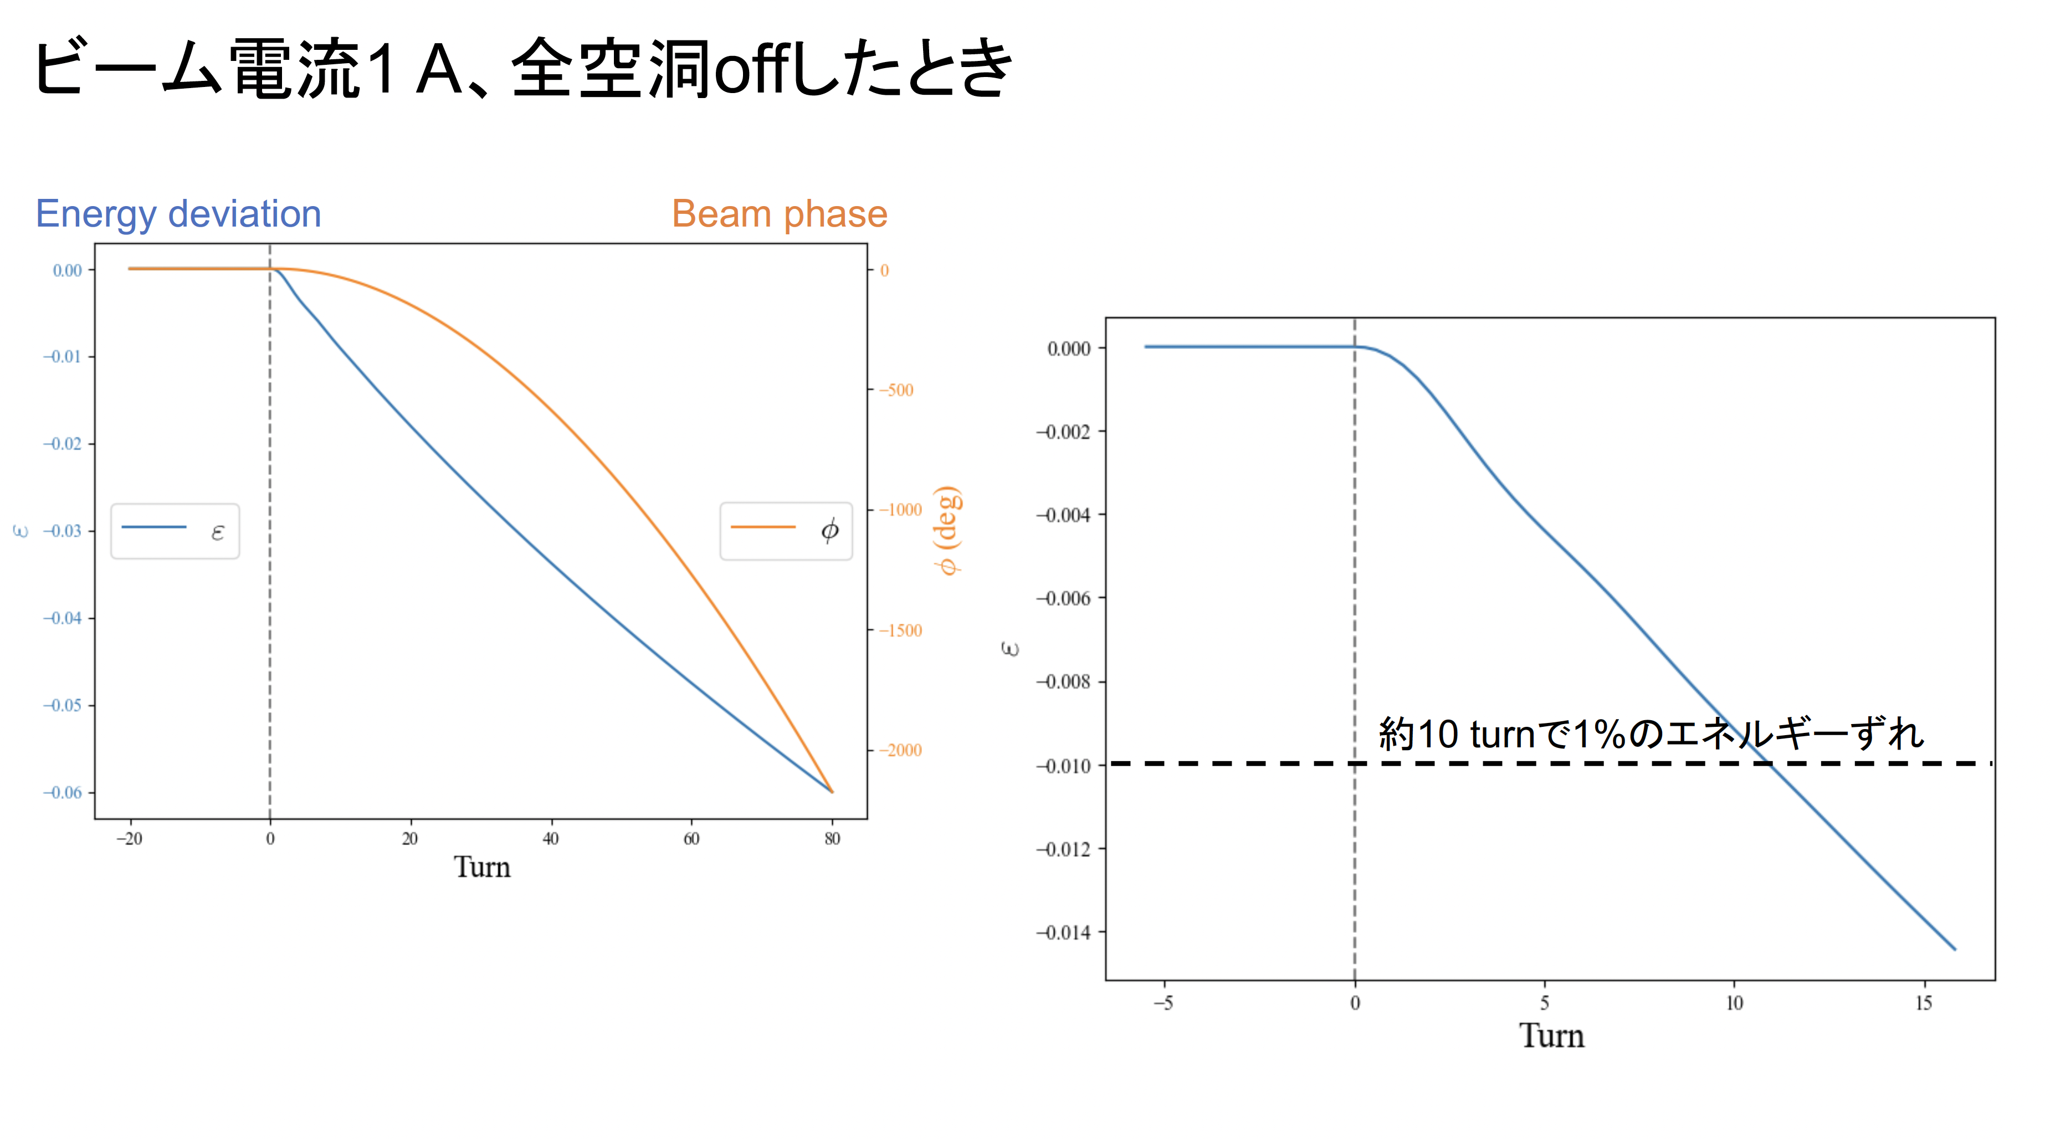
Beam current 1A, All cavity RF OFF
1% energy loss with 10 revolutions

Slide 10
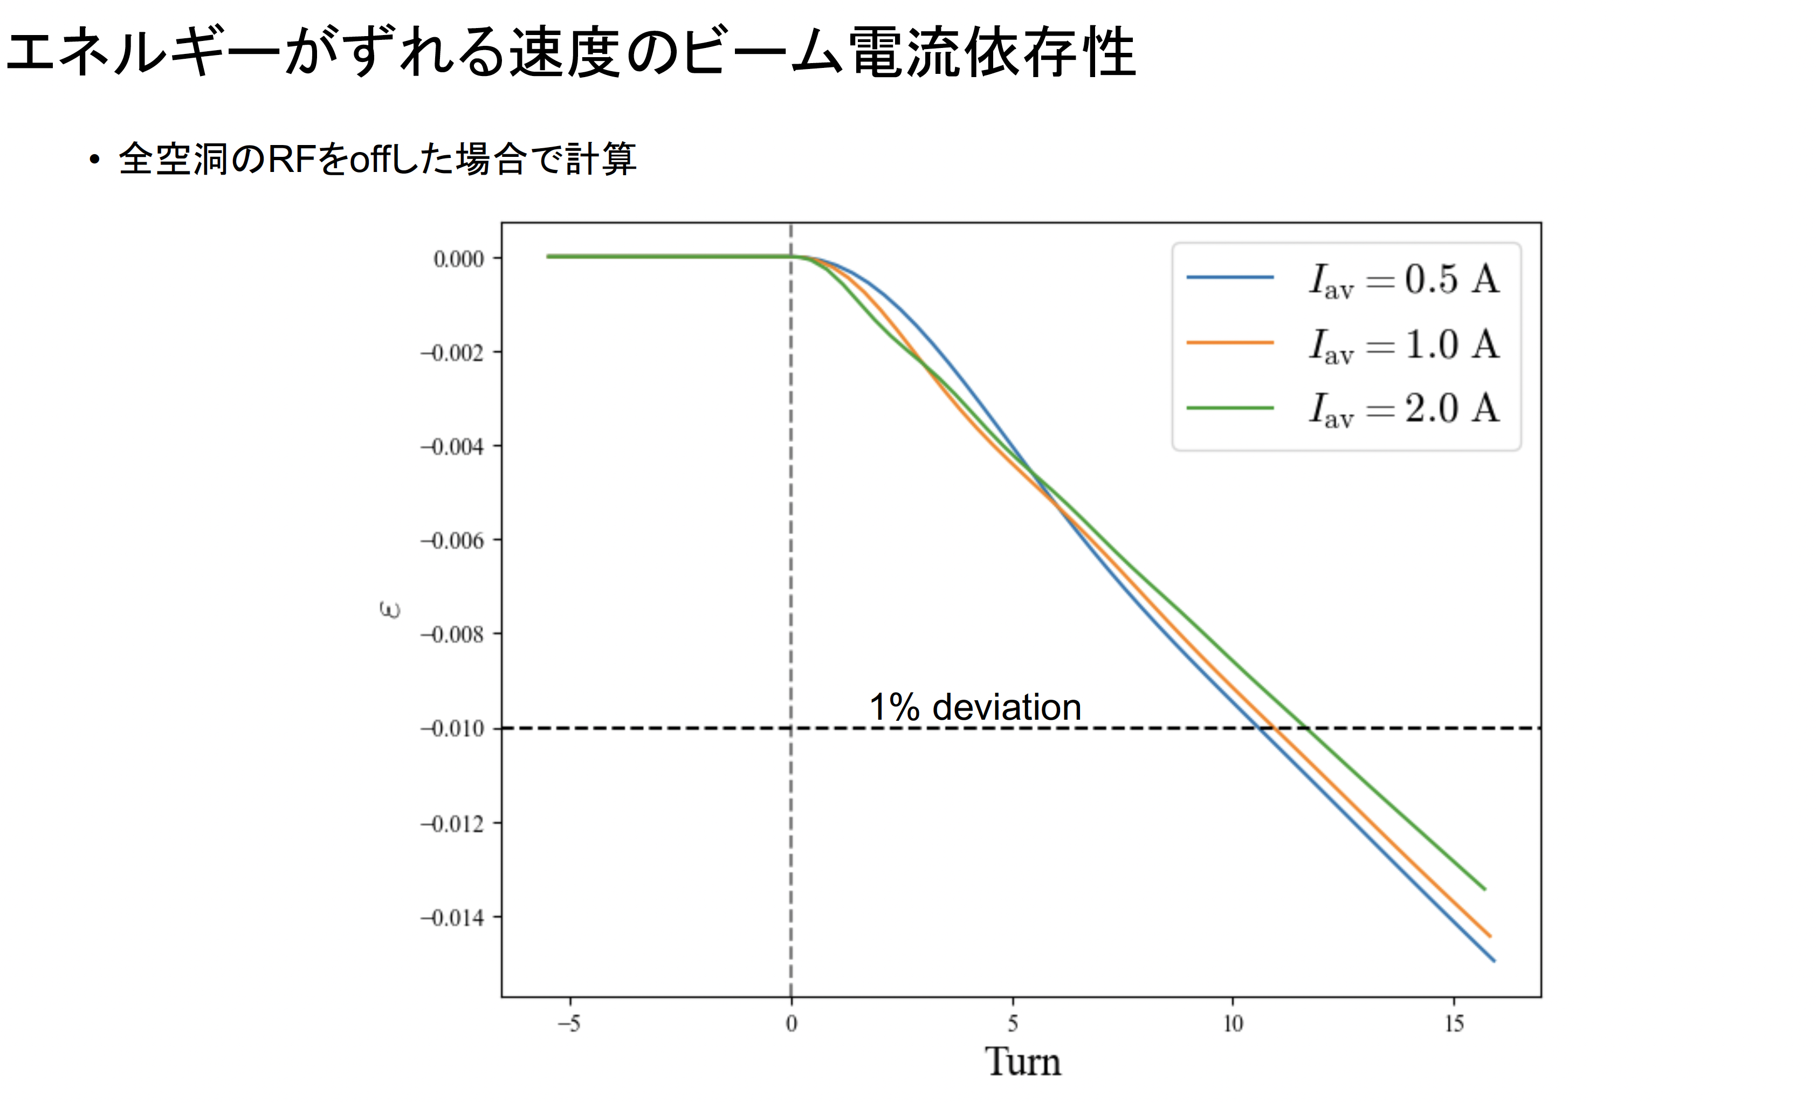
Beam current dependences
Beam current dependence of the beam energy deviation after RF OFF

Slide 11
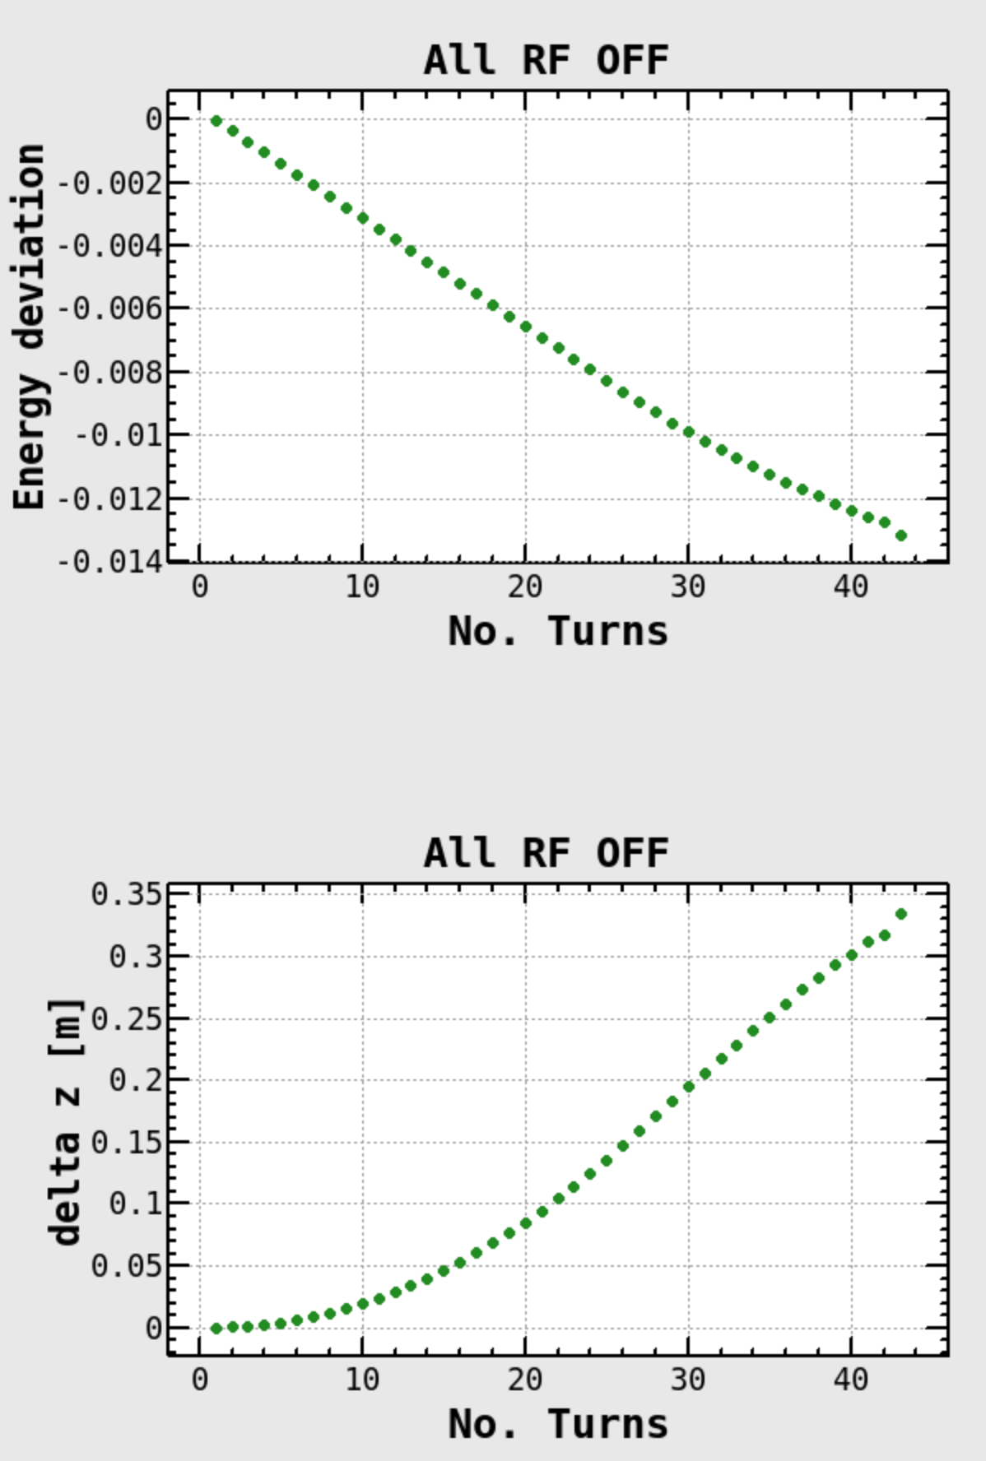
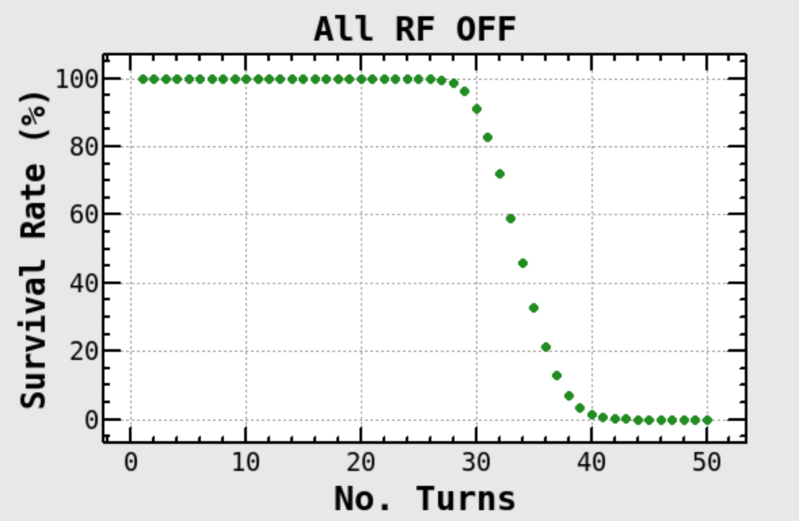
Element["VOLT",RFname]
Out[119]:= {0,0,0,0,0,0,0,0,0,0,0,0,0,0,0,0}
Rfname＝
{"CADNLE","CACNLE","CABNLE","CAANLE","CAANRE","CABNRE","CACNRE","CADNRE","CAHOLE","CAGOLE","CAFOLE","CAEOLE","CADOLE","CACOLE","CABOLE","CAAOLE"}
Average of survived particles
RF RF off without beam loading
Average of survived particles
Element Loss [%]
PMD01H3 10.54
PMD09H2 66.28
PMD09H4 .02
PMD09V4 .76
PMD12H3 1.76
PMD12H4 20.64
2024.12/27

Slide 12
Tracking simulation results
If the RF is turned off, the beam energy drops sharply and is almost entirely lost in the horizontal collimator, which has high dispersion.
Since the beam energy does not drop immediately even when the RF is turned off, the change in beam energy is likely to be much slower.
If the energy decreases slowly, feedback may become ineffective due to changes in beam phase, potentially leading to beam loss caused by beam instability

Slide 13
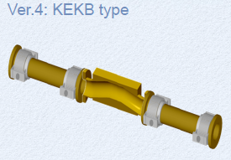
Candidate of emergency dump
Downstream of IR, far from superconducting cavities
  D9 symmetry point for LER (SF8NFP pairs), D3 or D9 symmetry point for HER
  >1 mrad horizontal steering kick to make π−bump larger than 50σx.
Example of D9 symmetric point
  3.3m drift space inside SF8NFP pairs, βx~29m.
  5.3m drift space around both side of QT5NFP, βx~13m, ηx~0.49m
  50σx->10.2mm bump + energy diviation 0.3mm
Plan to use KEKB HER-type horizontal collimator
  Production costs have turned out to be unexpectedly high, and the manufacturing process is taking a long time.
    Re-optimize the structure will be needed.

Slide 14
Immediate improvement plan for 2027a run
Enable the automatic beam abort function when the pulse power supply of the abort kicker (charging circuit) has failed.
If the kicker cannot fire, reduce the current while maintaining the beam and try to recover the abort kicker.
Prepare the software logic for “RF off.” This should essentially correspond to the horizontal collimator in the arc section, and we expect the impact to be less severe than when the weak bending magnet is turned off.
Continue design and fabrication of emergency beam dump systems using horizontal bump+collimator on both rings by the end of the 2027 summer maintenance period.
We would appreciate any good ideas you may have.

Slide 15
Backup

