Slide 1
October 26, 2026
ARC
Current status of QCS upgrade
Michinaka SUGANO
Cryogenics Science Center, KEK
On behalf of the QCS group

Slide 2
Acknowledgement
• KEK (in particular)
N. Ohuchi, Y. Arimoto, K. Aoki, K. Suzuki, H. Yamaoka, X. Wang, T. Oki, T. Nakamoto, T. Ogitsu, R. Bajpai
• Sophia University: Characterization of Nb₃Sn wires, simulation of magnetic field decay
S. Hoshino, K. Kaneko, T. Yagai
• Furukawa Electric: R&D of Nb₃Sn wires
K. Mun, R. Taniguchi
• FNAL: Technical support for the Nb₃Sn QC1P development
S. Stoynev, V. Kashikhin, G. Ambrosio, M. You, S. Krave, X. Xu, G. Velev, S. Gourlay
• BNL: Design for corrector magnets
V. Teotia, B. Parker

Slide 3
Contents
• Answers to recommendations from the reviewers at the last ARC
• Overview of the QCS upgrade
• Nb₃Sn QC1P development
• Corrector magnets and compensation solenoid

Slide 4
Answers to recommendations from the reviewers at the last ARC
R15.2: Complete the study of whether the radiation doses to the SC magnet coils due to SBLs, other beam aborts, and accumulated backgrounds will ultimately degrade the integrity of the SC magnet.
We have answered this comment in the previous talk given by Arimoto.
R22.2: Before embarking on the manufacture of tooling, study the possibility and implications of using a two-layer coil, and compare manufacturing, cost and performance issues with those associated with the single layer coil design shown in the presentation.
After the last ARC, we discussed which coil design option to choose within our group and FNAL. Then, we concluded that, in such a small coil, there will be a risk of mispositioning of the Nb₃Sn wire and insulation damage in a two-layer coil. Thus, we prioritized R&D for single-layer coils. We are repeating the fabrication of practice single-layer coils, but we have recognized some difficulties such as mispositioning of the ramp lead. In parallel with developing the single-layer coils, we have started R&D for two-layer coils. We will report on the results of the first practice winding for a two-layer coil in this presentation.

Slide 5
Overview of the QCS upgrade

Slide 6
Why is the QCS upgrade needed?
QC2LP
Correctors
QC1LP
QC1RE
Correctors
QC2RE
Correctors
Correctors
Belle solenoid field
HER
IP
LER
QC2LE
Correctors
QC1LE
Correctors
QC1RP
QC2RP
Correctors
Correctors
Compensation solenoid
Layout of current QCS
– Main quadrupoles are exposed to the detector solenoid field in the current QCS
Install the main quadrupoles with rotation and offset
Large chromatic x-y coupling
→ IR optics need to be simplified.
– Moving QC1P forward to IP
Larger dynamic aperture and longer beam lifetime were expected in an early study.
A more severe space constraint → Replacing Nb-Ti coils with Nb₃Sn coils having a higher critical current density
– Mitigation of beam-induced quench
Larger temperature margin by adopting Nb₃Sn with a higher critical temperature

Slide 7
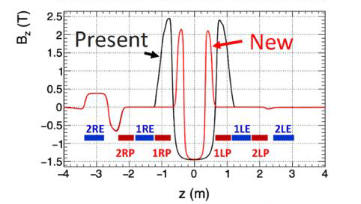
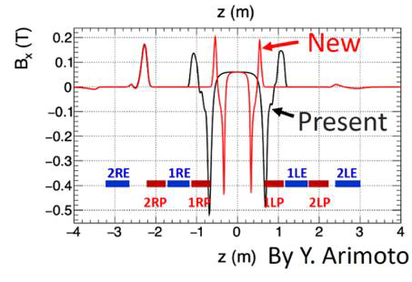
QCS upgrade
IP
Current
QCS
Move QC1P forward
closer to IP
100 mm
Corrector
magnet
Compensation solenoid
QC2LP
QC1LP
QC2RE
IP
QC1RE
Upgraded
QCS
HER
LER
QC1RP
QC1LE
Extension of
compensation
solenoid
QC1RP
QC2LE
Corrector
magnet
• Extension of compensation solenoid
The detector solenoid field is canceled ahead of QC1P.
→ Simplified IR optics
• Place Nb₃Sn QC1P with iron yoke 100 mm closer to IP
→ Thinner coil size, larger temperature margin
Lower operating current, reducing magnetic crosstalk to HER
by iron yoke

Slide 8
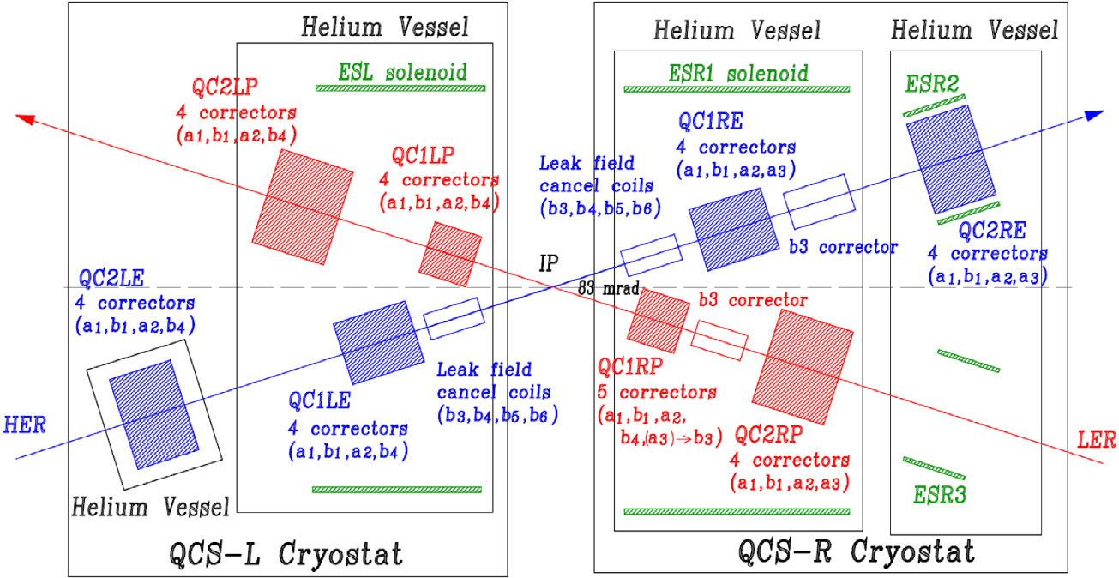
Layout of QCS magnets
Current QCS
Specifications of magnets for the current QCS
Main quadrupoles
 | Field gradient (R, L) (T/m) | Design current, I_{d} (R, L) (A) | Peak field at I_{d} (R, L) (T)
QC1P | 76.37 | 1800 | 4.56
QC1E | 91.57 | 2000 | 3.50
QC2P | 31.97 | 1000 | 2.43
QC2E | 38.56, 36.39 | 1562.5, 1250 | 2.81, 2.63
Compensation solenoids
 | Design current, I_{d} (A) | Peak field at I_{d} (T) | Coil inner radius (mm)
ESL | 390 | 3.56 | 78~(145)
ESR1 | 450 | 3.05 | 70~189
ESR2 ESR3 | 151.1 | 0.3 T | 81.1
Upgraded QCS
(tentative)
Extended
compensation solenoid
He Vessel
He Vessel
He Vessel
ESL solenoid
ESR1 solenoid
ESR2
QC2LP
Correctors
QC1LE
Correctors
Correctors
QC1LP
QC2RE
Correctors
Main changes in upgraded QCS
• Extension of compensation solenoid
• Relocation of QC1P with iron yoke
(Nb₃Sn is the baseline, Nb-Ti as a backup)
• New correctors for QC1P
• No leak field cancel coils
QC2LE
Correctors
IP
QC1RP
HER
QC1LE
Correctors
Correctors
QC2RP
Correctors
LER
*Multipole order of correctors
has not been fixed.
He Vessel
ESR3
QCS-L Cryostat
QCS-R Cryostat

Slide 9
Tentative schedule of QCS production
 | FY2026 | FY2027 | FY2028 | FY2029 | FY2030 | FY2031 | FY2032 | FY2033 | FY2034 | FY2035
QC1P
Corrector magnet
Compensation solenoid
Cryostat
QCS system including main quadrupoles other than QC1P
Run2
LS2
Run3
Development
of Nb₃Sn QC1P
(Nb-Ti as a backup)
R&D magnet 2
in case of Nb₃Sn
Production of
QC1P proto
by KEK
Production of
QC1LP, RP
R&D magnet
in case of Nb-Ti
Test and review
of QC1P proto
Bid for
QC1LP, RP
Production of supplies
Specifications
Design and
production of R&D
magnets
with a company
Design of
corrector magnets
Production of corrector magnets
for QCSL, R
Bid for corrector magnets
for QCSL, R
R&D of Nb₃Sn
solenoid, test
Design of corrector magnets
Production of QCSL, R
compensation solenoids
Bid for compensation
solenoids
Production of supplies
QCSL
installation to beam line,
test, alignment
Design of QCSL/R cryostat
Specifications for
production of QCSL, R
Production of QCSL
QCSL test
on the ground
QCSR
installation to beam line,
test, alignment
Bid for production
of QCSL, QCSR
Belle
roll-in
MFM
Production of QCSR

Slide 10
Nb₃Sn QC1P development

Slide 11
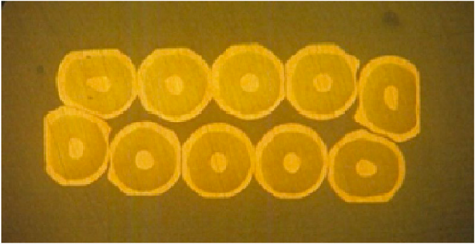
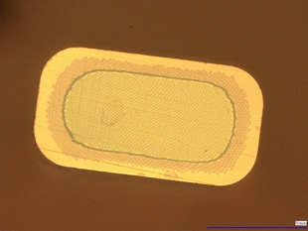
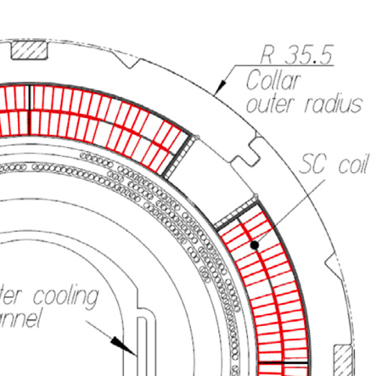
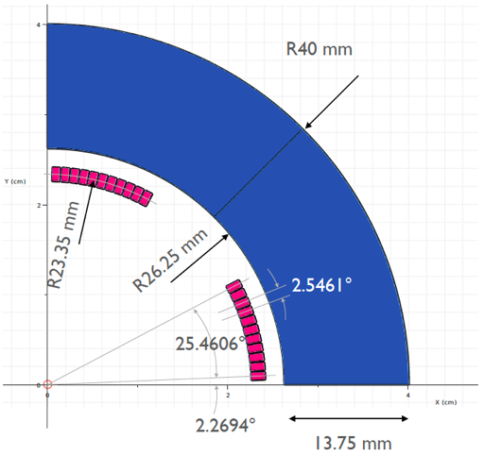
New Nb₃Sn QC1P
Main Design Parameters of QC1P (Tentative)
 | Units | Present | Upgrade
Conductor material |  | Nb-Ti | Nb₃Sn
Integral Gradient | T | 22.96 | 26.7
Operation current | A | 1600 | 1832
Field gradient | T/m | 68.74 | 80
Field Quality |  | < 10⁻⁴
Material of magnetic yoke |  | - | Iron
Inner radius of coil (1st layer) | mm | 25.0 | 22.5
Outer radius of coil (1st layer) | mm | 27.65 | 24.2
Inner radius of coil (2nd layer) | mm | 27.78 | -
Outer radius of coil (2nd layer) | mm | 30.43 | -
Inner radius of collar or yoke | mm | 30.75 | 26.25
Outer radius of collar or yoke | mm | 35.5 | 40.0
Physical length | mm | 409.3 | < 400
Effective magnetic length | mm | 333.6 | 334
Stored energy | kJ | 1.43 | 0.484
Inductance | mH | 0.88 | 0.29
Cross sectional size of strand | mm | Φ 0.498 | 0.8 x1.5
Cu/SC ratio |  | 1 | 0.83
Filament diameter | µm | 7.7 | < 5
Number of strands |  | 10 | 1
Cable width | mm | 2.5 | 1.5
Cable thickness | mm | 0.93 | 0.8
Magnet operation temperature | K | 4.7 | 4.7
Load line ratio | % | 72 | 80
Temperature margin to Tcs | K | 1.9 | 4.6
I_{c} at 7 T, 4.2 K | A | 193 | -
I_{c} at 12T 4.2 K | A | - | > 500
• The coil thickness needs to be reduced to install the magnet into
a narrower space
– Nb₃Sn monolith wires will be used instead of Nb-Ti Rutherford
cables
– Two options for the coil design: single-layer or two-layer
• Collaring with iron yoke
– Coil pre-stress as high as 100 MPa during assembly to keep the
Nb₃Sn coils in compression after cooling
Current QC1P
Nb₃Sn QC1P (tentative)
2.5 mm
1.5 mm
Nb-Ti
Rutherford
cable
Nb₃Sn
monolith
wire
0.8 mm
0.93 mm
Stainless steel collar
Iron yoke
R25
R22.5

Slide 12
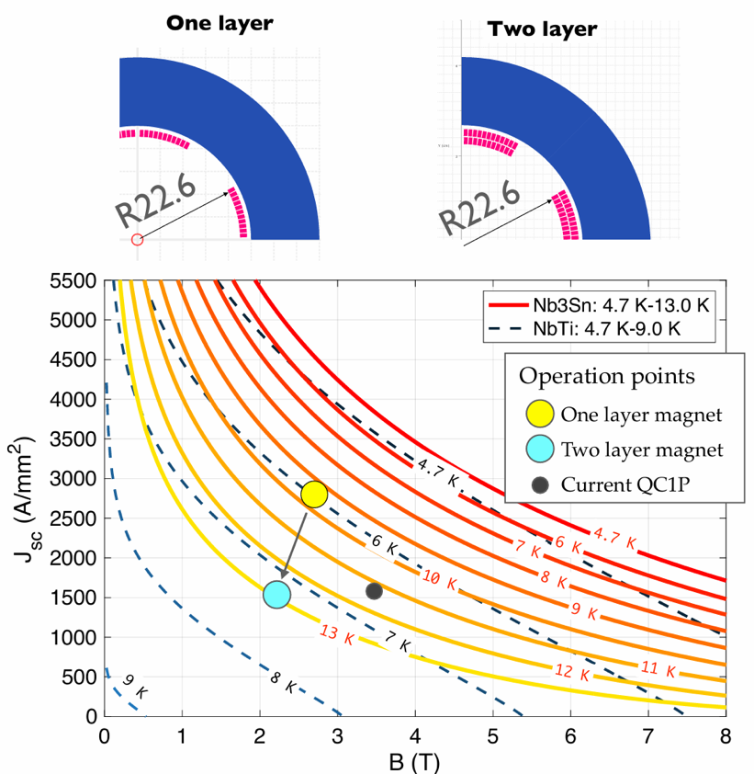
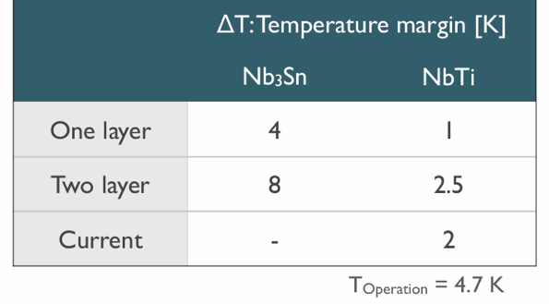
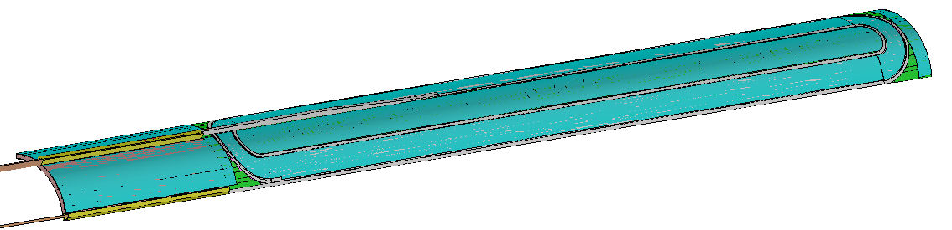
Coil design: Single-layer or Two-layer
Single-layer coil
Pros
• Simple coil winding
• A thinner coil
Cons
• Higher operating current and smaller temperature
margin than that of two-layer coils
• Position control of ramp lead
• Difficult mechanical support for ramp lead
Two-layer coil
Pros
• Lower operating current and larger temperature margin
• Easy lead support
• Layer jump can be placed at the coil end.
Cons
• More complex coil winding, which can cause misalignment of turns
• A risk of wire insulation damage during coil winding
Single-layer
Two-layer
Ramp lead of a single-layer coil
Both options have pros and cons.
We will decide which coil design to choose after the mirror magnet tests.

Slide 13
Flow of the Nb₃Sn QC1P development
Establishment of coil fabrication technology
Individual performance test of coils using a mirror magnet
Selection of either single-layer coil or two-layer coil
Fabrication of R&D quadrupole magnet, Performance verification test
Review of Nb₃Sn QC1P at the end of FY2027
(If the technical maturity of the Nb₃Sn magnet is deemed insufficient,
we will switch to the Nb-Ti option.)

Slide 14
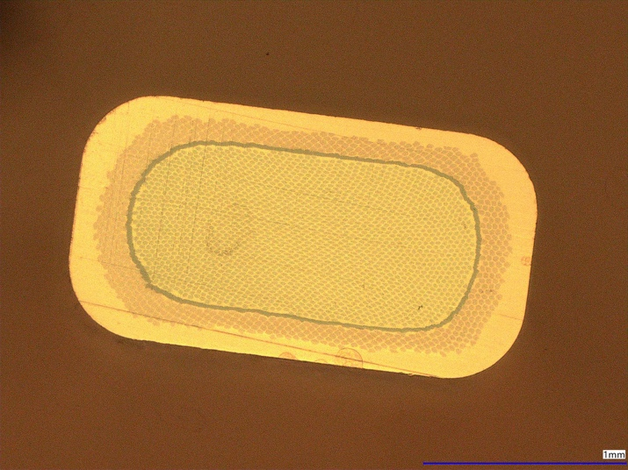
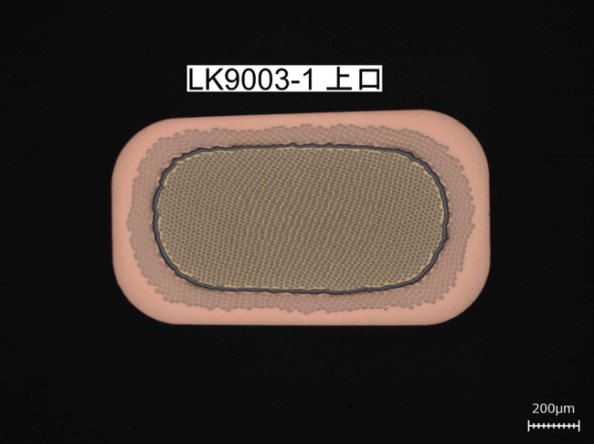
CuNb-reinforced Nb₃Sn wire
Reduction in the time decay of the magnetic field → Fine filaments
Large pre-stress during assembly → CuNb-reinforced wire
Size： 0.80±0.02 mm x 1.50±0.02 mm
Areal ratio： non-Cu 50±5%, CuNb 23±5%, Cu 27±5%
Filament diameter： 2.3 μm（nominal）
Reinforcer： CuNb（Cu-20vol%Nb）
Barrier： Ta
Insulation：S-2 glass braid
Size of insulated wire：1.00±0.035 mm x 1.70±0.035 mm
I_{c} at 12 T, 4.2 K: >500 A
RRR： >100
CuNb
Cu
Ta
Nb + Bronze
200 μm
Rectangular wire for R&D
• Furukawa Electric fabricated Nb₃Sn wire with a keystone angle
of 2.29º as a trial.
• Quench occurred during I_{c} measurements for short straight samples.
A further study will be conducted at KEK.
Wire with a keystone angle

Slide 15
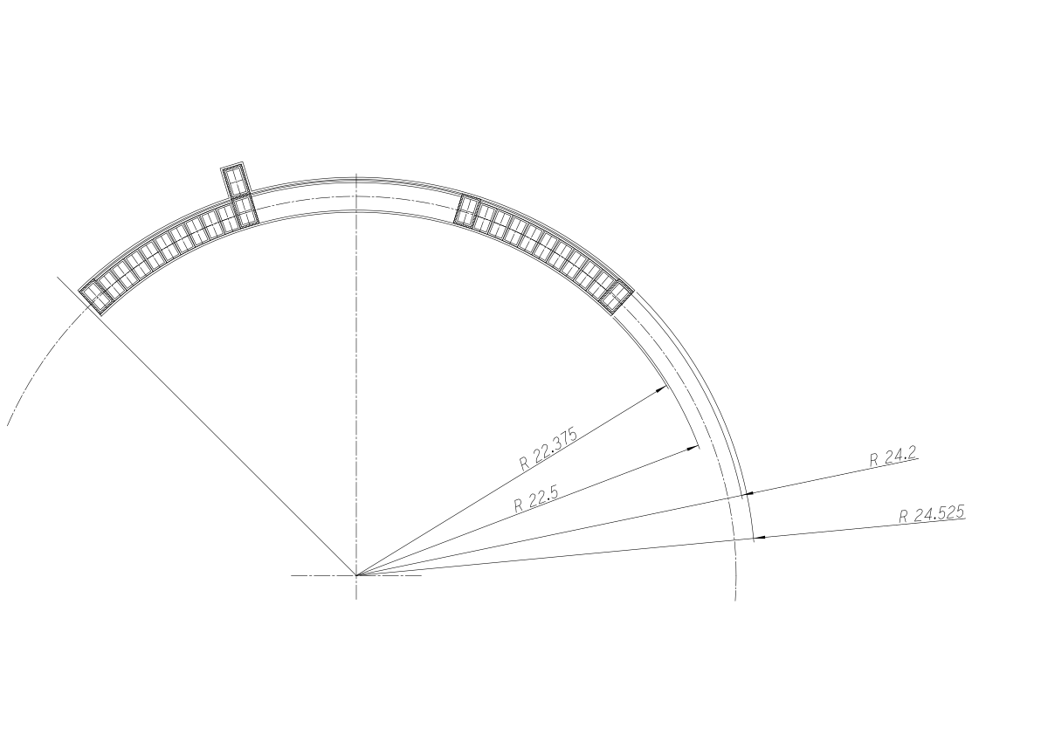
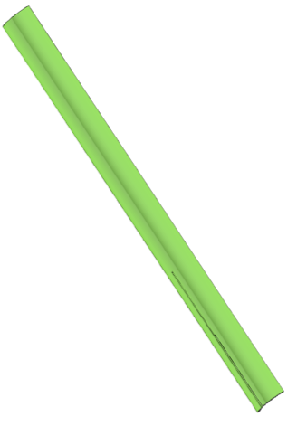
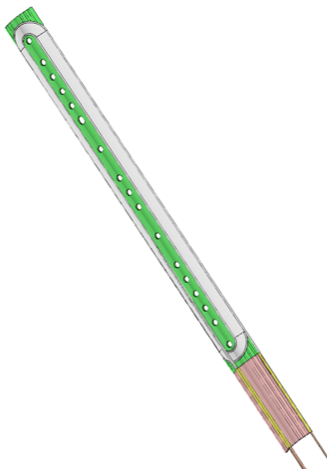
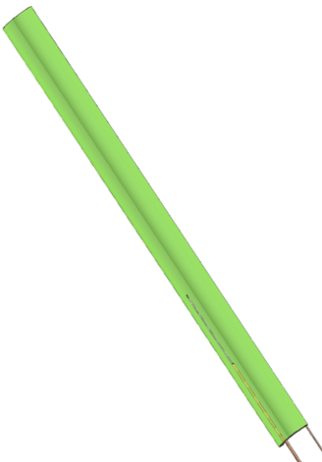
Structure of single-layer coil
Ti-alloy pole
S2-glass sheet: t0.125 mm
Double S2-glass sleeves: t0.1 mm x 2
S2-glass sleeve: t0.1 mm
S2-glass sheet
for thickness compensation:
t0.125 mm
G10 cover
S2-glass sheet: t0.125 mm
Nb₃Sn wire
• Coil inner radius: 22.375 mm, coil outer radius: 24.525 mm
• Coil mechanical length: 441 mm
• Number of turns: 11
• Insulation
– Double S2-glass sleeves for the pole and mid-plane turn
– S2-glass sheet for thickness compensation
– S2-glass sheet to cover the inner and outer surfaces
• A G10 cover is impregnated with a coil for mechanical support
of the ramp lead.
Splice
441 mm

Slide 16
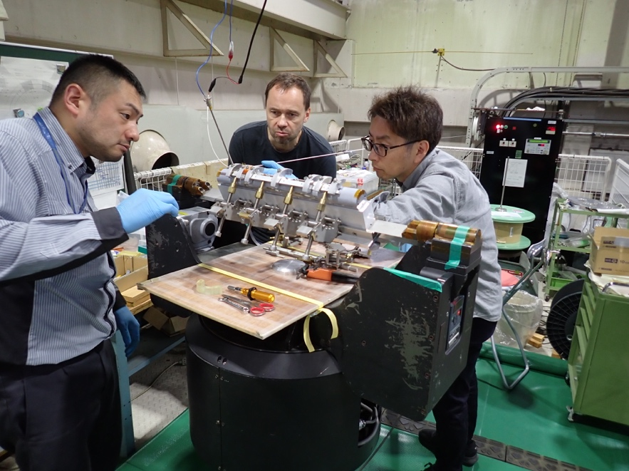
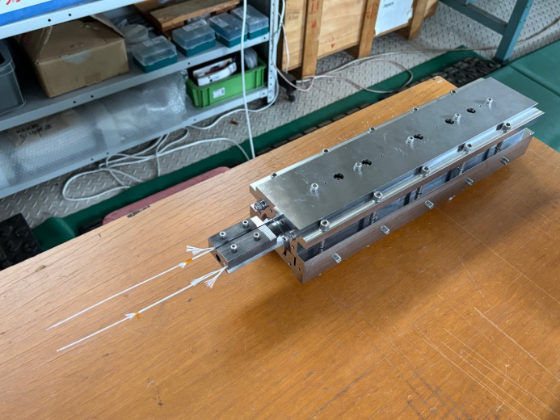
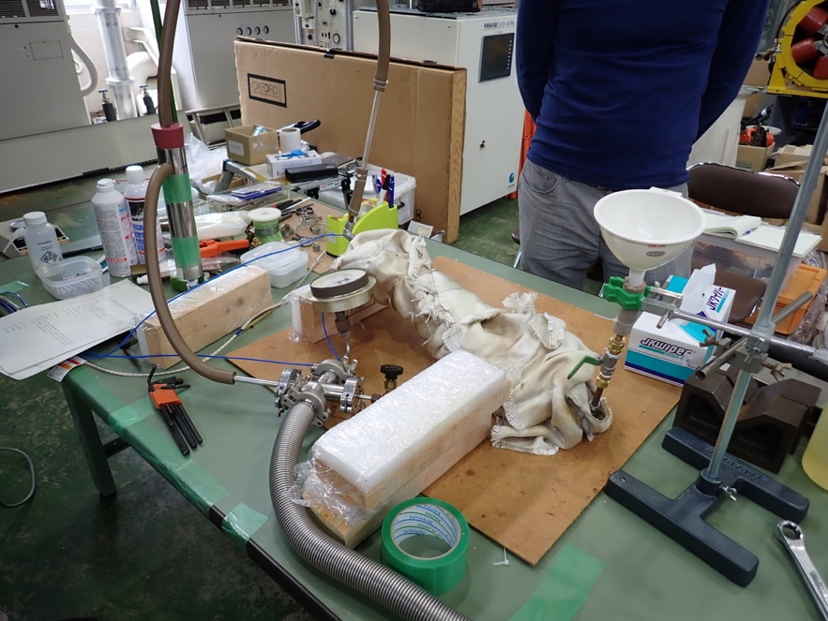
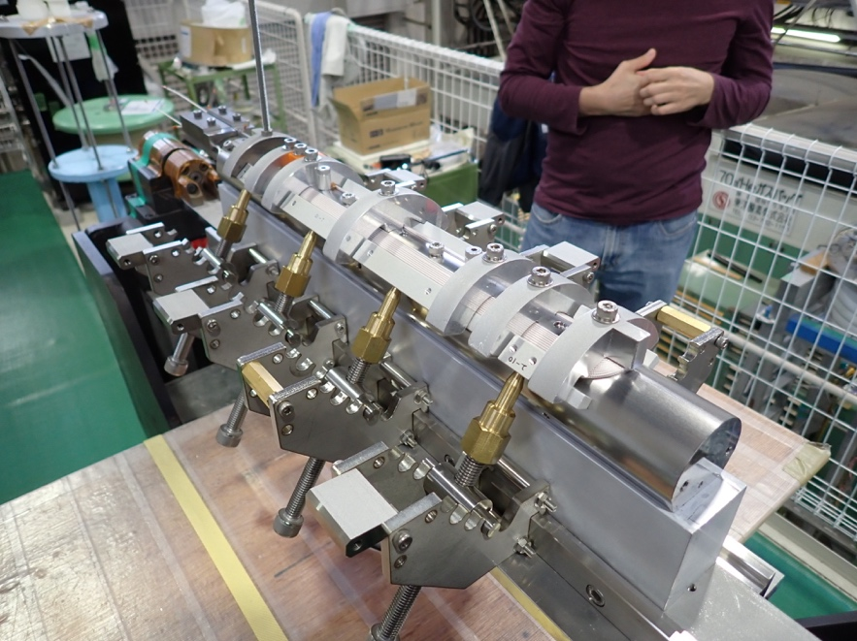
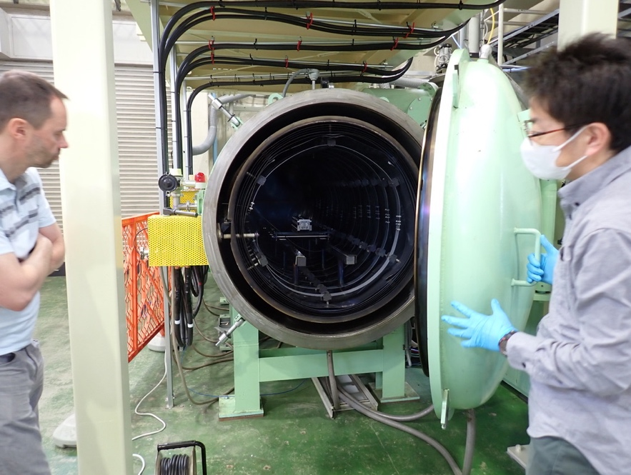
Fabrication of single layer Nb₃Sn coils
Coil winding
Heat treatment
Epoxy impregnation
• A coil is not cured before reaction.
• Multi-step heat treatment over 2 weeks
(Max. temperature = 650ºC)
• Impregnation with CTD-101K (Epoxy
resin)

Slide 17
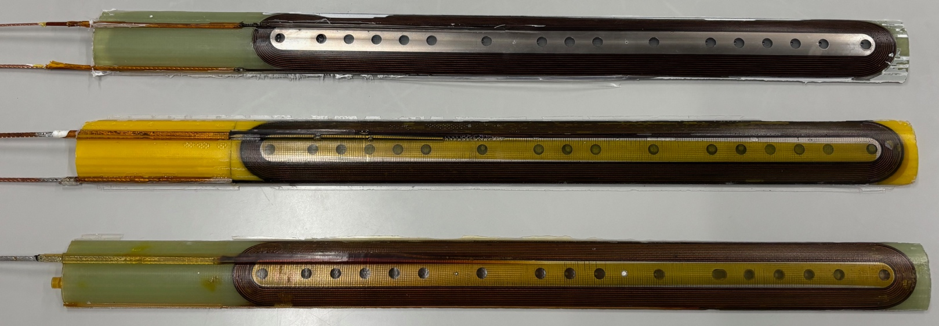
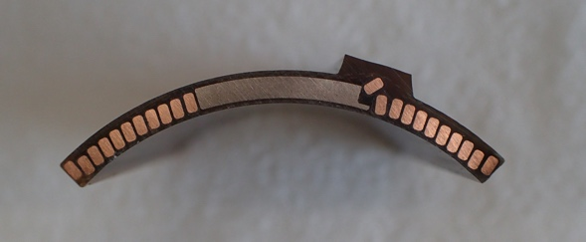
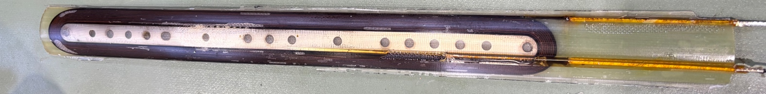
Practice coils
(Single-layer
coils)
Ti-alloy pole
PC1
Nb₃Sn wire
PC2
Cross-section
of PC3
PC3
The coil fabrication
process has not been
fully established.
PC4
ID | Purpose | Insulation between pole turn and Ti-alloy pole | Heat treatment | Epoxy | Electrical test result (Hi-pot test btw pole and conductor)
PC1 | Check winding, heat treatment, and epoxy impregnation tooling | Single S2 glass sleeve | Shortened pattern | EPO-TEK 301 | Electrically shorted in a Hi-pot test → NG
PC2 | Slightly modified tooling to accommodate additional glass sleeve, check the electrical insulation | Double S2 glass sleeves | Shortened pattern | EPO-TEK 301 | Leak current of 15.7 μA at 1 → NG
PC3 | The same tooling as PC2, check the electrical insulation, first coil impregnated with CTD101-K | Double S2 glass sleeves | Shortened pattern | CTD101-K | No leak current at 2 kV → OK
PC4 | Minor modification from the tooling for PC3, full reaction for coil size measurement, electrical test | Double S2 glass sleeves | Full reaction | CTD101-K | Leak current of 206 μA at 0.09 kV → NG

Slide 18
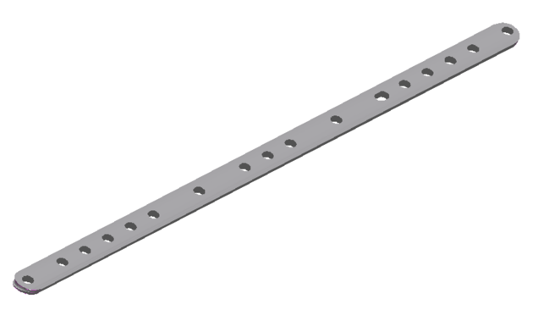
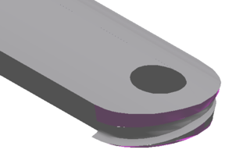
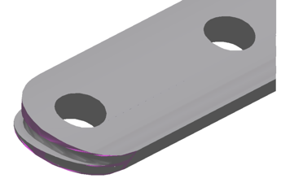
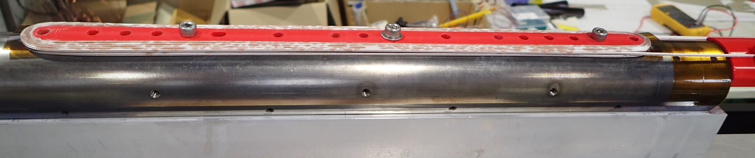
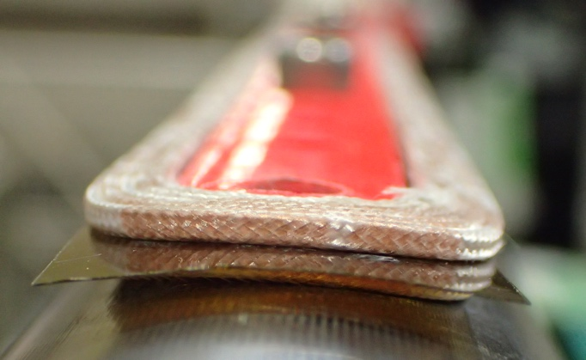
R&D of two-layer coil
Location of the layer jump
Groove for layer jump
• Practice winding of a two-layer coil with 3D-printed parts has started.
• Each layer was temporarily secured by instant glue to simulate the curing process.
• The layer jump lead could be wound along the groove located at the coil end.
• Design of coil fabrication tooling for two-layer coils will start soon.

Slide 19
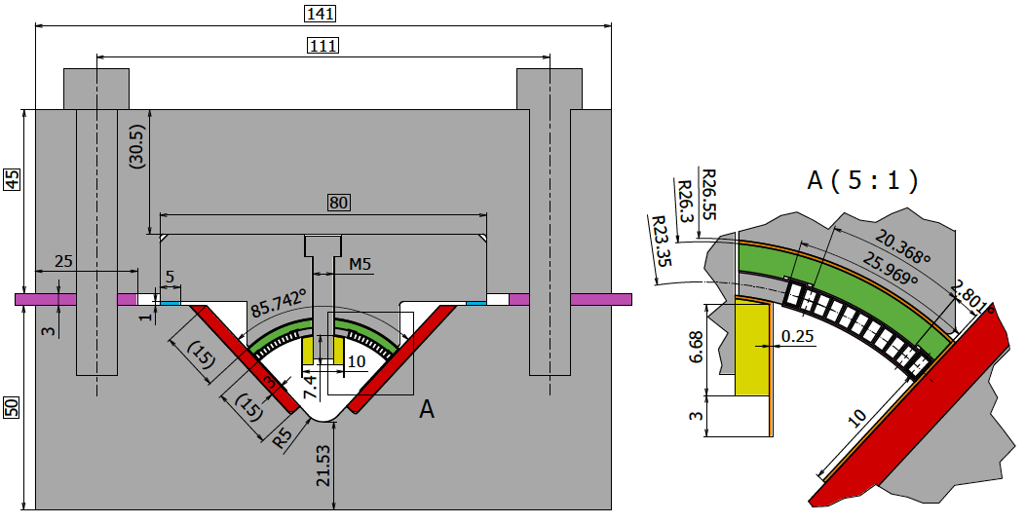
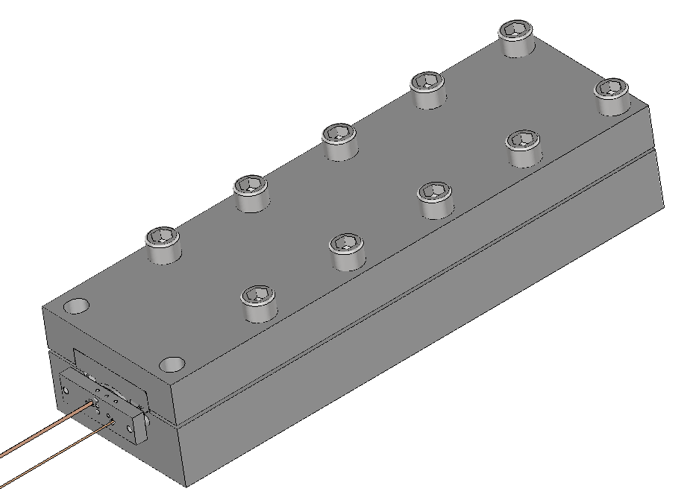
Mechanical structure of mirror magnet
Coil fixing bolt (SUS304)
Load-bearing bolt
(SUS316L)
Top block
Temporary shim
during coil insertion
(SUS304)
Pushing
block
Bottom block
3D model with end structure
Final shim
(Iron)
Mid-plane block (Iron)
Nb₃Sn coil
Fixing part (SUS304)
2D cross-section
• A “Mirror magnet” can reproduce the magnetic field distribution and Lorentz force within a quadrupole magnet.
→ Relatively easy performance test for a Nb₃Sn coil
• Monitoring coil stress during assembly, cooldown, and excitation by strain gauges
→ Verify the validity of the mechanical design for brittle Nb₃Sn coils
• Training performance will be checked by excitation tests at 4.2 K.

Slide 20
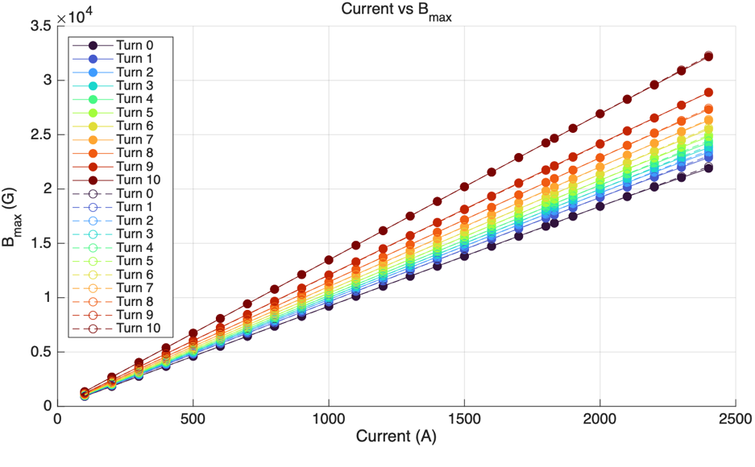
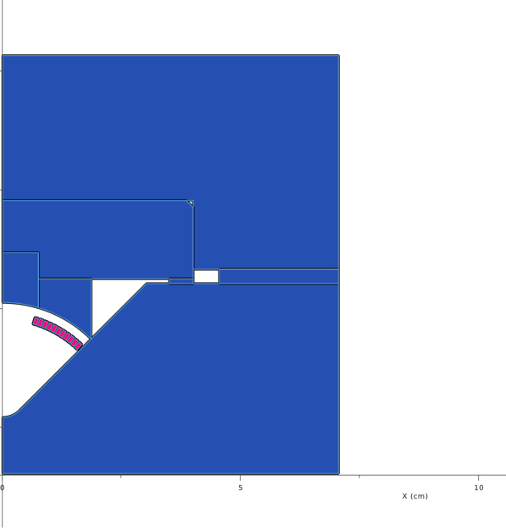
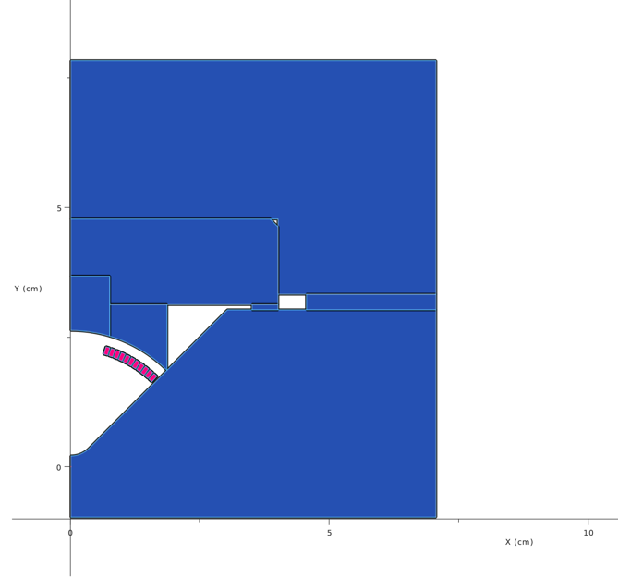
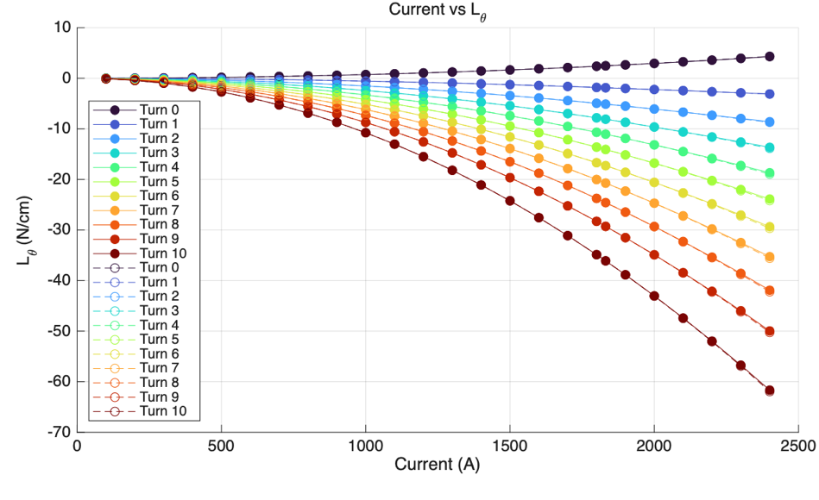
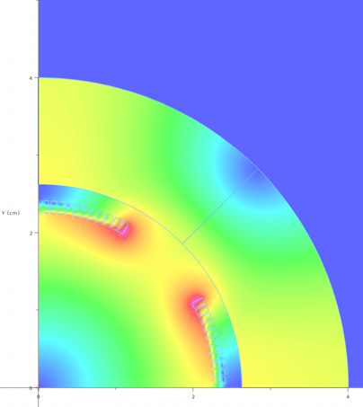
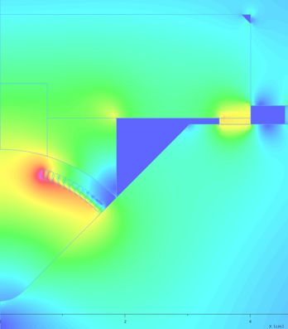
Magnetic design of mirror magnet
Operating current
Y. Arimoto
Quadrupole
magnet
Pole turn
B_{max} (G)
Mirror
magnet
MP turn
MP turn
Current (A)
Operating current
Operating current
2.5 T
Quadrupole
magnet
L_{θ} (N/cm)
Pole turn
Mirror
magnet
Current (A)
• Difference in magnetic field within a coil between a quadrupole magnet
and a mirror magnet < 0.25%
• Difference in Lorentz force exerted on a coil between a quadrupole magnet and a mirror magnet ~3%
Quadrupole magnet
0 T
A mirror magnet reproduces a similar magnetic field distribution
and the stress of a quadrupole magnet.
Mirror magnet
ANSYS simulation for more detailed structural analysis is ongoing.

Slide 21
Corrector magnets and compensation solenoid

Slide 22
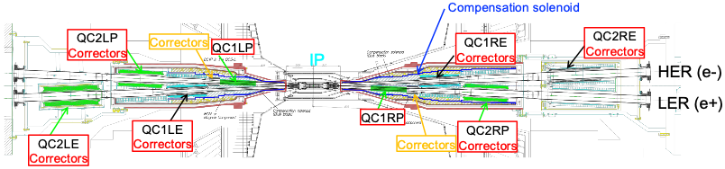
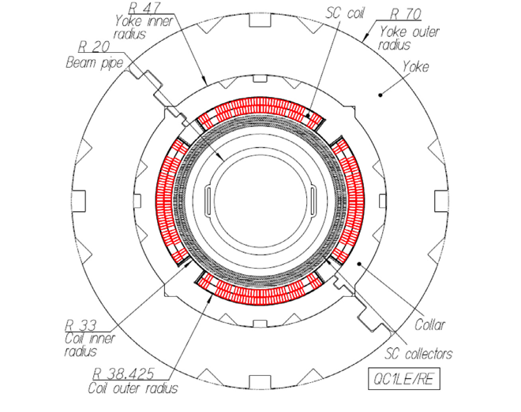
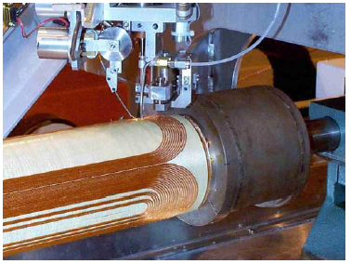
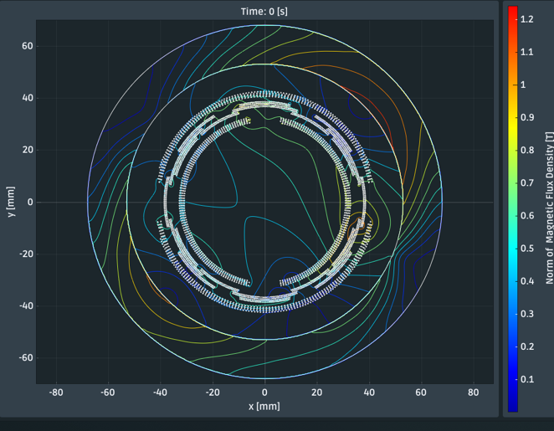
Corrector magnets
Required corrector magnets
• Corrector coils for main quadrupoles other than QC1P
– Almost the same design as those for the current QCS
• Corrector magnet for new QC1P
– Limited longitudinal space → Higher magnetic field to keep the same field integral
• Required multipole orders of the correctors and field integral for each coil are being discussed with the optics team.
Strategy for design and fabrication
• Correctors for the current QCS were designed and fabricated by BNL based on the direct winding technology.
• In the QCS upgrade, BNL is responsible only for the design of the correctors, while a Japanese company will
manufacture the magnets.
• KEK plans to place an order for a trial fabrication of corrector coils with the candidate company in FY2027.
Corrector coils (a₁, b₁, a₂, b₄)
Main
quadrupole
coils
Cross-section of current QC1E
Direct winding technology developed by BNL
Design study for corrector magnet for new QC1P

Slide 23
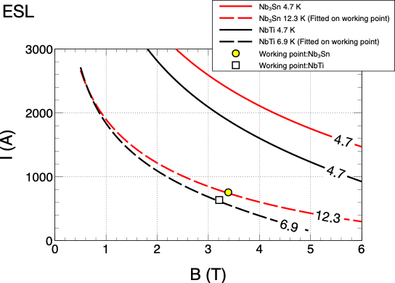
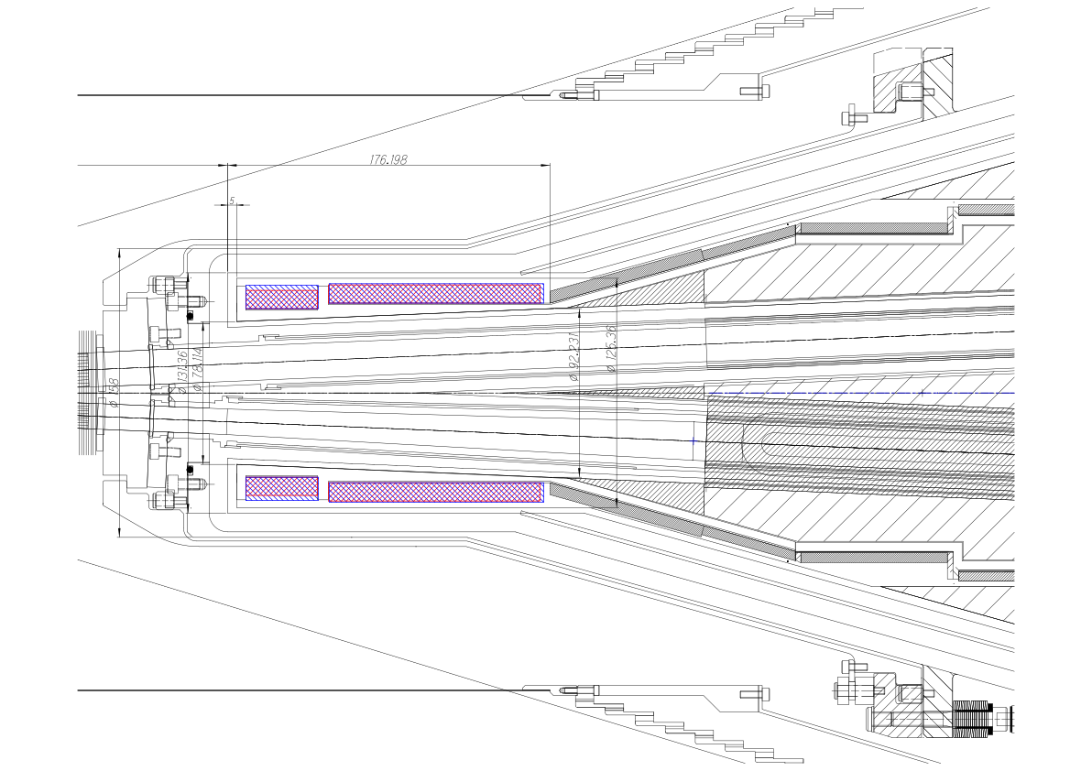
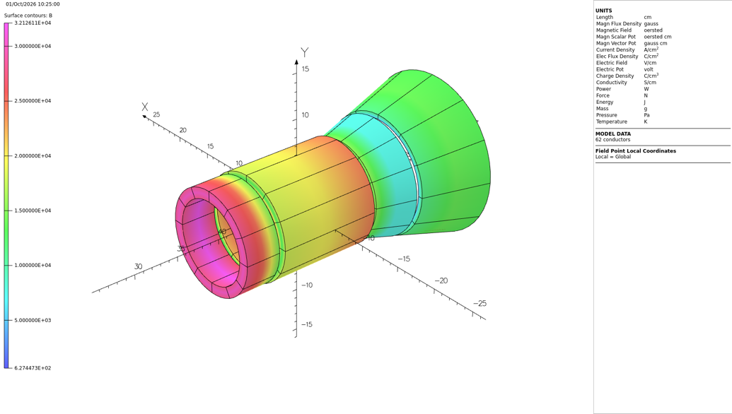
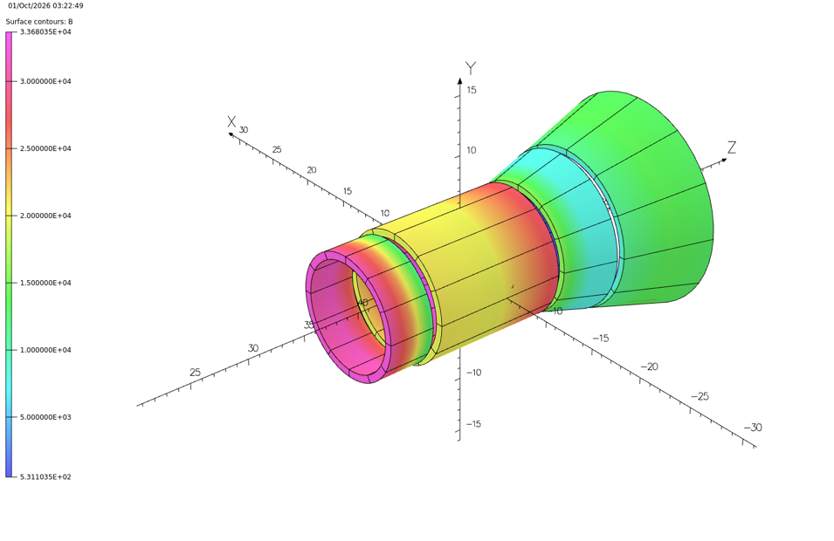
Compensation solenoid
• The front end of the extended compensation solenoid will be made of Nb₃Sn
for a smaller coil size and mitigation of beam-induced quench.
• Nb₃Sn “solenoid coils” are widely used in commercial products.
• Assuming the same Nb₃Sn wire as QC1P
• A design study has started for ESL for QCS-L.
• Thinner coil with a comparable current margin and
a larger temperature margin in the Nb₃Sn option than in the Nb-Ti one
• For the rest of the compensation solenoid, Nb-Ti coils will be adopted,
which is the same as the current QCS.
Nb₃Sn
4.7 K
Nb-Ti
4.7 K
T_{margin}
6.9 K
12.3 K
NbTi: current margin 35%
Nb3Sn: current margin 40%
Critical current – magnetic field curves
B_{peak}=3.21 T at J=304 A/mm²
B_{peak}=3.39 T at J=631 A/mm²
T_{margin}=2.1 K
T_{margin}=7.6 K
Front end of the extended
compensation solenoid
Front end of the extended
compensation solenoid
Nb-Ti coil
LHe vessel
23.6 mm
16.6 mm
Magnetic design of the extended ESL
Nb₃Sn coil

Slide 24
Summary
• QCS upgrade is planned during LS2. The main changes include the extension of the compensation
solenoid, moving QC1P with Nb₃Sn coils forward to the IP, and a new corrector magnet for QC1P.
• R&D on Nb₃Sn QC1P is currently underway at KEK. If the technical maturity of the Nb₃Sn magnet is
deemed insufficient at the end of FY2027, we will switch to the Nb-Ti option.
• BNL is responsible for the design of corrector magnets, while a Japanese company will manufacture the
magnets.
• The Nb₃Sn option will be adopted for the front end of the extended compensation solenoid, considering
a thinner coil size and larger temperature margin.

Slide 26
Appendix

Slide 27
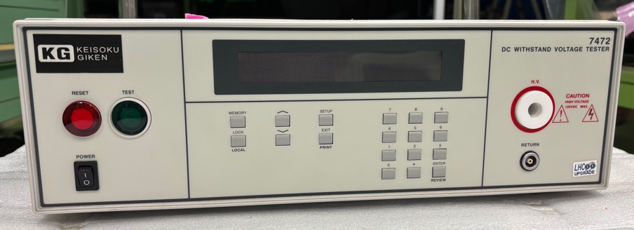
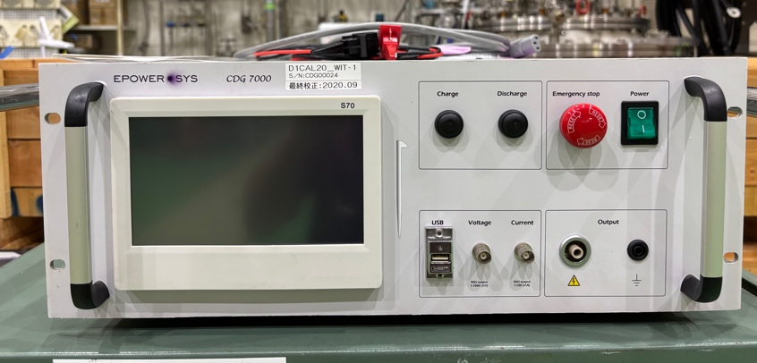
Plan for electrical test
• Coil resistance
before splice
after splice
• Coil inductance
• Hi-pot test
Voltage is applied between Ti-pole and wire.
Max voltage estimated from quench simulation: 184 V (Kento Suzuki, “QC1P_250521.pptx”)
Criteria adopted for HL-LHC magnets
– Max voltage: (184 x 2 + 500) x 2 =1736 V → 1.8 kV
– Leak current < 10 μA
– Duration time = 30 sec
• Impulse test
184 / 4 = 46 V/coil
Max voltage: (46 x 2 +500 ) x 2 = 1184 V → 1.2 kV
We need to check if the max current during the test is acceptable.

Slide 28
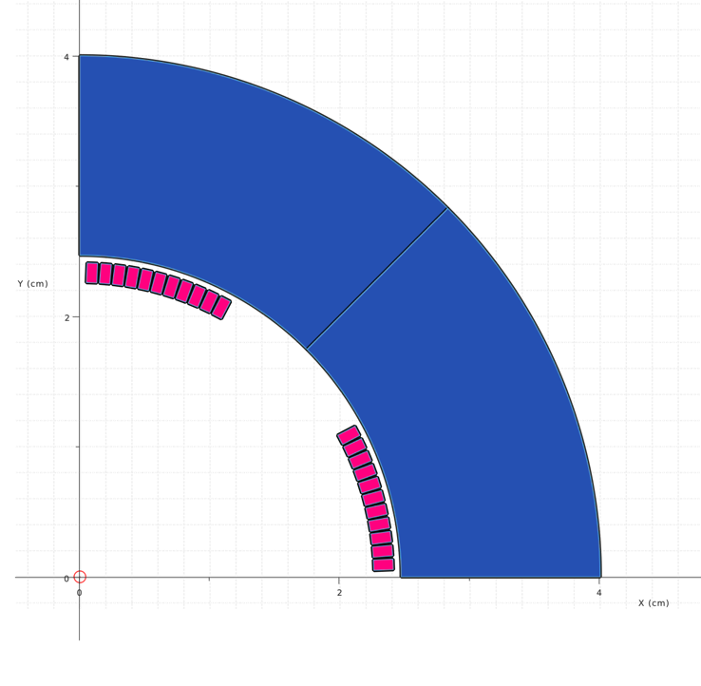
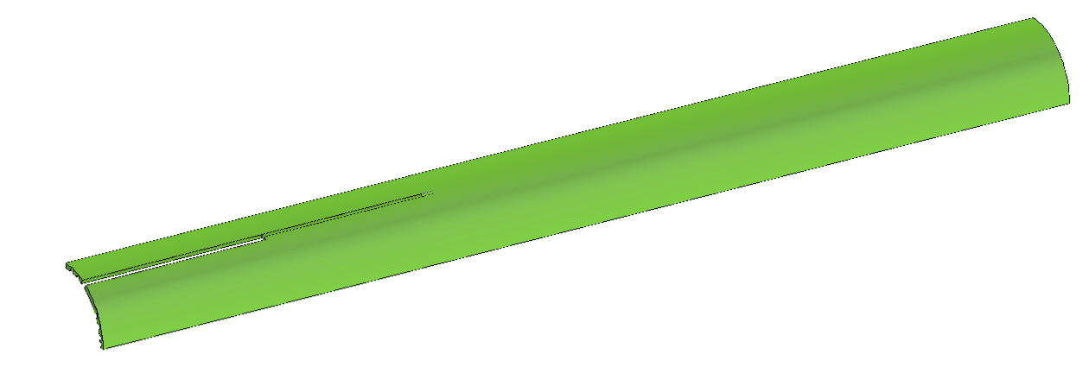
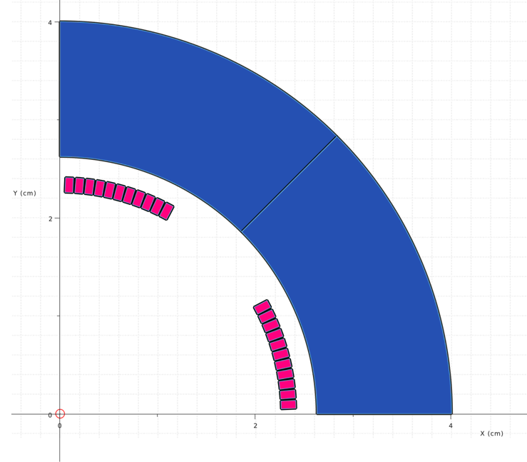



Magnetic design of single-layer coil (2D, 3D)
G10 cover
R40 mm
R40 mm
Single-layer coil
R23.35 mm
R23.35 mm
R26.25 mm
R24.7 mm
2.5461°
2.5461°
25.4606°
25.4606°
2.2694°
15.3 mm
• Epoxy impregnation with a G10 cover
• Enlargement of yoke inner diameter
to 26.25 mm
2.2694°
13.75 mm
SingleLayer_v1
SingleLayer_v2
* Current at G=80 T/m at the longitudinal center
of the straight section
 | SingleLayer_v1 |  | SingleLayer_v2
 | 2D | 3D | 2D | 3D
Yoke ID (mm) | 24.7 |  | 26.25
Yoke OD (mm) | 40 |  | 40
B_{max} (T) | 2.47 | 2.84 | 2.47 | 2.77
I at G=80 T/m (A) | 1656 | 1658* | 1831 | 1832*
J (non-Cu) (A/mm²) | 2760 | 2763 | 3052 | 3054
Load line ratio | 0.72 | 0.76 | 0.76 | 0.80
Rin=26.25 mm
Rin=24.7 mm
2D

Slide 29


Two-layer magnet
Two layer magnet is designed with 2D analysis.
Number of turns
  – 11 turn (inner coil)
  – 12 turn (outer coil)
Inner radius
  – 22.6 mm (inner coil) (same as single-layer magnet)
  – 24.4 mm (outer coil)
R41.8 mm
R26.8 mm
22.6 mm
24.4 mm
Jnc is half the value of the single-layer option.
Bpeak = 2.3 T
R_{ref} = 10 mm
 | I (A) | A (mm²) | J nc (A/mm²) | B₂ (T) | b₆ (units) | b₁₀ (units)
Single-layer | 1700 | 1.2 | 2833 | 0.8042 | 0 | -2.2
Two layer (12 turn) | 920 | 1.2 | 1533 | 0.8017 | -0.1 | -1.7
Two layer (11 turn) | 960 | 1.2 | 1600 | 0.8040 | 0 | -1.9

Slide 30

Critical surface and operation points
• The operating point of the two-layer magnet
moves to the lower J region.
• The temperature margin increases by twice
for Nb₃Sn.
Operation points
One layer magnet
Two layer magnet
Current QC1P
4.7 K
6 K
7 K
6 K
4.7 K
 | Temperature margin (K)
 | Nb₃Sn | NbTi
Single-layer | 4 | 1
Two-layer | 8 | 2.5
Current QC1P | - | 2
10 K
8 K
9 K
13 K
7 K
8 K
12 K
11 K
9 K

Slide 31



Location of electrical short in PC4
Ramp lead side
V1
I
Ramp lead
1
2
Nb₃Sn conductor
X
Nb-Ti Rutherford cable
Splice
Electrical
short
Ti pole
MP lead
Zero-crossing
I
Splice
V2
If an electrical short is located between Points 1 and 2,
a sign of V1 and V2 is reversed.
Approximate location of electrical short
4
5
6
7
8
3
2
1
Resin and glass insulation were removed at Points 1-8 to measure the voltage
between the pole piece and the conductor.
• The location of an electrical short was identified between 5 and 6 by a voltage measurement.

Slide 32






Corrector magnets in the current QCS
 | Multipole orders
QC1P | a₁, b₁, a₂, b₄
QC1RP | a₁, b₁, a₂, b₄, b₃*
QC1LE | a₁, b₁, a₂, b₄
QC1RE | a₁, b₁, a₂, a₃
QC2LP | a₁, b₁, a₂, b₄
QC2RP | a₁, b₁, a₂, a₃
QC2LE | a₁, b₁, a₂, b₄
QC2RE | a₁, b₁, a₂, a₃
QC1-2RE | b₃
QC1-2RP | b₃

Slide 33






Possible reason for mispositioning of ramp lead
Before epoxy impregnation, a coil is completely released from the heat treatment jig, and then the coil is turned
upside down to put a glass sheet on the coil inner surface. Since the coil is not cured, the ramp lead would be
easily twisted. → Curing would be necessary even for a single-layer coil.

