Slide 1
Injector
F. Miyahara for KEK e-/e+ Injector Linac
Status Report from 2025a to Present and Overview of Upgrades

Slide 2
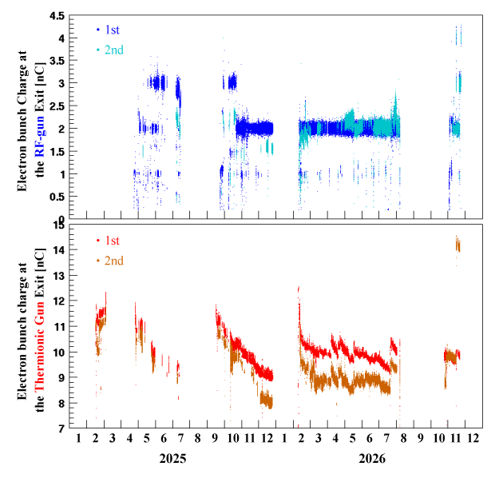
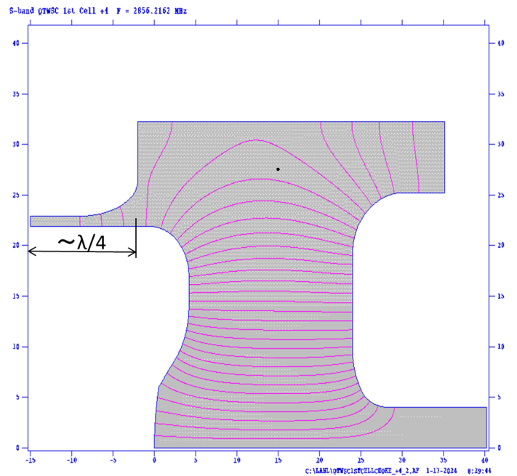
Gun Status
Gun#3
Electron Beam
Gun#1:Frequent electrical discharges → Improved structure of the 1st cell
Gun#1
Gun#2
RF-Gun#1
RF-Gun#2, 3
M. Yoshida
Two bunch operation was successfully achieved
Gun#2: Brazed the cavity cells in the wrong order
→Inner diameter corrected afterward
Operated with a shorter pulse width than designed
Gun#3: Operated at the designed pulse width. The 2nd bunch is also stable
Positron Beam
New Cathode (Thermionic Gun)
The charge from the thermionic electron gun gradually decreases
(The cause remains unknown)
Cathode was replaced in summer 2025, but the new cathode shows the same trend
Even with an increased heater current, the charge only reaches about 11 nC (a characteristic of this cathode)
Increase the charge by extending the pulse width (2nd bunch only).
There is an issue with satellite bunch generation, but tuning and testing are currently underway.
Detail will be presented in Electron gun/Positron source(Zhou-san’s talk).
Stable operation was achieved during the 2026ab run.

Slide 3
Energy Compression System (ECS)
Y. Seimiya
Panel for zero-crossing phase search and accelerating gradient measurement
Current Energy Spread and Required Specifications
 | 1st only | 1st+2nd | 1st+2nd （energy adjusted） | Requirement
e- | 0.033% | 0.076% | 0.074% | 0.07%
Four 3-m S-band accelerating structure
Installation was completed during the 2025 summer shutdown.
Due to electrical discharges in the waveguide (caused by a flange issue), operation has been carried out at reduced RF power.
The energy spread in the HER BT has been successfully suppressed.
RF contactors were installed during the 2026 summer shutdown.
RF conditioning and testing are scheduled to begin at the end of October 2026 → High RF power

Slide 4
Fast Kicker: Operational use began in the 2026ab run
Y. Okayasu, T. Natsui
A failure occurred in April 2026
➔Repairs and countermeasures
have been completed
Radiation shielding is currently being designed for the area where the failure occurred due to high radiation levels.
Orbit correction using the Fast Kicker and Its Effect
Fast Kicker led to stable injection of the second bunch

Slide 5
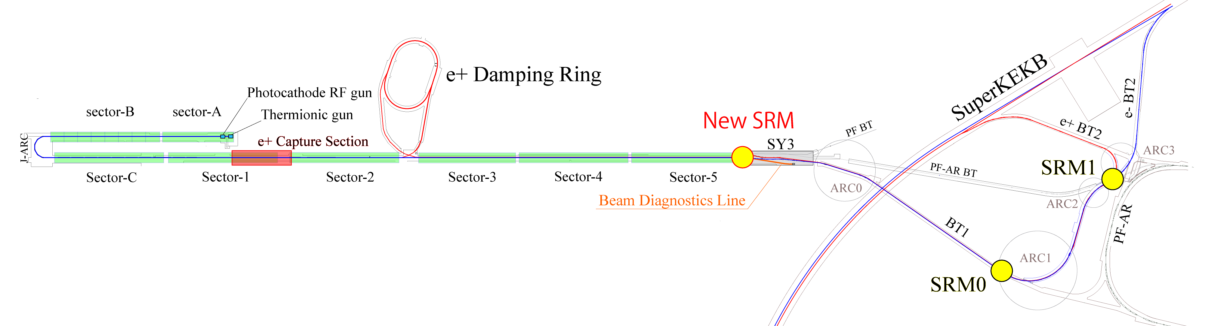
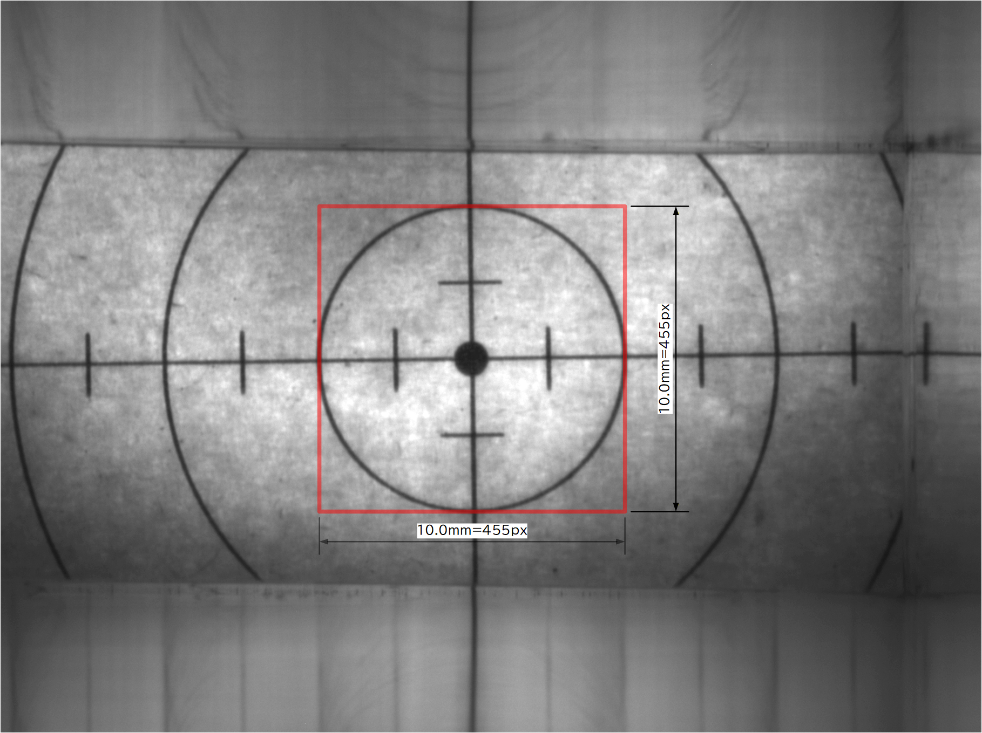
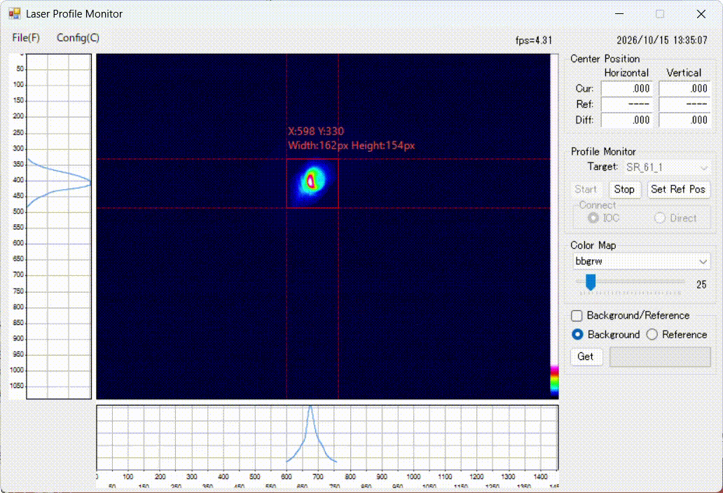
New SR Monitor (SRM_61_1) at SY3 entrance
R. Zhang, Y. Okayasu
Imaging system layout
Synchrotron radiation intensity calculation and optics design
  The SRM was designed for installation at bending magnet BM_61_1 in the linac’s 3rd switchyard (SY3), beginning in August 2025
  Synchrotron radiation power on the first HR mirror: ~0.3171 W; no water cooling required (7.0 GeV KBE electron beam)
  Radiation power density is also much lower than in the DR and Main Ring cases
  Single lens imaging configuration
    $l=3500 mm, f=500 mm, β=0.167$(Limited by the available space)
    Commercial Achromatic lens: 𝐹# = 10 (Based on the simulation results)
  Remote control of the ND filter wheel and horizontal and longitudinal stages for optimal imaging
  Solid radiation shield is designed for protection of CCD and motorized stages
Beam patterns near focus point
  Installeld in summer this year
  Synchrotron radiation from a 7 GeV e- beam was successfully observed
We plan to incorporate this SR monitor in to the emittance tuning system.
Potential applications to the positron beam are also expected.

Slide 6
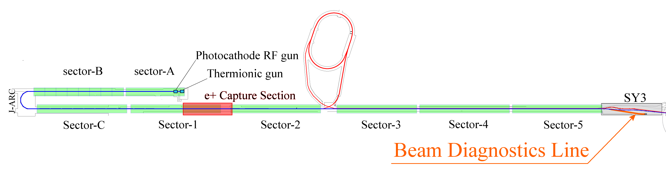
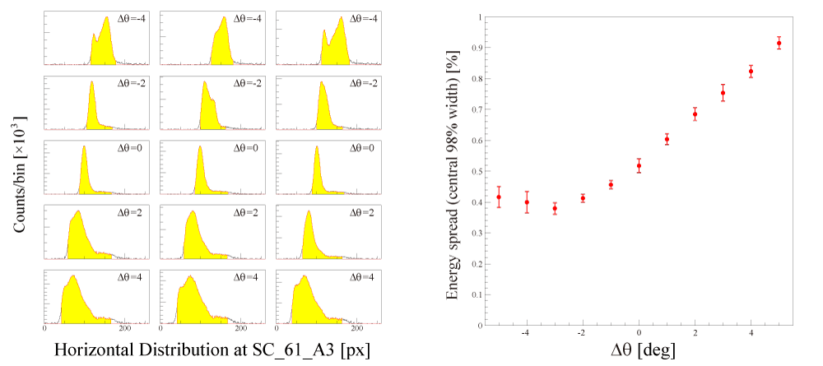
SY3 Beam Diagnostic Line
Energy distribution measurements can be performed by intermittently (1Hz or less) diverting a duplicated KBE (e- for HER) beam mode to the SY3 diagnostic line during normal HER injection operation.
RF phase: Knob to control energy spread
(longitudinal distribution)
Screen: SC_61_A3
The beam energy distribution can be measured using the screen monitor at the end of the diagnostic beamline.
The energy distribution can be controlled by adjusting the RF phases in Sectors 3–5.
During operation, beam diagnostics can be performed using a test beam mode copied from the KBE mode (Rep. rate ≤ 1 Hz)
Issue: Radiation-induced camera failures and degradation
➔ Improved radiation shielding is required
Energy distributions at different upstream RF (sector 3-5) phases, and energy spread as a function of upstream RF phase.

Slide 7
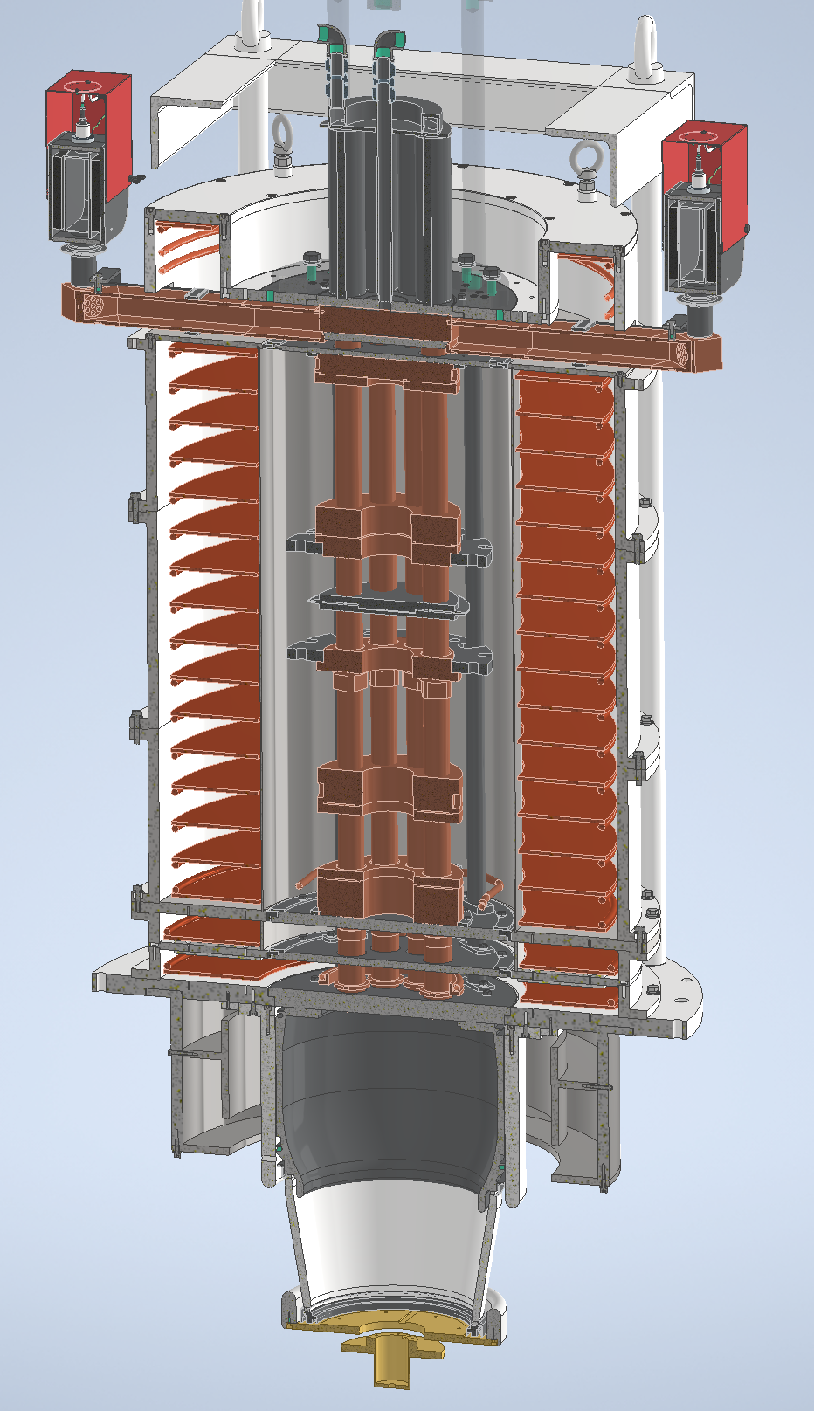
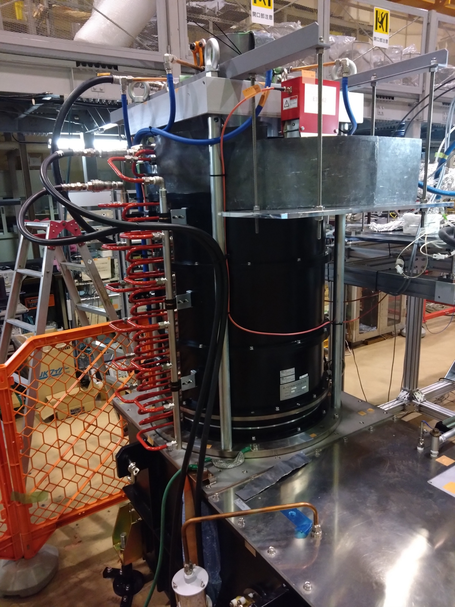
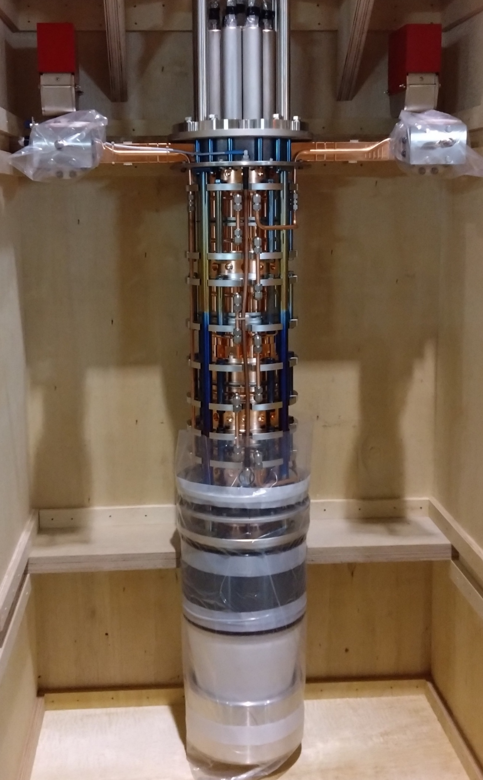
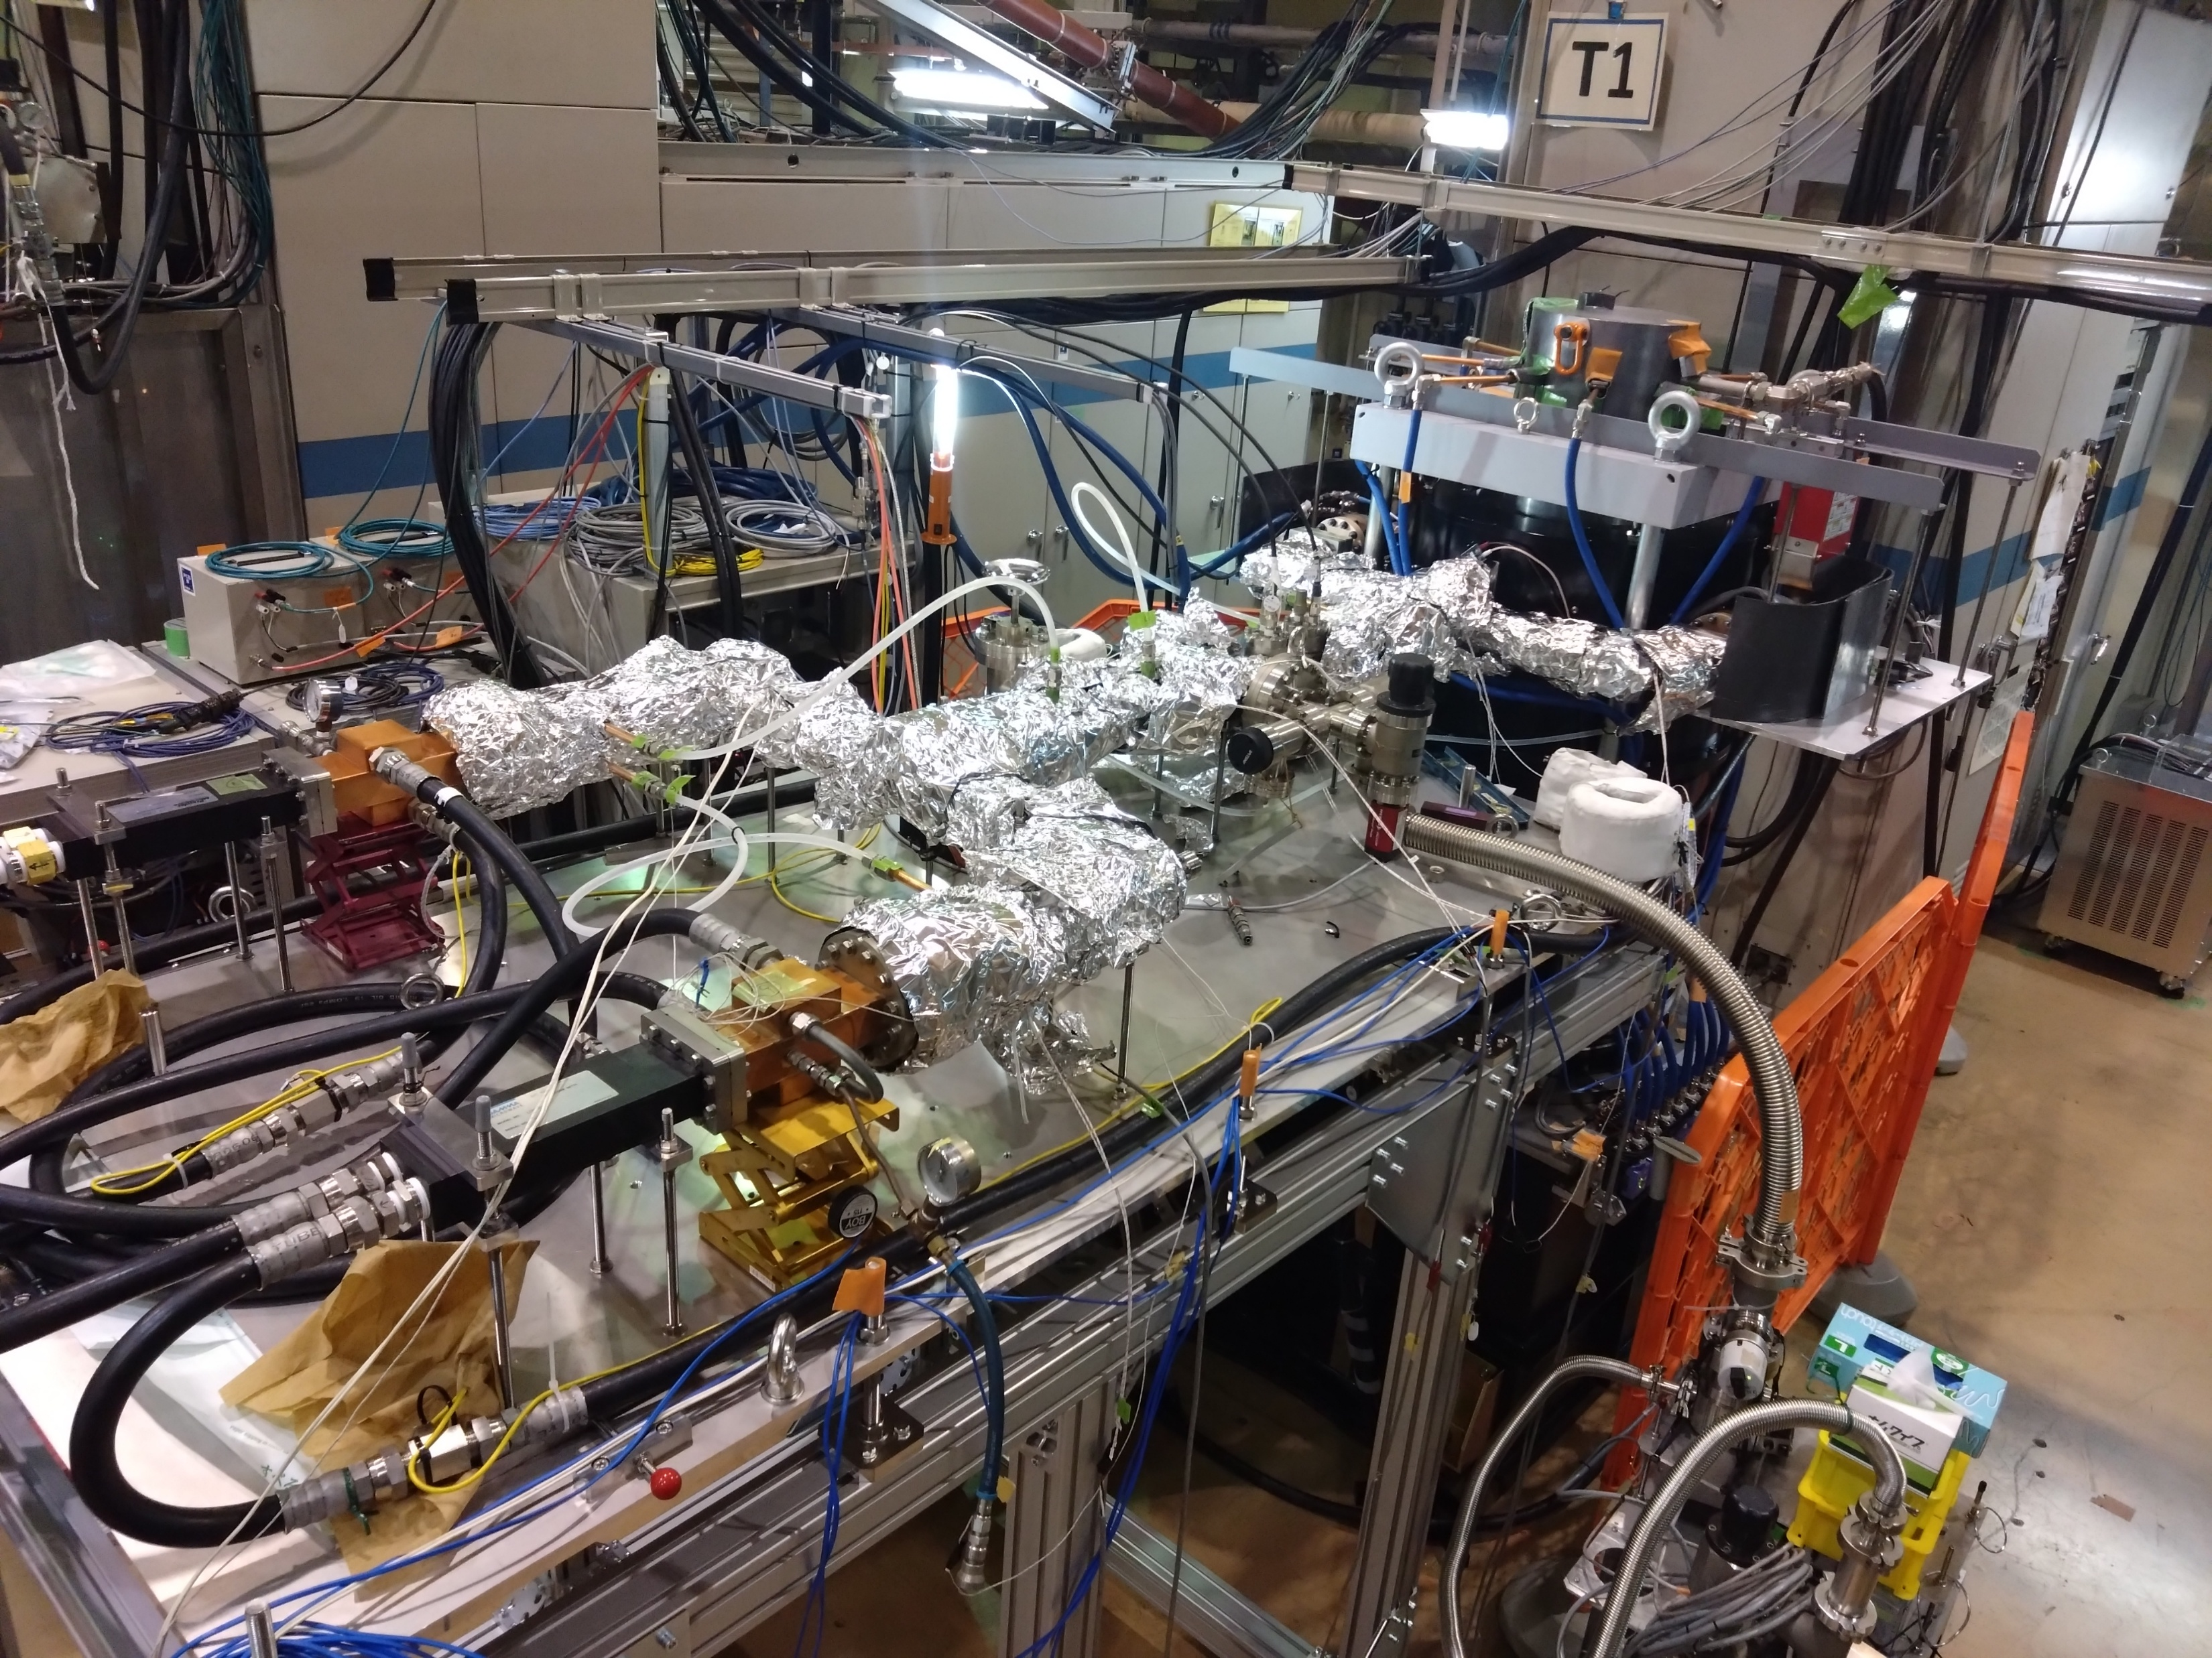
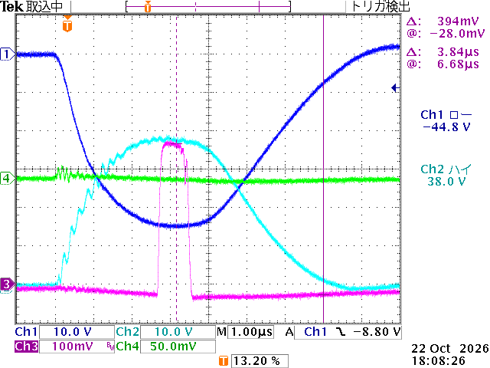
New development: Multi-beam Klystron
T. Natsui
We are developing klystrons to achieve high efficiency and high output power. Although the beam power is at the same level as that of conventional models, the output will be 80 MW due to improved efficiency.
S. Wang
 | E3730A | MBK (KMS80)
Power : MW | 50 | 80
Efficiency : % | 45 | 70
# of Beam | 1 | 8
Perveance(10^-6). | 2.1 | 2.2 (0.27×8)
Cathode V : kV | 312 | 304
Cathode I : A | 362 | 376
Gain Min: dB | 51 | 51
Pulse width (RF): us | 4.0
Rep rate :pps | 50
MBK
Test Stand
RF Power: 71 MW
We have already begun RF conditioning and have confirmed an output of 71 MW.
A higher accelerating voltage can be achieved with lower RF power

Slide 8
Summary
Electron Gun
The RF gun upgrade during the 2026 summer shutdown enabled operation with the input pulse width at its design value.
An improvement in beam quality is expected, particularly for the second bunch compared with the 2026ab run.
HER BT ECS
Although the design RF power could not be applied due to discharges in the waveguide, the energy spread was successfully reduced to nearly the required level.
The installation of an RF contactor in summer 2026 is expected to allow higher RF power.
RF conditioning and beam studies will begin in the 2026c run.
Fast Kicker
The fast kicker contributed to stable injection of the second bunch.
Countermeasures against electrical discharges have been implemented.
Radiation shielding is being designed for areas with high radiation dose rates.
SR Monitor at SY3
Non-destructive monitoring of electron and positron beams at the end of the LINAC has become possible.
The monitor is also expected to be useful for positron beam tuning.
SY3 Beam Diagnostic Line
The diagnostic line allows a portion of the electron beam to be sampled and directed to the diagnostic line for direct measurement of the energy spread.
It was confirmed that the energy spread can be controlled by adjusting the RF phases in sectors 3–5.
The camera frequently stops functioning due to beam losses at the dispersive section near the screen monitor and radiation from the beam dump.
Radiation shielding needs to be designed and implemented.
New development: Multi-Beam Klystron (MBK)
A high-efficiency klystron has been successfully developed as part of the injector upgrade program.
The MBK achieves an efficiency of 70%, compared with 45% for conventional klystrons.
High-power testing is progressing smoothly.
More stable operation and higher accelerating gradients are expected.

Slide 9
Current / Injection
F. Miyahara for Current/Injection Task force

Slide 10
Challenges of the Current/Injection Task Force
We aim to improve injection beam quality and injection efficiency, and increase beam current to achieve higher luminosity.
Collaborative efforts among optics and hardware experts are important to improve performance and resolve outstanding issues.
Members of the Optics, Hardware, and Belle II teams are working together to address these challenges.

Slide 11
Current Status

Slide 12
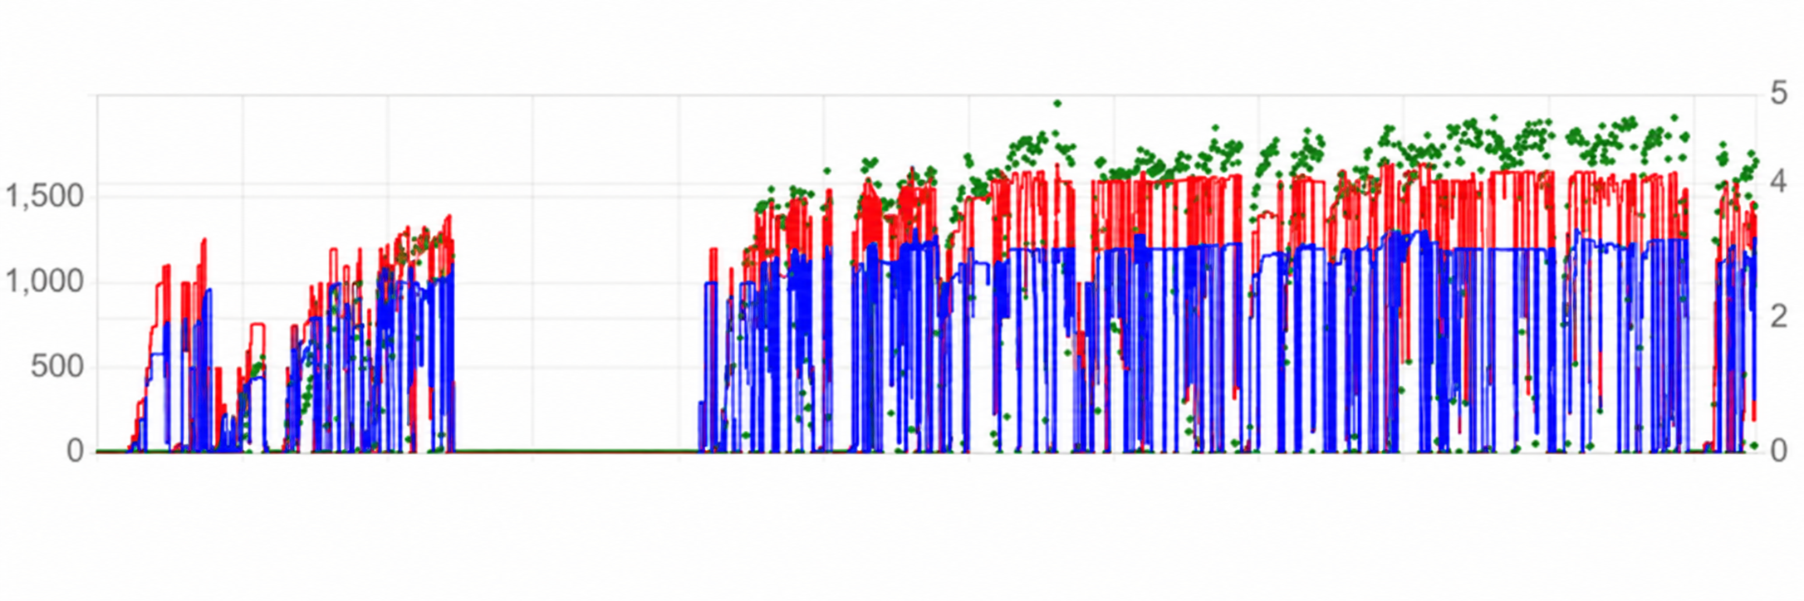
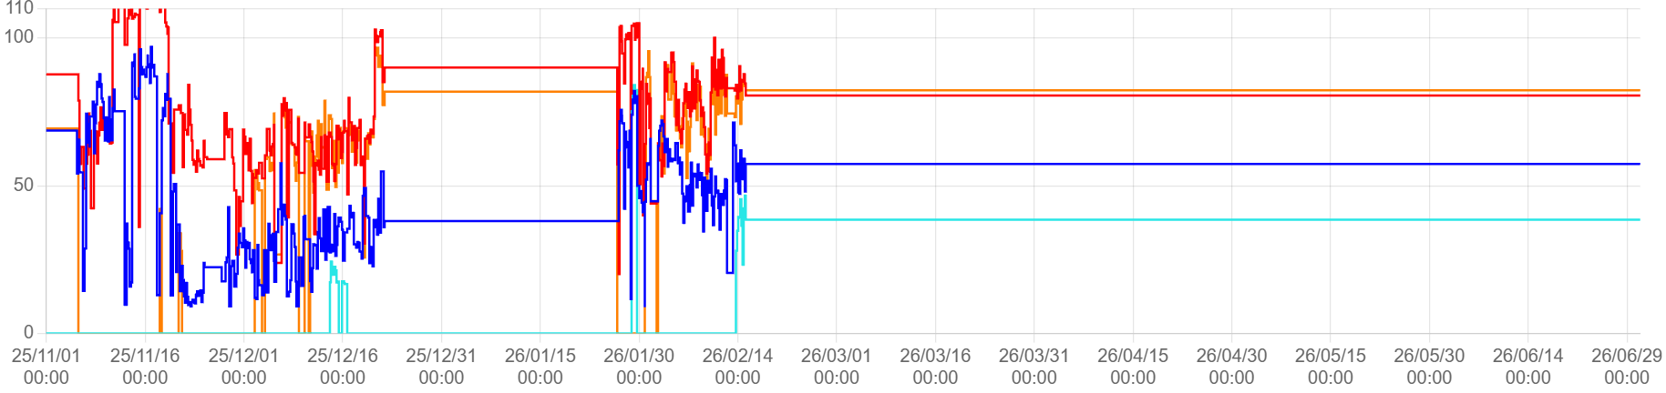
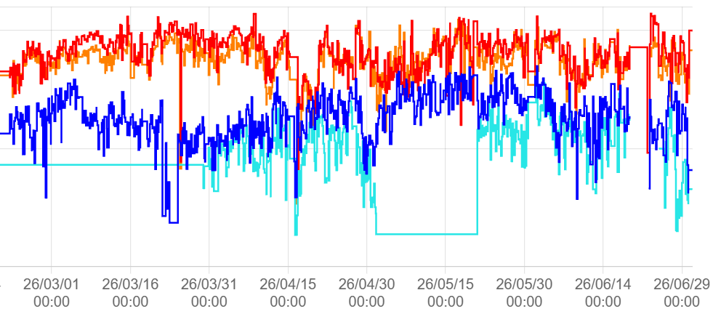
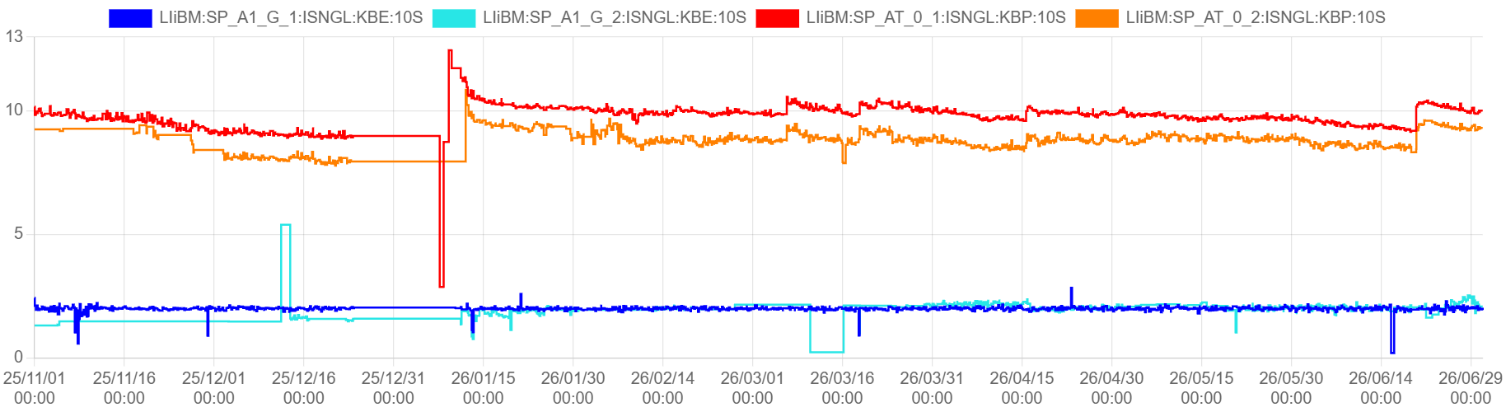
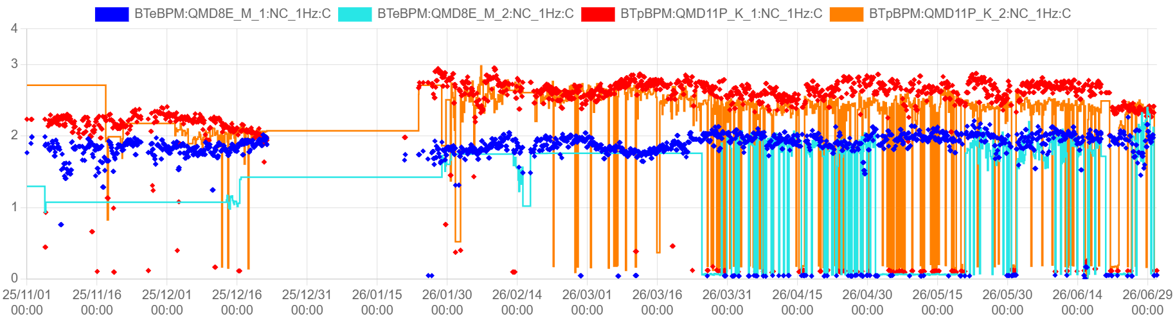
Injection Status
Beam Current
Luminosity
1500
LER
Maximum beam current
LER: 1650 mA, HER: 1300 mA
HER/LER
Current [mA]
Luminosity [x 10³⁴ cm⁻²s⁻¹]
1000
HER
500
0
Injection Beam Emittance
100
e+: 1st
During the 2026ab run, injection efficiency improved and could be maintained at a high level, particularly in the HER.
Daily Injection Turning
Emittance Auto Tuning
Automatic Orbit Feedback
e+: 2nd
Injection Efficiency [%]
50
e-: 1st
0
e-:2nd
10
Bunch Charge
at Gun Exit [nC]
Bunch Current
5
The positron beam charge gradually decreased due to a reduction in electron emission from the cathode of the thermionic gun.
The electron beam charge remained stable at 2 nC/bunch.
Successfully achieved stable injection of the second bunch
0
3
2
Bunch Charge
at BT END [nC]
1
0
Power outage: Many devices lost their calibration

Slide 13
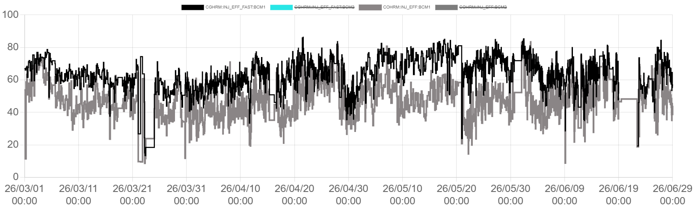
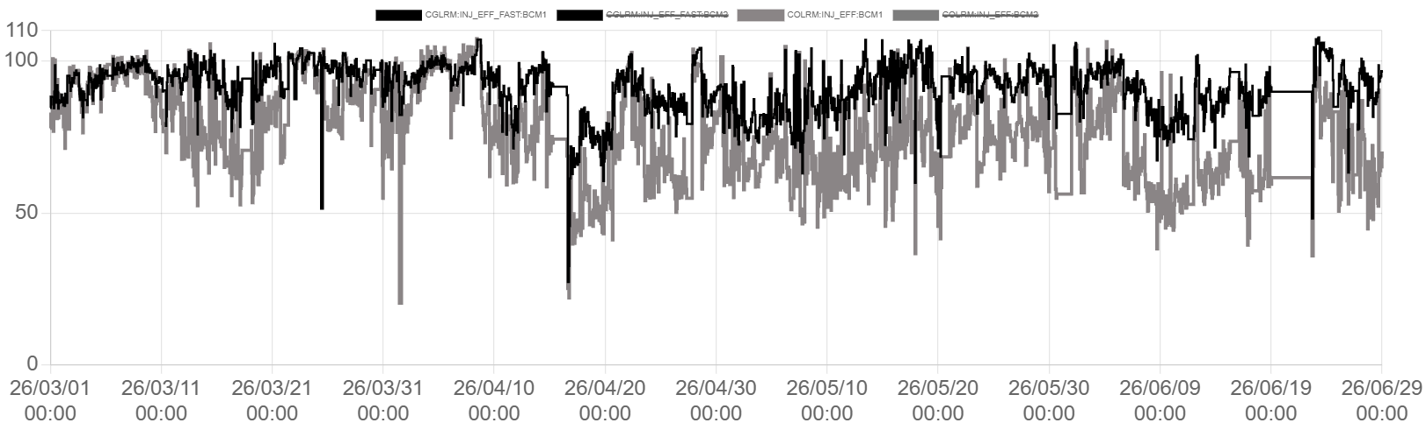
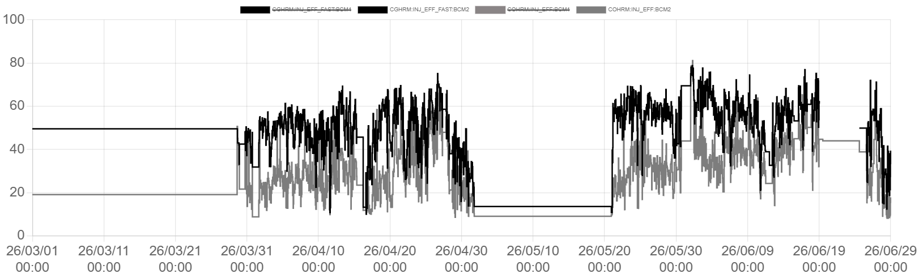
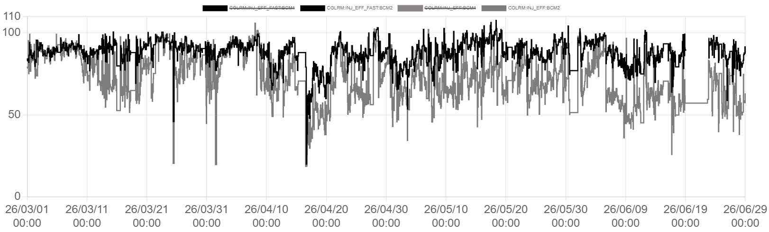
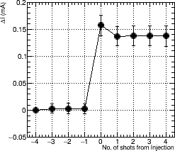
Injection Status: Injection Efficiency
HER
LER
e- 1st (100th turn)
e- 1st (Next Inj.)
e+ 1st (100th turn)
e+ 1st (Next Inj.)
e- 2nd (100th turn)
e- 2nd (Next Inj.)
e+ 2nd (100th turn)
e+ 2nd (Next Inj.)
Injection efficiency 100 turns after injection
Injection efficiency at the next injection
Injection
Depends on
Injection beam quality (ε, σ_{E})
Injection tuning (Septum, Kicker)
H. Kaji
From the 2026ab run, the injection efficiency calculated from the bunch current at the timing of the next injection cycle has also been measured and archived.
Injection efficiency at the next injection timing
Depends on MR condition (tune, Collimator, …)
Bunch Current Monitor [mA]
Next Injection Cycle
The net injection efficiency is the injection efficiency at the next injection timing.
Num. of shots from injection
Improving injection efficiency measured at next injection is also important.

Slide 14
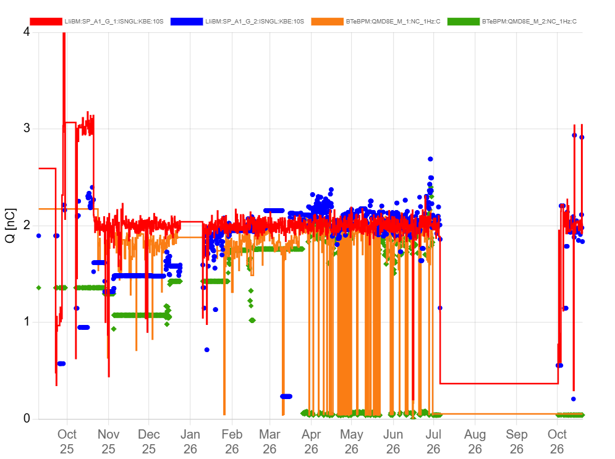
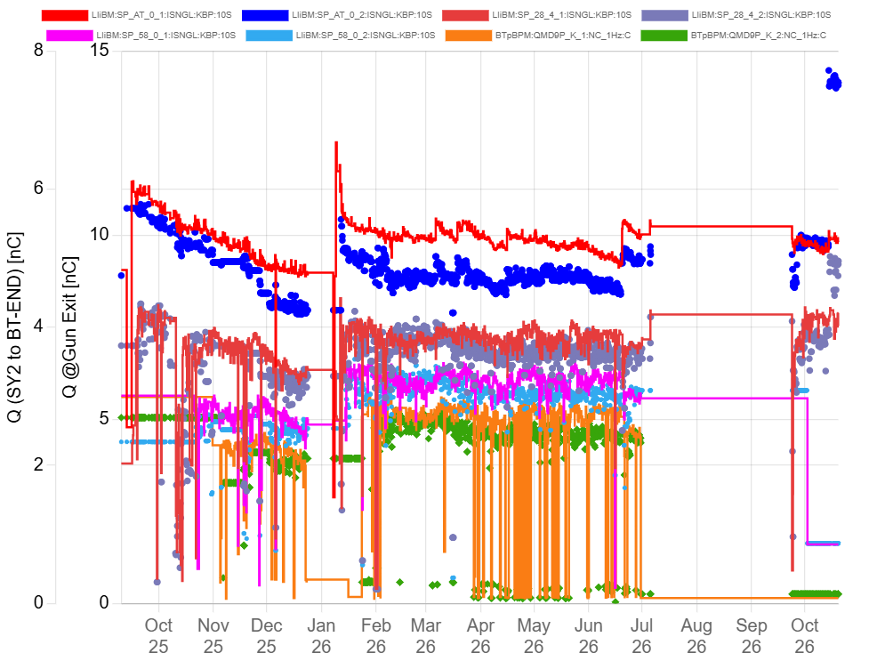
Required Parameters and Current Status: Bunch Charge at BT END
Electron Beam
Positron Beam
New gun
(now)
Increased the grid
pulser pulse width
10→14 nC @Gun Exit
1st @ Gun
Target: 3 nC
1st @ Gun
2nd @Gun
Targett: 4 nC
2nd @Gun
SY2
LINAC END : 1st / 2nd
BT END: 1st / 2nd
1st
2nd
Previously operated at 2 nC.
Confirmed 4 nC beam extraction from the electron gun.
Currently optimizing and verifying the generation and transport of low-emittance beams at high bunch charge.
Cathode emission current has been gradually decreasing.
In 2026ab, positron capture was optimized to maximize transmission efficiency to the DR → The bunch charge at BT remained constant of 2.5 nC
Extended the grid pulser pulse width to increase the bunch charge
Gun Exit: 10→14 nC SY2 (BT to DR Entrance): 3.9 → 4.9 nC
➔ Currently conducting beam tests up to SY2.
Beam tests up to DR-BT are scheduled for December.
Detail: Electron gun/Positron source talk (Zhou-san).

Slide 15
Required Parameters and Current Status: Energy Spread
Current Energy Spread and Required Specifications
Y. Seimiya
 | 1st only | 1st+2nd | 1st+2nd （energy adjusted） | Requirement
e- | 0.033% | 0.076% | 0.074% | 0.07%
e+ | 0.058% | 0.069% | 0.067% | 0.16%
Electron Beam
The electron beam energy spread is close to the required value.
Phase drifts in the downstream LINAC can occasionally cause the energy spread to exceed the required limit.
The input RF power was limited by discharges at the waveguide flange,
but a countermeasure was implemented in the summer of 2026 by installing an RF contactor.
Increase the ECS accelerating gradient to further reduce the energy spread.
Positron Beam
The energy spread of the positron beam is sufficiently small

Slide 16
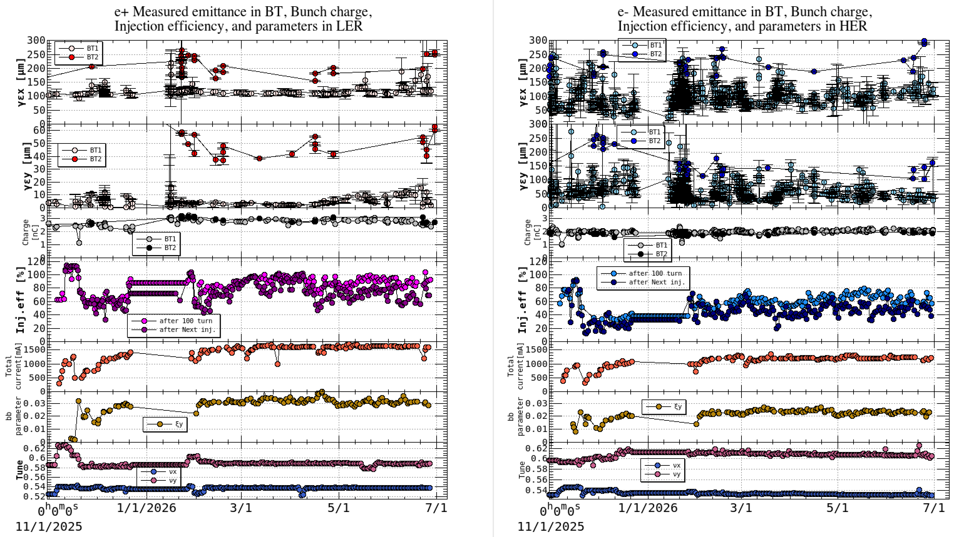
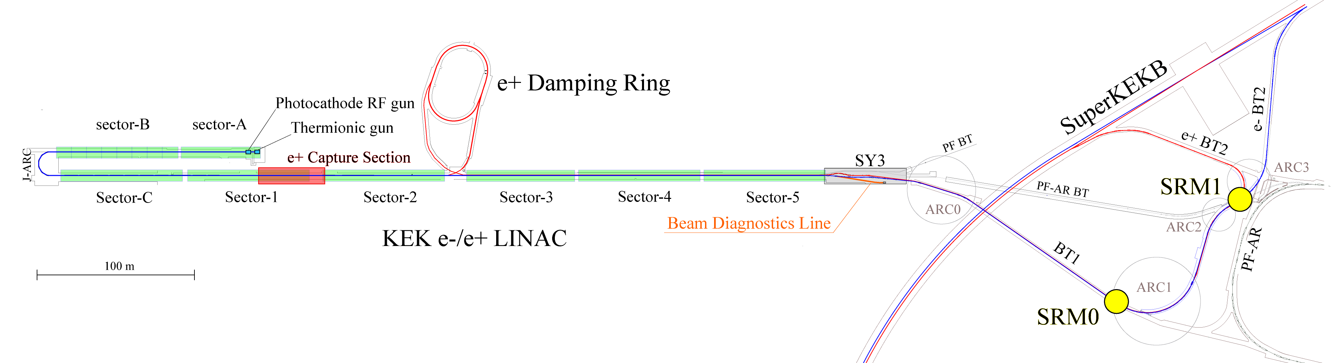
Required Parameters : Emittance of the Injection Beam
N. Iida
BT2
BT1
e+ 2026ab | BT1 | BT2 | Req.
γεx [μm] | 119±2 | 207±9 | 100
γεy [μm] | 5.4±0.4 | 47±2 | 15
e- 2026ab | BT1 | BT2 | Req.
γεx [μm] | 104±2 | 233±11 | 40
γεy [μm] | 52.8±1.6 | 135±7 | 20
Significant emittance blowup from BT1 to BT2 is a major issue for both e- and e+ beams

Slide 17
Emittance Blow-up in BT
One of the highest-priority issues
➔ Mori-san’s talk

Slide 18
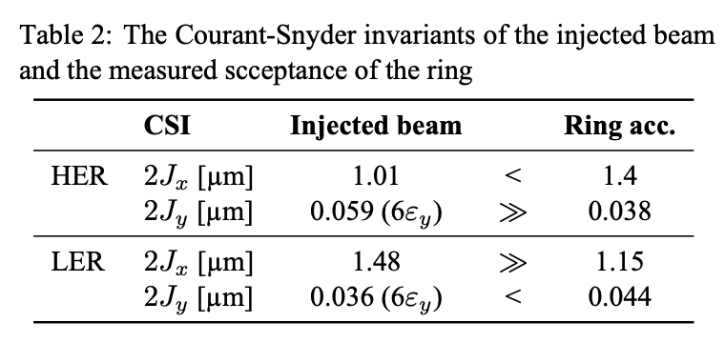
Betatron Oscillation Amplitude and Ring Acceptance
LER
HER
N. Iida
2024c
2024c
βy* | Action | Injected beam | Ring Acc.
1.0 | 2Jx [μm] | 1.29 ~ | 1.4
 | 2Jy [μm] | 0.062(6σ) >> | 0.025
βy* | Action | Injected beam | Ring Acc.
1.0 | 2Jx [μm] | 0.95 ~ | 0.90
 | 2Jy [μm] | 0.060(6σ) >> | 0.04
2026ab
2026ab
βy* | Action | Injected beam | Ring Acc.
0.9 | 2Jx [μm] | 1.48 >> | 1.15
 | 2Jy [μm] | 0.036(6σ) < | 0.044
1.0 | 2Jx [μm] |  | 1.65
 | 2Jy [μm] |  | 0.04
βy* | Action | Injected beam | Ring Acc.
0.9 | 2Jx [μm] | 1.01 < | 1.4
 | 2Jy [μm] | 0.059 >> | 0.038
1.0 | 2Jx [μm] |  | 1.7
 | 2Jy [μm] |  | 0.037
HER: Vertical Emittance is Critical
LER: Horizontal Emittance is Critical

Slide 19
Emittance Automatic Tuning

Slide 20
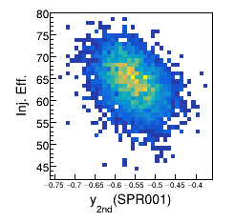
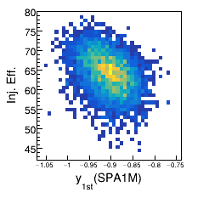
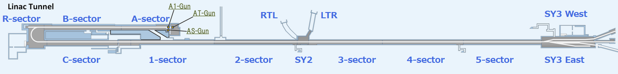
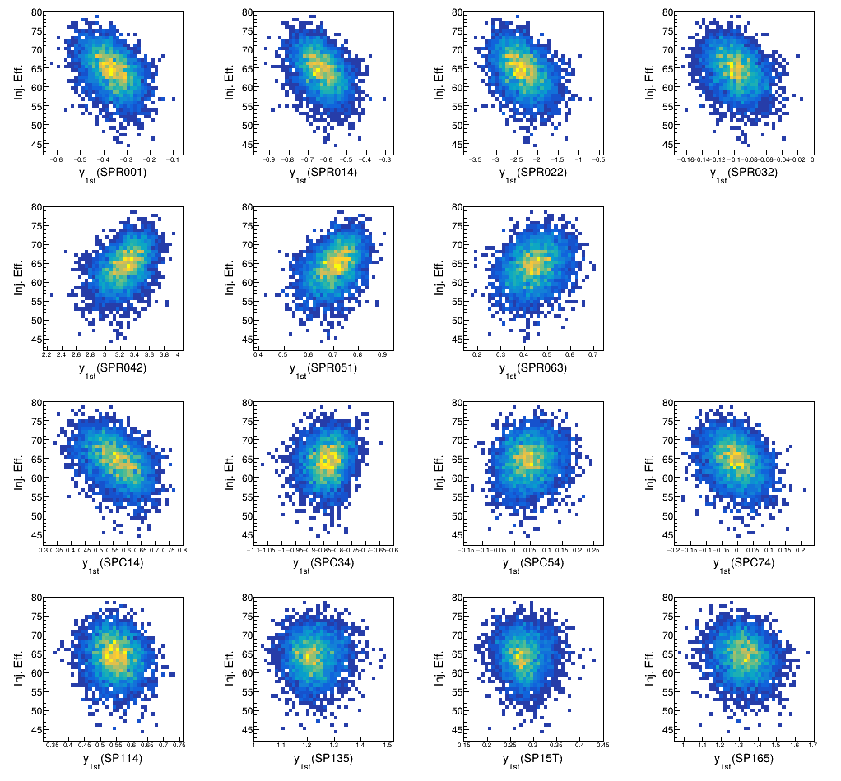
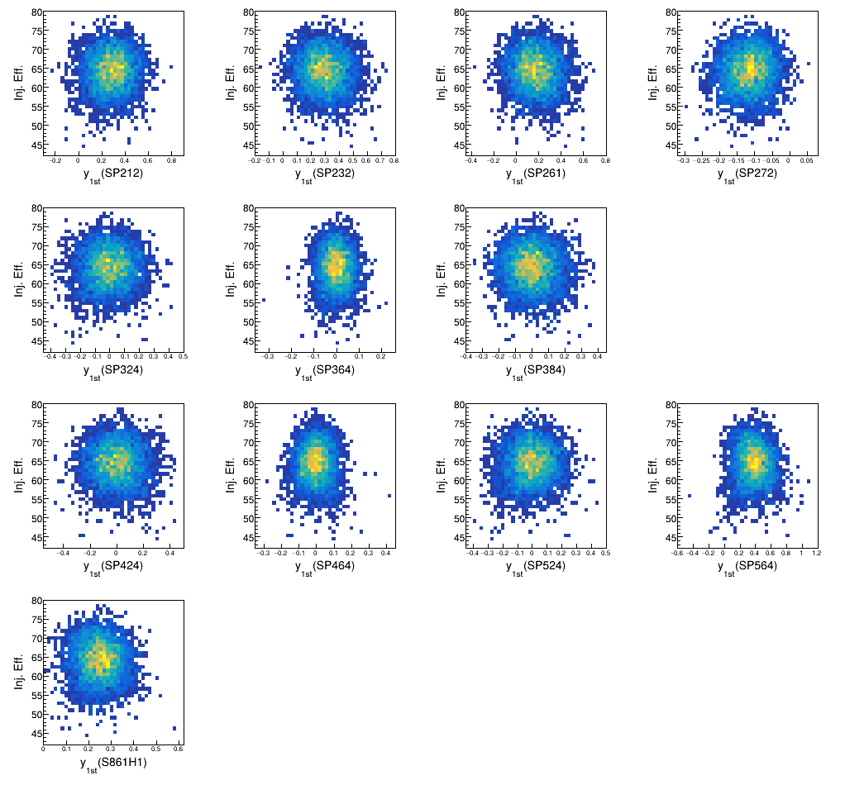
Laser-RF relative phase and Injection Efficiency
Objectives: Identify the factors causing variations in beam emittance and injection efficiency
SRM beam size variations and injection efficiency degradation are often associated with vertical orbit deviations just downstream of the electron gun
Upstream orbit changes induce kicks on the bunch tail
Relative phase between Laser and RF affects the beam orbit
1) Beam orbit and Injection Efficiency
A correlation was observed between the upstream beam orbit and injection efficiency
No clear correlation is observed downstream, presumably because orbit feedback maintains stable beam conditions.

Slide 21
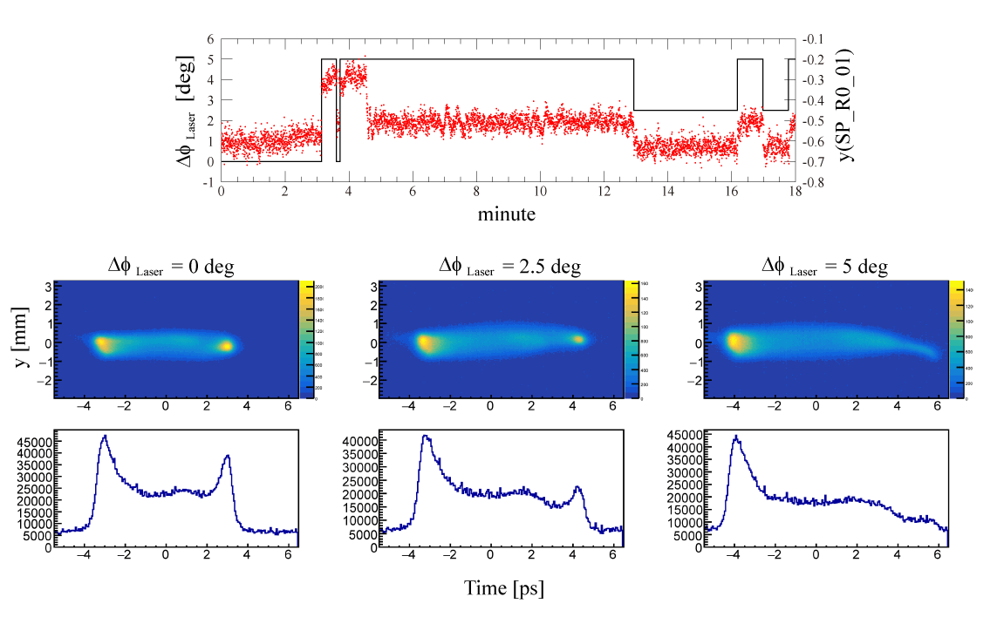
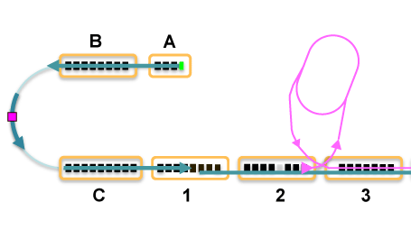
2,3) Effect of Laser-RF relative phase on the beam orbit and Wakefield-induced kicks
Varied the laser phase to observe beam orbit changes
Applied an energy chirp in Sector-B to measure the longitudinal (time) distributions
Laser phase
y position at J-ARC entrance
Energy chirp
head
tail
Screen Monitor
Beam position changes with laser phase (top) and beam profile measured at the center of J-ARC with an applied energy chirp (bottom). The horizontal axis is converted to an approximate time scale.
Wakefield-induced kicks on the bunch tail when the beam orbit deviates from the optimal operating orbit (Δφ_{Laser} = 2.5, 5 deg).
The laser–RF relative phase affects beam emittance.
It also affects energy spread by shifting the beam phase relative to the accelerating RF.
Adjusting the relative phase between the laser and RF is required to maintain low emittance

Slide 22
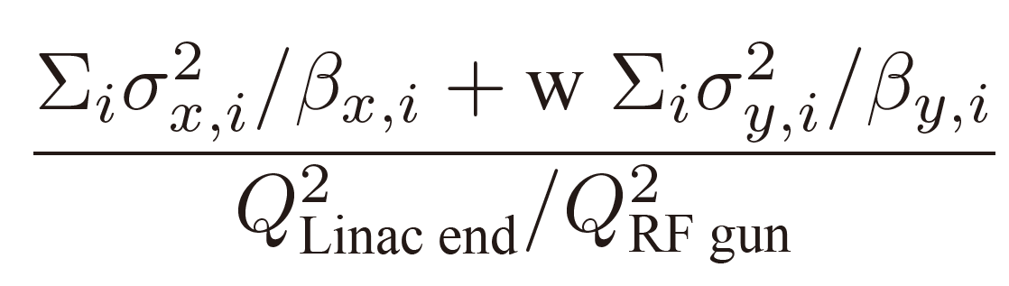


Emittance Auto Tuning (EAT)
Y. Seimiya
Objective function:
$$σ_{x,i}$$
/
$$σ_{y,i}$$
: Horizontal / Vertical Beam size at SRM i (i = 0, 1)
$$β_{x,i}$$
/
$$β_{y,i}$$
: Horizontal / Vertical β function at SRM i
$$Q_{RF gun}$$
/
$$Q_{Linac end}$$
: Bunch charge at Gun eixit / Linac end
w : Weighting factor (w=2) to emphasize vertical emittance
Optimize the beam orbit to minimize the beam sizes measured at two SRMs
In two-bunch operation, this also minimizes the overlap of the two bunches, leading to an overall improvement in injection efficiency
Upgrade of EAT
Objective: Add the adjustment of the relative phase between the laser and RF to the EAT

Slide 23
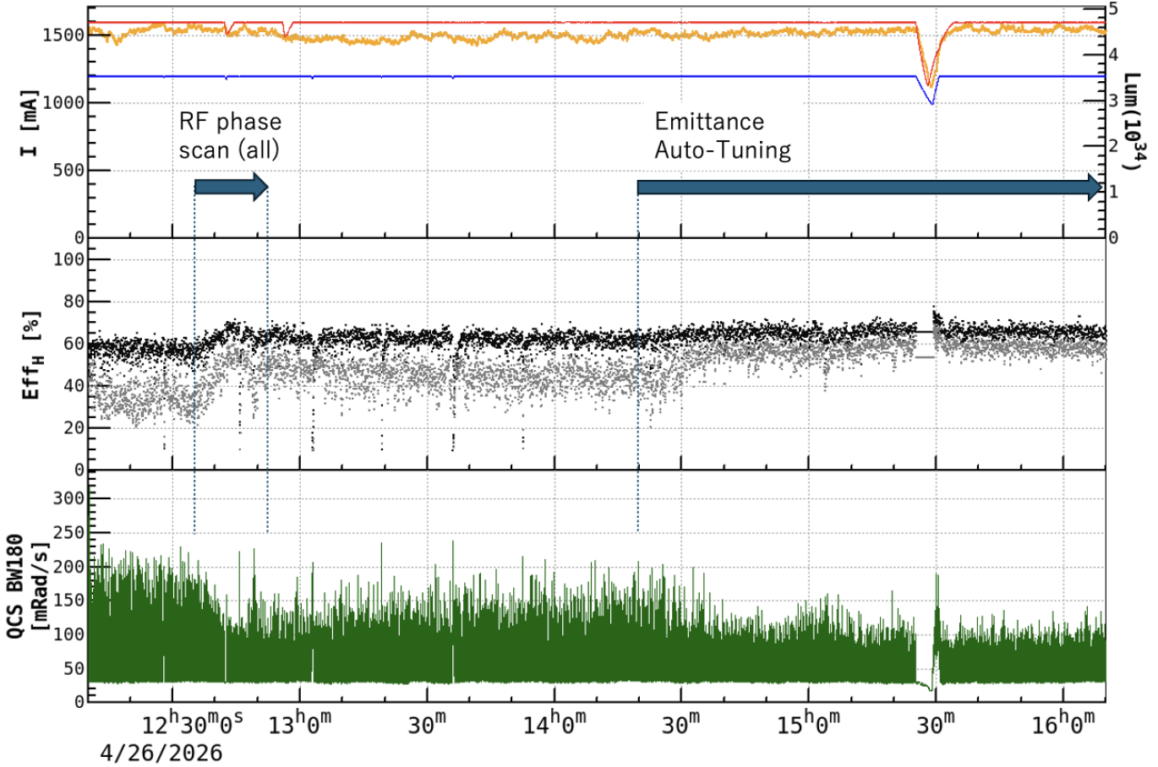
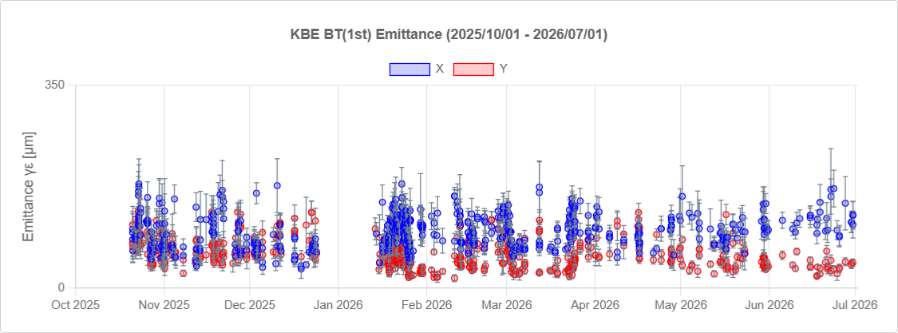
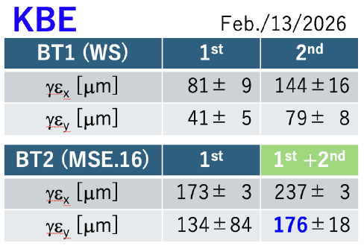
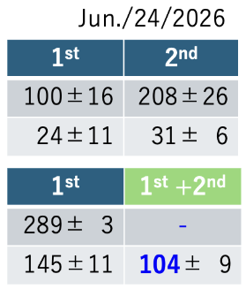
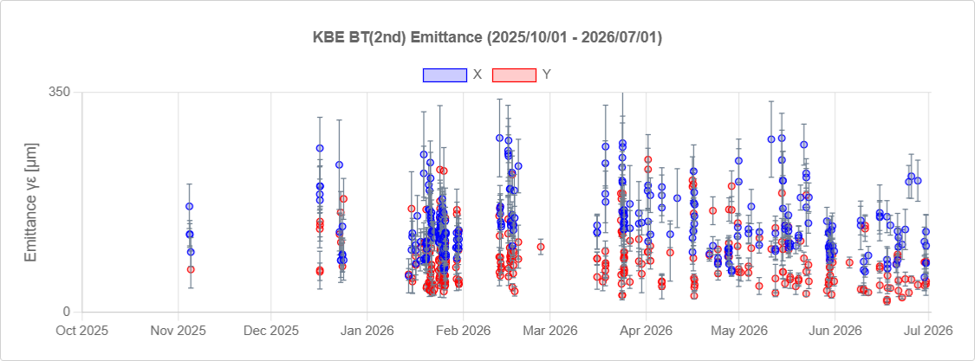
Injection efficiency improvement through Emittance Auto Tuning
Include the overall LINAC RF phase in Emittance Auto-Tuning (EAT)
Y. Seimiya
Comparison of emittance before and after the introduction of EAT
1st bunch
Blowup
2nd
Vertical emittance at BT1 has been significantly reduced.
Emittance blowup between BT1 and BT2 remains a major challenge.
Improved injection efficiency and reduced Belle II background with RF Phase Adjustment and Emittance Auto Tuning.
EAT operation
EAT with RF phase
optimization
EAT and RF phase optimization significantly improved HER injection efficiency and reduced the Belle II background.
A reduction in beam emittance in the BTe was confirmed.
Future Improvements
Optimization of energy spread with SY3 beam diagnostic line
Implement automatic tuning of the 2nd bunch using the Fast Kicker
Using the new SR Monitor at SY3

Slide 24
Automatic Orbit Feedback

Slide 25
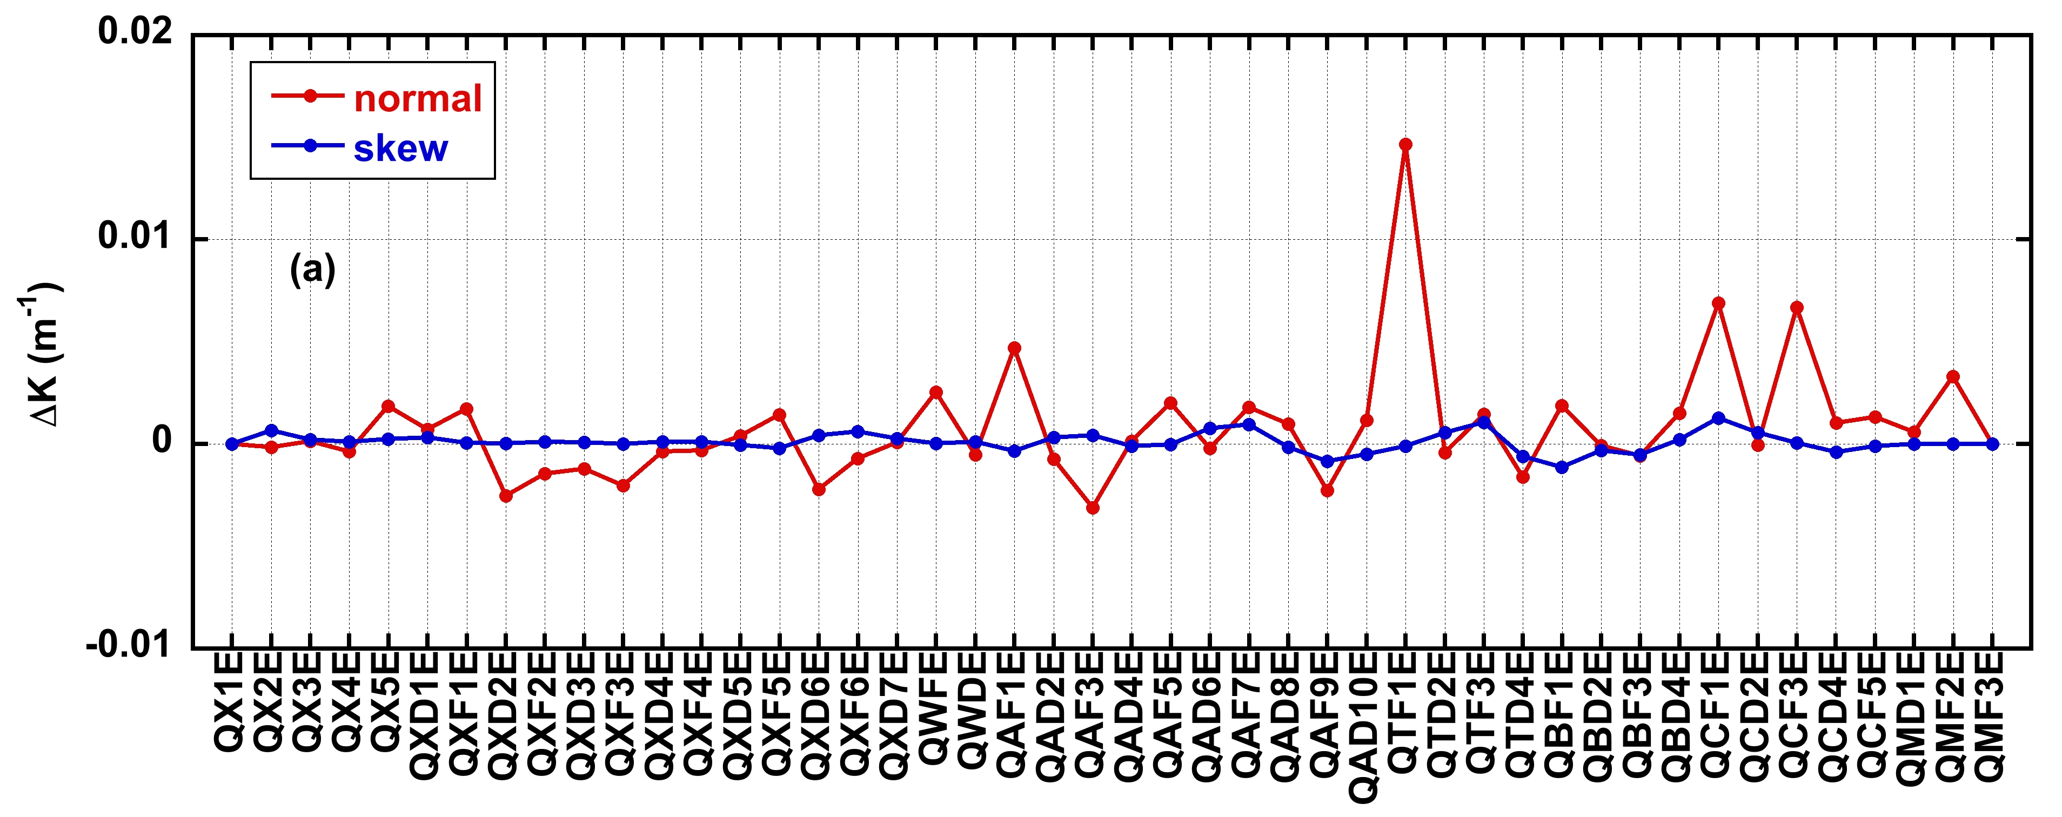
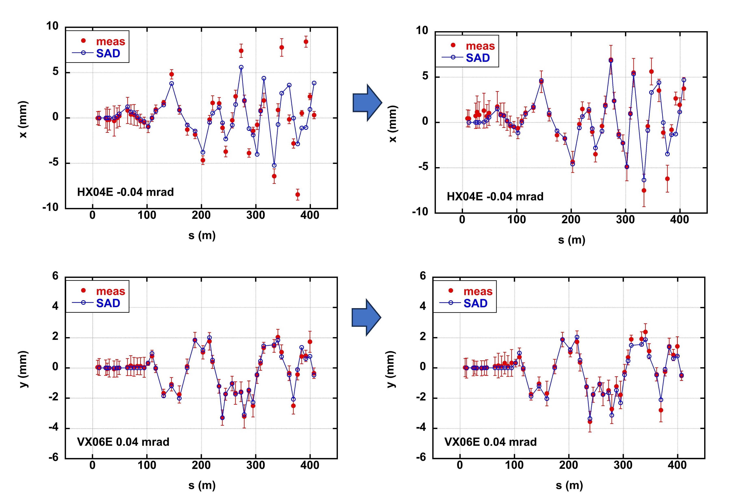
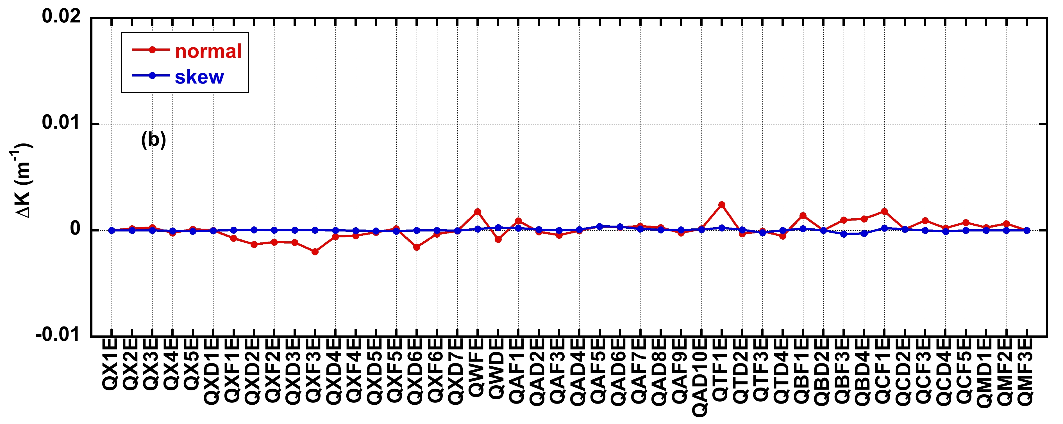
Reconstruction of the BT simulation Model and Implementation of Automatic Orbit Feedback
Y. Shimosaki
Objectives: Compare model predictions with measurements and Stabilize the injection beam orbit
Response Function Measurement and Model Reconstruction
before
Large error
Cause unknown
Measure the orbit response function (displacement per unit kick angel) and dispersion function
Evaluate the normal and skew quadrupole field errors required to reproduce the measured response in SAD simulations.
?
Horizontal (before)
Hor. (After field error cor.)
after field error correction
Vertical (before)
Ver. (After field error cor.)
Magnetic field errors of individual Quadrupoles(Top: Before correction; Bottom: After Correction)
Automatic Correction
Calculate the steering kick angles required to correct the orbit deviations from the golden orbit.
Comparison of measured and simulated injection beam orbit

Slide 26
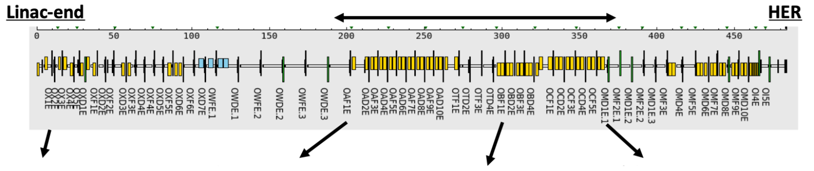
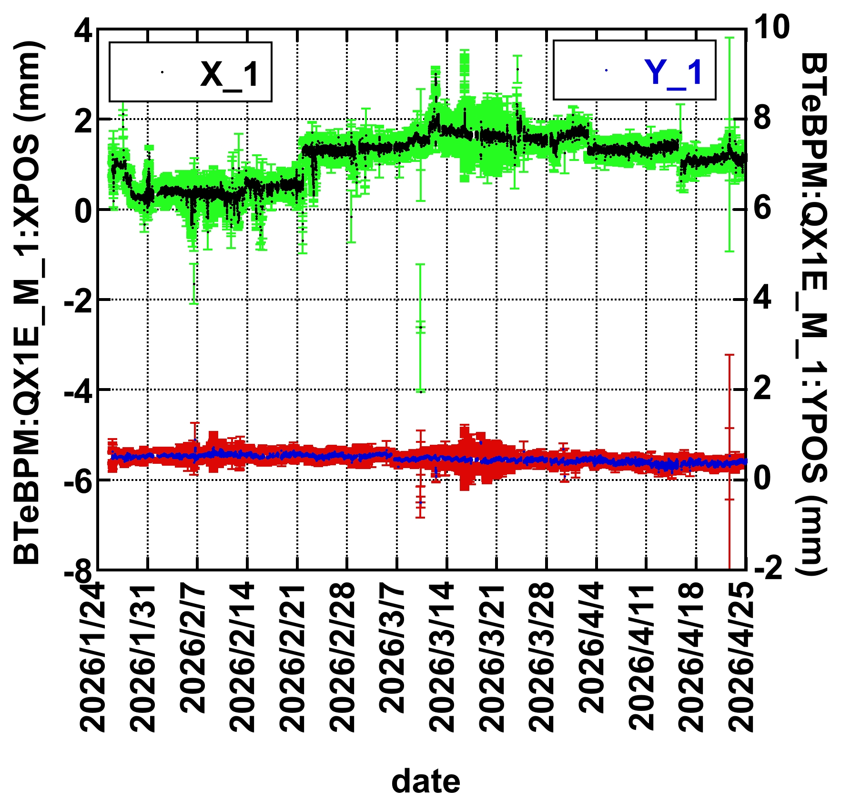
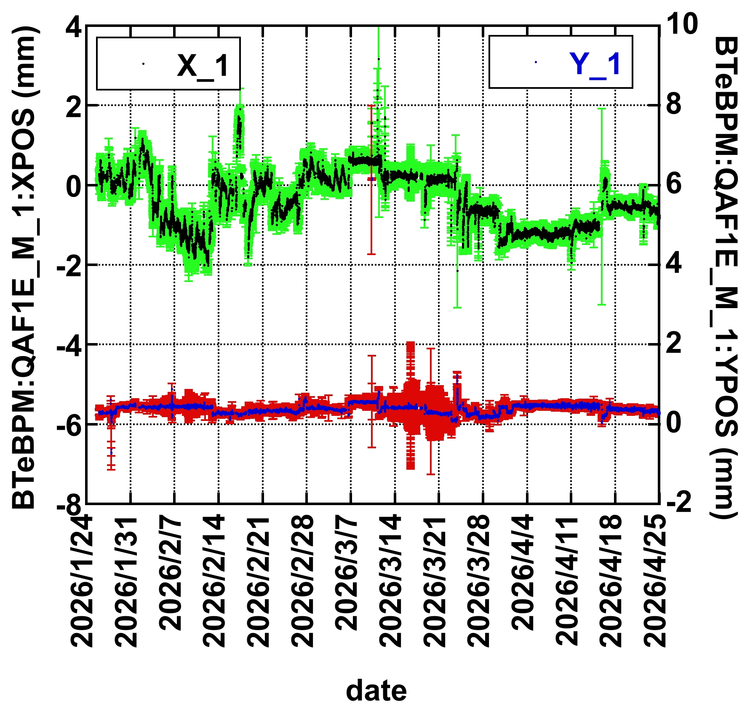
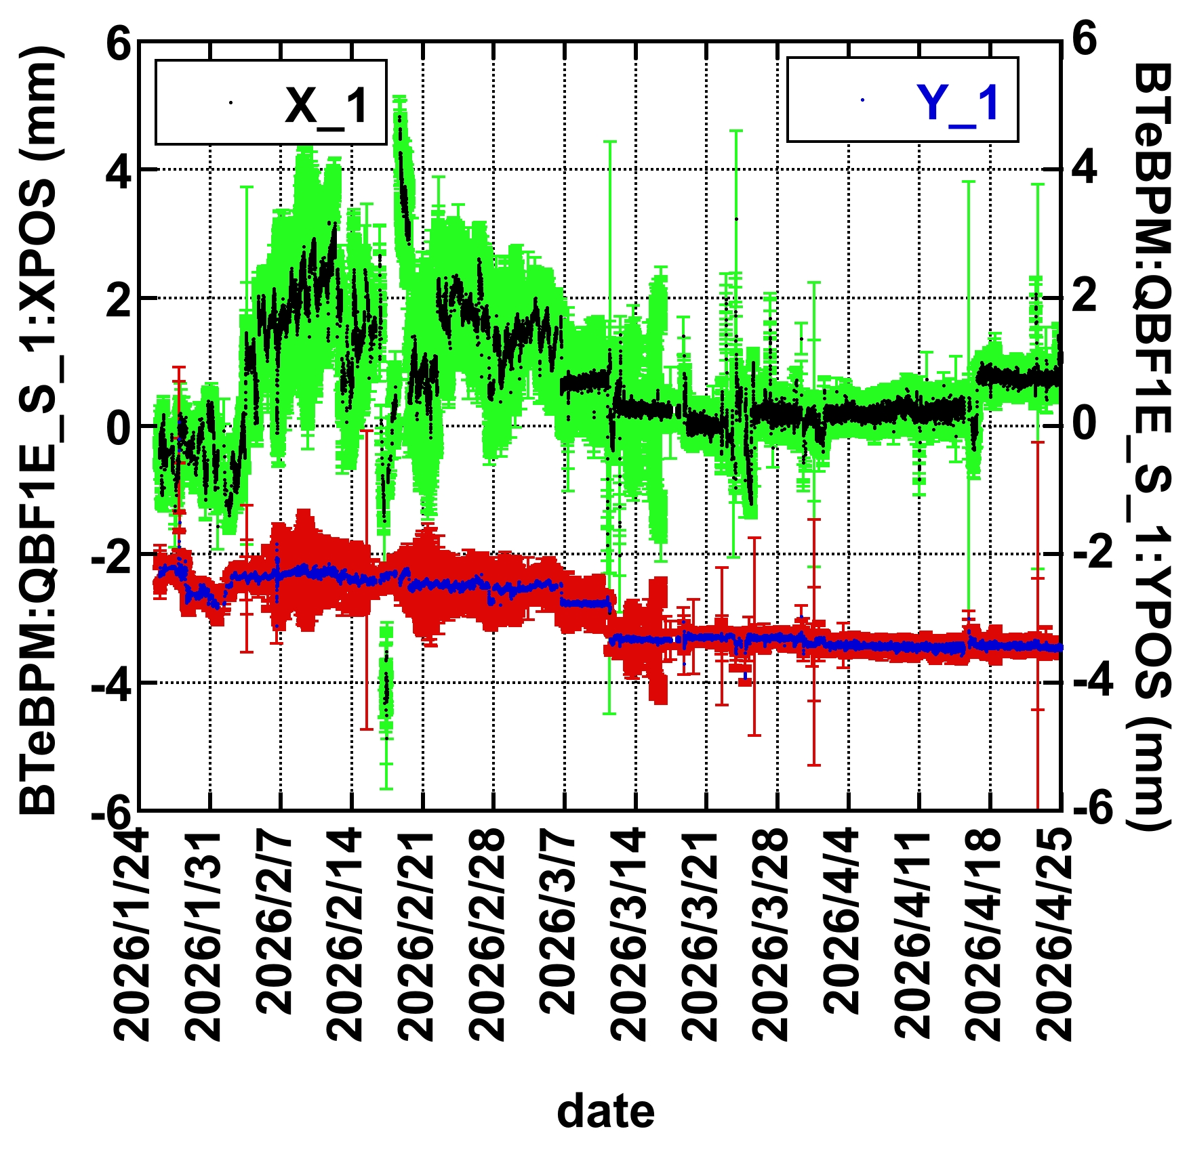
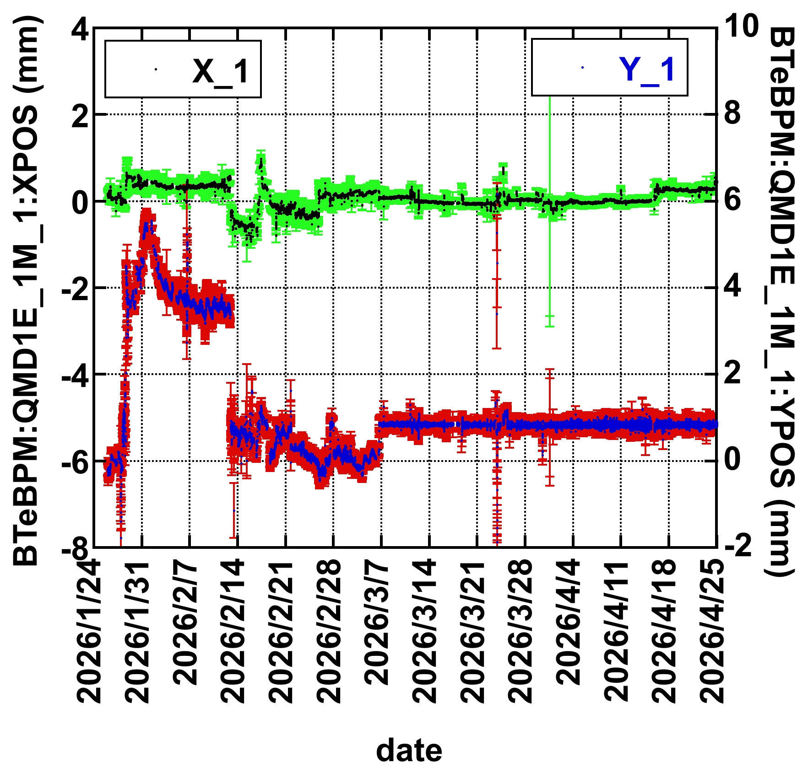
Automatic Orbit Feedback in BTe
Y. Shimosaki
ECS
FB ON
FB ON
FB ON
Large beam orbit fluctuations
Stable after FB implementation
(Steps correspond to changes in the golden orbit, etc.)
Long-term beam orbit drift was eliminated, and orbit jitter was significantly reduced

Slide 27
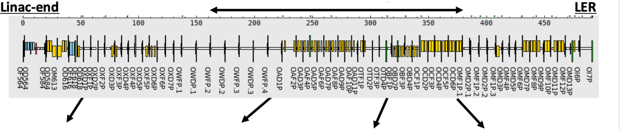
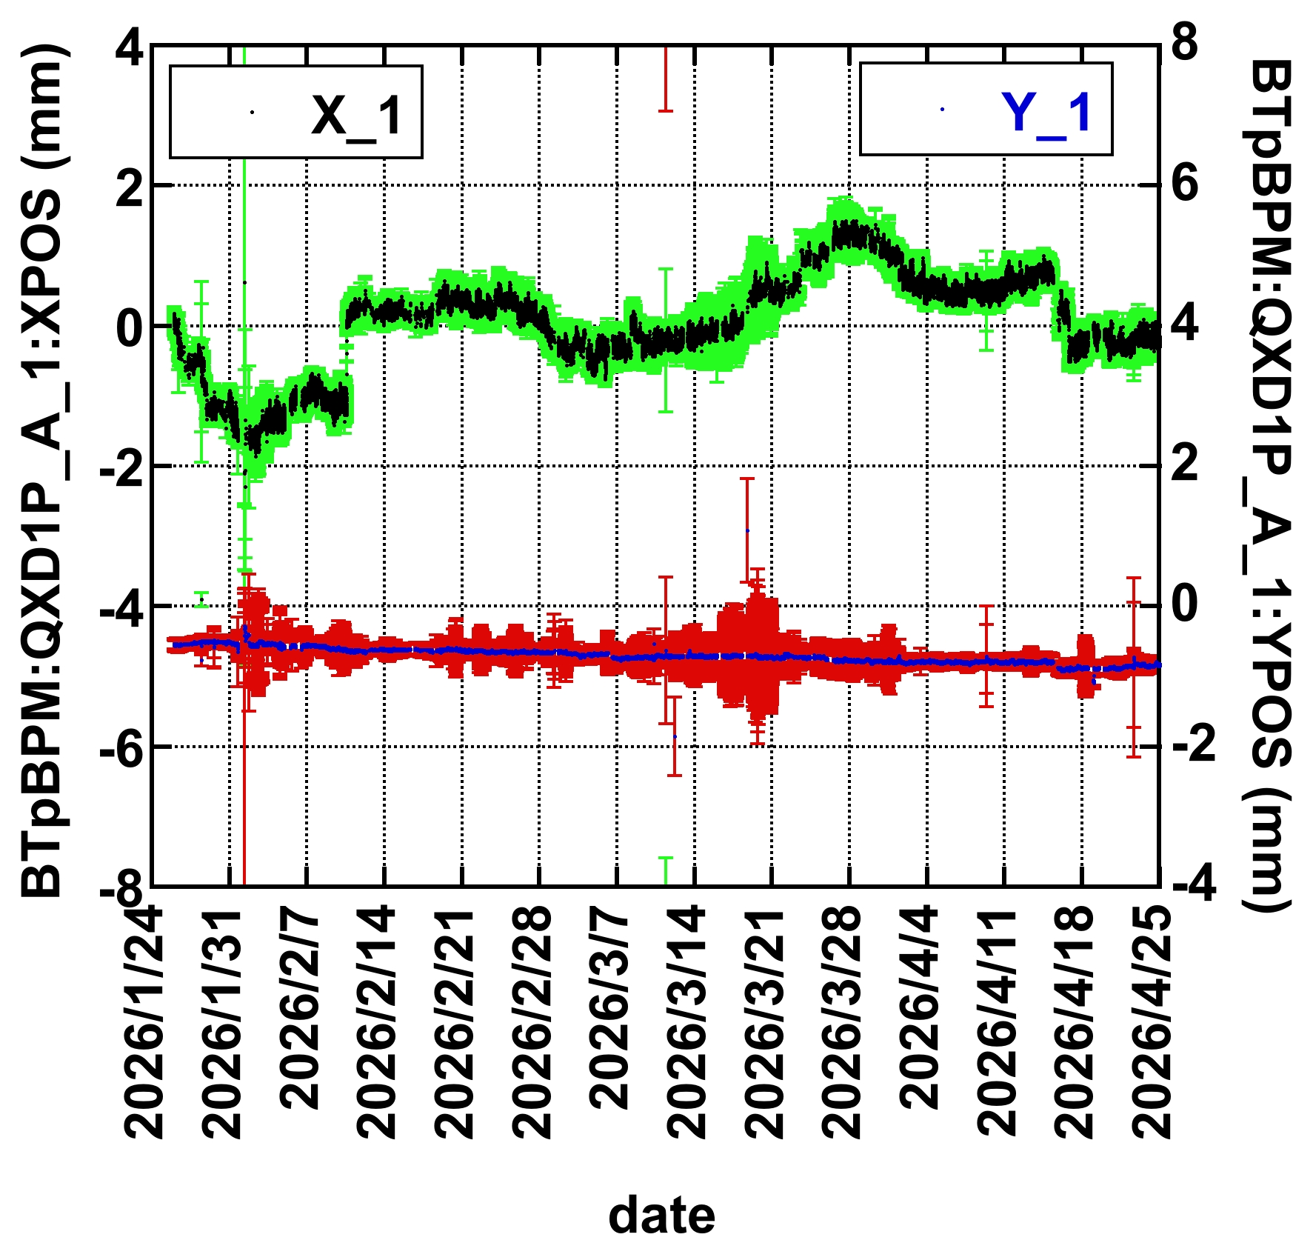



Automatic Orbit Feedback in BTp
Y. Shimosaki
FB ON
FB ON
FB ON
Positron beam orbit is also stabilized
In the LER, since correcting for field errors stil resulted in large discrepancies between simulations and experiments, orbit correction is performed using the measured response matrix.

Slide 28

Automatic Orbit Feedback and Injection Stability
FB ON
Long-term beam orbit drift was eliminated, resulting in stable injection efficiency
Implementation of Automatic Orbit FB
Injection stability was greatly improved
Enabled practical use of collimators (Studies are planned for the next operation period)
Future Improvements
Improve FB accuracy and stability by increasing the number of BPMs (BPM signal overlap issue is resolved) and optimizing BPM and steering magnet selection
Investigate the causes of large magnetic field errors

Slide 29
Increase in Positron bunch charge

Slide 30


Increase in Positron bunch charge
At the thermionic gun exit
➔Detail will be presented tomorrow by Zhou-san.
e+ Capture Section → SY2 (entrance of Linac To Damping Ring BT)
SY2
There are more than 100 DC quadrupole magnets, and their settings cannot be changed during PF operation.
Due to the time-consuming tuning process, optimization to increase the transmission efficiency had been performed only once before this Octber.
➔ In this October this year, we performed optimization again.
T. Natsui
DC magnet optimization in this section

Slide 31

Optimization of Positron Production and the Downstream Section of the Capture Section
Positron target:
Q(SP_15_T)
Target-to-SY2 transmission increased by 6% relative to 2026ab.
SY2 entrance:
Q(SP_28_4)
 | Q_{target} [nC] | Transmission: 15T→28_4
2026/1 | 9 | 45%
2026/10 | 8.3 | 51%
Optimization including the BT from SY2 to the DR is planned for December
Optimize the capture phase in the Capture Section and the magnets downstream of SY2.

Slide 32
HER Synchrotron Injection

Slide 33





Why synchrotron injection
N. Iida
The horizontal phase space at the injection point
In SI, the horizontal betatron injection oscillation is replaced by longitudinal synchrotron oscillation by utilizing the horizontal dispersion and an energy offset of the injected beam
Optics and orbits in the injection region
Comparisons of the betatron injection(BI) and synchrotron injection (SI)
Synchrotron injection (SI)
On axis, off momentum
 | BI | SI
Beam-beam kick at IP | Large H. oscillation | No H. oscillation
Beam-beam with nano-beam | H. osci. causes shift of s→large βy | (Coll. at s~10σz)
Dynamic aperture (DA) | Large H. osci. decreases V. DA | No H. osci.
SR to the IP beam pipe | Larger due to H. osci. | No H. osci.
Damping time | 58 ms (Horizontal) | 29 ms (Longitudinal)
Sensitivity to b-b, sext. misalignment, and tune | More sensitive | Less sensitive
Betatrotron injection (BI)
Off axis, on momentum
Injection point
Injection point
Dispersion
Dispersion
Inj. orbit
Δx
Inj. orbit
Δx
Extraction region
Extraction region
ηx=ΔX/δ: horizontal dispersion=orbits of the beam with offset energy (δ)
In SI, the energy of injection beam is made 0.6% higher = The injection beam’s orbit makes the dispersion orbit.
In the non-dispersive region.
→ ΔX=0 at the interaction region.
→ However, although it oscillates in the longitudinal direction, its impact on collisions is small.

Slide 34






Injection Comissioning
N. Iida
Comparison of ten-minutes operation with the βy*=1 mm optics
The SI was tested from Nov.6 to 20 in 2025.
Measured beam oscillations using TbT-BPMs with the detuned optics
Inj. Eff. ~60%
Betatron injection
Synchrotron injection
Inj. Eff. ~20%
x [mm]
x [mm]
y [mm]
y [mm]
Q [nC]
Q [nC]
Number of turns
Number of turns
The injection efficiency of SI reached 60% after 7.5hr-tuning, on the other hand, that of BI stayed only 20% after 4 days.
νx=.535
FFT(x)
FFT(x)
Frequency components
FFT(y)
FFT(y)
νs=.0277
Injection tuning is easier because it is less sensitive to the tune and sextupole misalignments, etc.
FFT(s)
FFT(s)
Fractional tune
Fractional tune
The test was terminated after a short period because:
Beam injection onto adjacent RF buckets occurred, and
the cause could not be identified.
(This had also occurred during BI, but only rarely)
Changin the rep. rate from 5 to 12.5 Hz increased the background
The physics run was scheduled immediately afterward.
A peak appears in the frequency spectra at the horizontal tune in BI, while the synchrotron tune in SI. These results indicate a perfect realization of the synchrotron injection as the simulation results.
Simulations (βy*=1mm, w/o collimators, knobs, b-b, and different tune)
In 2026ab, the injection efficiency reached 60% even with BI, thanks to Emittance Auto-Tuning and injection optimization.
We aim to evaluate the effect of Synchrotron Injection under the same injected beam conditions.
K. Oide

Slide 35
Parameters Required for Luminosity of 1x10³⁵ and Future Plans

Slide 36
Parameters Required for Luminosity of 1x10³⁵
Parameters Required to Achieve a Luminosity of 1 x 10³⁵, and Expected Loss and Injection Rates, Based on Measured Injection Efficiency, Beam Lifetime, and Specific Luminosity in 2026ab
Y. Funakoshi
 | Spec. Lum. Case A Based on the Maximum Spe. Lum. Archived in 2026ab |  | Spec. Lum. Case B βy*=0.8 and 112.5% of Case A
 | LER | HER | LER | HER
Luminosity [10³⁵cm⁻²s⁻¹] | 1 |  | 1
Nb | 2746 |  | 2346
Total beam current [mA] | 3033 | 2426 | 2365 | 1892
Bunch current [mA] | 1.104 | 0.8835 | 1.008 | 0.8066
Bunch current product [mA²] | 0.9758 |  | 0.8133
Specific luminosity [10³¹cm⁻²s⁻¹mA⁻²] | 3.732 |  | 5.241
βy* [mm] | 0.9 |  | 0.8
Lifetime [min.] | 4.29 | 11.3 | 5.11 | 12.4
Loss rate [mAs⁻¹] | 11.8 | 3.58 | 7.71 | 2.55
Injection rate [mAs⁻¹] # | 4.19 | 3.16 | 5.12 | 4.37
# Assumption: e+/e- Bunch charge = 3 nC, Beam Rep. Rate: LER 23 Hz, HER 25 Hz
One Model Scenario: Model-Dependent Due to the Unexplored Beam Current Regime
In the LER, the beam loss rate significantly exceeds the injection rate.
The situation is also challenging for the HER.

Slide 37
Hardware Upgrade

Slide 38

Requests to the Hardware Group
Requests for Hardware Improvements to Enhance Injection Efficiency, Reduce Injection Background, and Investigate Issues Such as Emittance Growth
Installation of New Synchrotron Monitor at SY3 and the LER BT
A new SRM has been installed at SY3.
Tests to integrate the new SRM into automated emittance tuning are planned to begin in December.
R. Zhang, Y. Okayasu
No SRM has been installed in the LER BT yet.

Slide 39


Radiation Protection for the SY3 Beam Diagnostic line Camera
Frequent camera shutdowns due to radiation from the beam dump prevent stable measurements.
Radiation shielding upgrades were postponed from the summer shutdown to the next shutdown due to higher-priority work, including SRM installation.
Addressing BT BPM Issues and Improving Performance
Issue1: Abnormal oscilloscope trigger timing in the BT BPM system caused missed beam measurements and timing shifts.
Fixed
missed beam
measurements
timing shift
e+ Bunch Charge at the LINAC END and BT BPM before timing correction
e+ Bunch Charge at the LINAC END and BT BPM After timing correction

Slide 40


Issue2: BPM Signal Overlap and Poor Position Resolution
An issue that complicates beam operation and root cause investigation.
Fewer BPMs provide valid measurements during double-bunch operation.
Limited BPM availability for orbit feedback.
Few BPMs can measure both bunches, requiring orbit comparisons using different BPMs for the 1st and 2nd bunches.
BPM resolution-induced position spread exceeds orbit jitter, making it difficult to identify the underlying problems.
CH1
(LER)
R1
R2
R3
R4
QWFP_4A_1
CH2
CH3
0.1 ns/point
CH4
QXF1P_A_1
QXD5P_K_1
1st bunch
QWFP_3A_1
QXD2P_A_1
QAF6P_K_1
QAD7P_A_1
QWDP_2A_1
QXD1P_A_1
QXF5P_K_1
QXD6P_K_1
QXF6P_A_1
QWFP_4A_1
QAF8P_K_1
QWDP_3A_1
QAD5P_A_1
QXF2P_A_1
QXF1P_A_2
QXD5P_K_2
2nd bunch
QWFP_3A_2
QXD2P_A_2
QAF6P_K_2
QAD7P_A_2
QWDP_2A_2
QXD1P_A_2
QXF5P_K_2
QXD6P_K_2
QXF6P_A_2
QWFP_4A_2
QAF8P_K_2
QWDP_3A_2
QAD5P_A_2
QXF2P_A_2
Overlap of the BPM raw signals.
➔Detail will be presented in this afternoon’s Control/Monitor session (Ikeda-san’s talk).

Slide 41

LER Injection Point Chamber Upgrade
Enlarge the aperture on the stored beam side of the Q-magnet chamber at the injection point
➔Increase the kicker height to reduce the separation between the injected and stored beam,
thereby reducing the amplitude of injection oscillations
This part will be widened
1 mm
Starting Point of the recess
Machine 1 mm deeper
An injection-point chamber with an enlarged aperture will be installed in December

Slide 42
Challenges for Luminosity Improvement
Specific Luminosity
Worse than in 2022 → Investigate the cause (Ground subsidence? Magnet misalignment?)
Investigate the cause of the decrease in Specific Luminosity at high beam currents
In 2024ab, The beam injection efficiency dropped at βy=0.8 → Search for better operating condition?
Beam Lifetime
Beam-gas Coulomb → Improvement of Vacuum Pressure
Touschek → Optimization of Dynamic Aperture (Sextupole Optimization)
Crab waist ratio Optimization
Injection Efficiency / Rate
Injection beam emittance → Reduction of Initial Emittance (RF-gun?)
Investigation of the Cause of Emittance Blow-up in BT and its Mitigation
Injection efficiency degradation along the train → Investigation of the Cause (Beam loading?, Tune?)
Increase in Charge → Attemp to transport a Low-Emittance Beam during the 2026c and 2027a Runs
Improved Automatic Orbit Feedback Precision Following the BT BPM Upgrade
⬅ In Later Slides and the Control/Monitor Talk (Ikeda-san)
Improved Emittance Auto Tuning (EAT) with SY3 beam diagnostics line, following the BT BPM Upgrade

Slide 43

Injection Background
High Injection Background →
Reduce DAQ Efficiency Due to Injection Veto
MR Beam Current Limited by Increased Injection and Storage Background
Objective: Remove beam halo and energy tails using collimators at SY3 and in the BT before injection
to Reduce Injection Beam-Loss Background
Why Haven’t we used the Collimators? Large orbit drifts previously prevented collimator use.
However, successful orbit feedback now makes collimator operation feasible
Challenges:
Confirm compliance with internal beam loss and radiation limits.
Review the limits with the Radiation Science Center if necessary.
Measure the radiation dose at the injection kicker power supply downstream of the collimators and evaluate the risk of radiation damage.
Planned Measurements
Radiation levels at critical locations (Radiation Science Center).
Collimator position vs. beam charge (beam profile scan).
Long-term beam loss stability.
Gamma-ray and neutron dose at the kicker power supply.
Collimator position vs. injection background.

Slide 44
Summary
HER/LER Beam Current
During the 2026ab run, the beam currents reached 1650 mA for the LER and 1300 mA for the HER.
Further increases in beam current are planned starting from the 2027a run (see Mitsuka-san's talk).
Challenges:
Beam lifetime currently limits the achievable beam current.
To reach a luminosity of \(10^{35}\), it is necessary not only to increase the injection power but also to reduce the beam loss rate.
Beam loss between successive injections (the difference between the injection efficiency at the 100th turn and that of the next injection) needs to be reduced.
For SBL, see Uno-san's talk.
Injection Beam Charge
During the 2026ab run, injection beam charges of 2 nC for the HER and 2.6 nC for the LER were achieved.
Higher bunch charges are expected through the RF gun upgrade and an increase in the pulse width of the thermionic electron gun.
Beam studies with higher bunch charges will begin in the 2026c run.
Injection Background Mitigation
We plan to reduce injection background by cutting the energy and emittance tails using collimators in SY3 and the HER/LER BT lines.
It is necessary to evaluate the constraints imposed by radiation dose limits at KEK and the risk of radiation damage to the kicker power supplies downstream of the collimators.
Beam studies will begin in the 2026c run.

Slide 45
Injection Beam Emittance, Energy Spread, and Beam Stability
Electron
Emittance Auto Tuning (EAT) and Automatic Orbit Feedback have enabled stable injection of low-emittance beams.
Stable injection of the second bunch into the HER has been achieved.
The gun upgrade is expected to improve the second-bunch quality to a level comparable to that of the first bunch.
We will further improve EAT and Automatic Orbit Feedback using the SRM at SY3, the upgraded BT BPMs, and the SY3 diagnostic line, aiming to reduce the emittance at the BT end.
The ECS can now compress the energy spread to the required level. However, the accelerating gradient is lower than the design value, leaving little margin relative to the requirement.
Higher RF power is expected to become available after addressing the waveguide discharge issue. Beam studies will begin in the 2026c run.
Positron
- Automatic Orbit Feedback has enabled stable beam orbit control from the DR to injection.
Common Challenges
Emittance blow-up in the BT remains a major bottleneck. Identifying its cause and implementing countermeasures are urgent priorities.
The upgraded BT BPMs are expected to facilitate further investigation of this issue.
Synchrotron Injection
Synchrotron injection successfully suppressed injection oscillations, making injection tuning easier.
Due to limited beam study time, a detailed comparison with betatron injection could not be completed.
We plan to make the necessary preparations and perform a more detailed comparison in a future beam study.

Slide 46
Appendix

Slide 47

Thermionic Gun Heater Current and Bunch Charge

Slide 48

Fast Kicker: Operational use began in the 2026ab run
Y. Okayasu, T. Natsui
Name | date | Status | Notes
FY_A2_2 | 2024/8 | Operation | Polarity Reversed，Capacitor: 40 μF → 8 μF
FY_A4_4 | 2024/8 | Operation | Capacitor: 40 μF → 8 μF
FY_R0_2 | 2022/8 | Shut down | Enhanced shielding is required
FY_48_4 | 2026/4 | Ope. → failure | Improving the High-Voltage Withstand Capability of Litz Wire. Capacitor: 40 μF → 8 μF
FY_58_4 | 2025/8 | Operation | Enhanced shielding is required
Hard switching
To avoid the risk of damaging the high-speed switching module (¥1.6 million) due to hard switching (high induced voltage), the capacitance was reduced to achieve soft switching.
However, soft switching increased the overshoot amplitude, so the introduction of a diode is being considered. In the current configuration, the 1st and 2nd bunches can be kicked in opposite directions, with sufficiently good waveform reproducibility.
On June 22, 2026, an electrical discharge occurred in the Litz wire of FY_48_4, and the cable was replaced. However, another discharge occurred on July 1, leading to the suspension of operation. The voltage withstand capability of the Litz wire was improved
Shielding for FY_R0_2 and FY_58_4 is currently being designed using PHITS.
Soft switching
Trigger
Current
Fast Kicker led to stable injection of the second bunch.

Slide 49


BTp simulation Model and Automatic Orbit Feedback
Example of an orbit
In the LER, since correcting for field errors stil resulted in large discrepancies between simulations and experiments, orbit correction is performed using the measured response matrix.

Slide 50

Injection Commissioning
HER Synchrotron Injection
Comparison of ten-minutes operation with the βy*=1 mm optics
N. Iida
The SI was tested from Nov.6 to 20 in 2025.
εinj~60%
εinj~20%
εinj~60%
Measured beam oscillations using TbT-BPMs with the detuned optics
Betatron injection
Synchrotron injection
x [mm]
x [mm]
y [mm]
y [mm]
The injection efficiency of SI reached 60% after 7.5hr-tuning, on the other hand,
that of BI stayed only 20% after 4 days. However, after retuning of injection in Feb. 2026, 60% was achieved by BI.
Charge
[nC]
Charge
[nC]
Dynamic aperturesm(DA) by simulations
Number of turns
Number of turns
BI
SI
νx=.535
K. Oide
FFT(x)
FFT(x)
Frequency components
FFT(y)
x-y
FFT(y)
νs=.0277
FFT(s)
FFT(s)
Fractional tune
Fractional tune
A peak appears in the frequency spectra at the horizontal tune in BI, while the synchrotron tune in SI. These results indicate a perfect realization of the synchrotron injection as the simulation results.
z-xy
Simulations (βy*=1mm, w/o collimators, knobs, b-b, and different tune)
(a), (b): The transverse dynamic aperture. The orange square indicates ∼ ±2.5σ of the injected beam. As for SI(b), the tracking starts with an initial momentum offset ∆p/p0 = 0.6 %, the perform a synchrotron motion. . The amplitude ratio Jy/Jx are set at 1 %.
(c), (d): The dynamic momentum acceptance are plotted in (c) BI and (d) SI, respectively, where the horizontal axes are the initial momentum offset. The orange squares show the horizontal size and momentum spread of the injected beams.
Possibility of larger off-momentum DA, see Koga-san’s talk tomorrow.
K. Oide

Slide 51

Specific Luminosity
Used to evaluate the required parameters
Y. Funakoshi
Assumption
-Specific luminosity@βy*=0.9 mm
HBC study (2026/6/16)
Red line (Case A):
a line tangent to the HBC study data
-Specific luminosity@βy*=0.9 mm
HBC study (2026/6/16) * (1-0.125)
Green line
(12.5% degrade at high beam currents)
-Specific luminosity@βy*=0.8 mm
(Red line * (1 + 0.125))
Blue line (Case B)
-Specific luminosity
Grey line (fit to 2022 data (βy*= 1mm))

Slide 52


Luminosity as function of LER Current
Used to evaluate the required parameters
Y. Funakoshi
Case A
Case B
Based on the Maximum Archived in 2026ab
βy*=0.8 and 112.5% of Case A
Specific luminosity: red
Specific luminosity: blue
I_{HER}/I_{LER} = 0.8
I_{HER}/I_{LER} = 0.8

Slide 53




Injection Efficiency model
Used to evaluate the required parameters
LER
Y. Funakoshi
HER
High beam current collision Study (2026/6/16)
${InjEff}_{LER}=−$37.52*Log$\left[I_{b}^{+}∗I_{b}^{−}\right]+29.62$

Slide 54


Beam Lifetime model (LER)
Used to evaluate the required parameters
Y. Funakoshi
LER: Touschek and vacuum lifetime is considered.
Data during beam collisions
$$τ_{LER}^{−1}=K_{L}^{T}\frac{I_{total}}{N_{b}}\frac{1}{\sqrt{ε_{x}}∙\sqrt{ε_{y}}∙σ_{z}}+K_{L}^{V}P_{vac}$$
$=C_{L}^{T}\frac{I_{total}}{N_{b}}+ C_{L}^{V}I_{total}$
G. Mitsuka
$I_{total}$ = 1600 mA, $N_{b}$= 2249, $ε_{y}=80pm, P_{vac}=$5.7 x 10⁻⁸Pa
-> $τ_{HER}$= ~7.4min. (Touschek: 14.8 min., Vac: 14.8 min.)
$C_{L}^{T}$ =0.0950 [mA⁻¹・min⁻¹], $C_{L}^{V}=$4.223e-5 [mA⁻¹・min⁻¹]
N_{b} = 2053
$$ε_{y}=80pm$$
$P_{vac}=$5.7 x 10⁻⁸Pa@1600mA
Current [mA]
Beam lifetime [min.]
I_{total} [mA]

Slide 55




Beam Lifetime model (HER)
Used to evaluate the required parameters
Y. Funakoshi
Data during beam collisions
HER: Touschek lifetime is considered.
$$τ_{HER}^{−1}=K_{H}\frac{I_{total}}{N_{b}}\frac{1}{\sqrt{ε_{x}}∙\sqrt{ε_{y}}∙σ_{z}}=C_{H}\frac{I_{total}}{N_{b}}$$
$I_{total}$ = 1300 mA, $N_{b}$= 2346 -> $τ_{HER}$= ~18min.
$C_{H}$ =0.1003 [mA⁻¹・min⁻¹]${, τ}_{HER}[min]$
G. Mitsuka
N_{b} = 2346
Current [mA]
Beam lifetime [min.]
I_{total} [mA]

