Slide 1
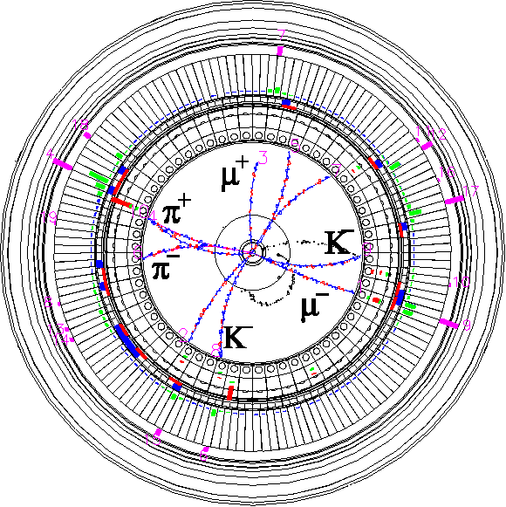


SuperKEKB operation status and overview
The 29th KEKB Accelerator Review Committee
26th October 2026
Kyo Shibata
Inter-University Research Institute Corporation High Energy Accelerator Research Organization (KEK)
大学共同利用機関法人 高エネルギー加速器研究機構 (KEK)

Slide 2
Contents
Introduction
  Challenges for higher luminosity
Operation status since the last KEKB Review
  Works during the shutdowns
  2025c and 2026ab runs
Preparations for the 2027ab run
  Toward 1×10³⁵ cm⁻²s⁻¹
  2027ab run schedule
Summary

Slide 3
Contents
Introduction
  Challenges for higher luminosity
Operation status since the last KEKB Review
  Works during the shutdowns
  2025c and 2026ab runs
Preparations for the 2027ab run
  Toward 1×10³⁵ cm⁻²s⁻¹
  2027ab run schedule
Summary

Slide 4
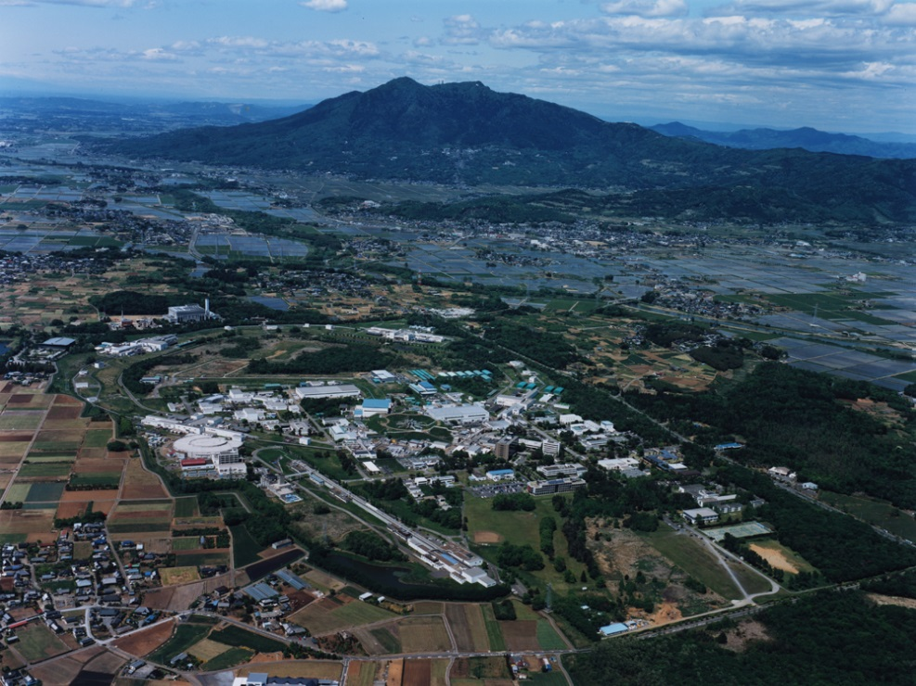
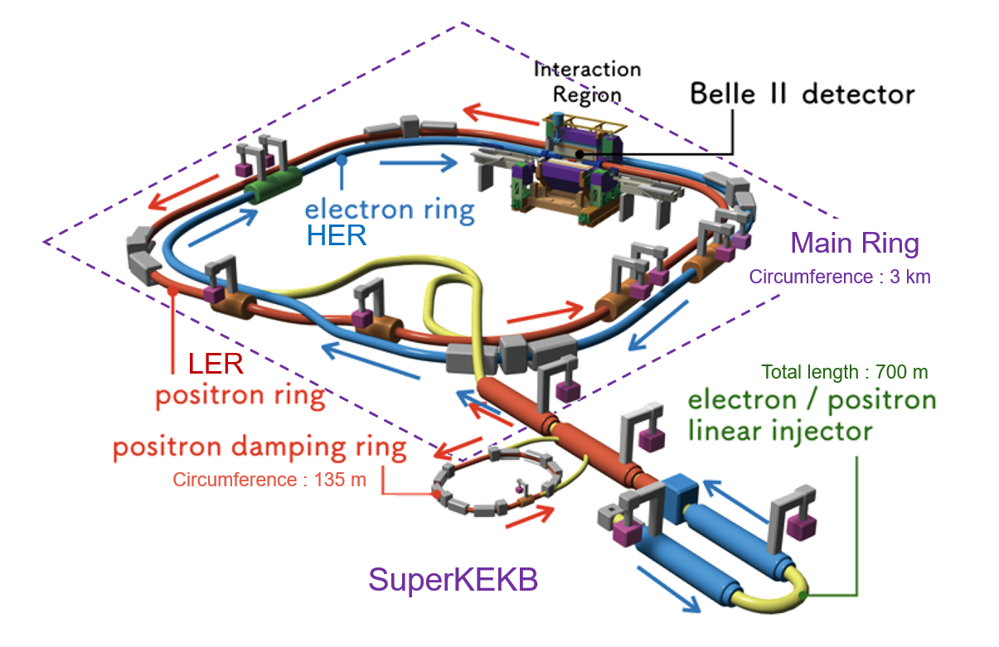

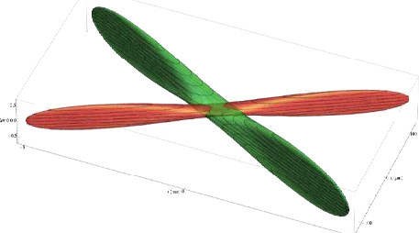
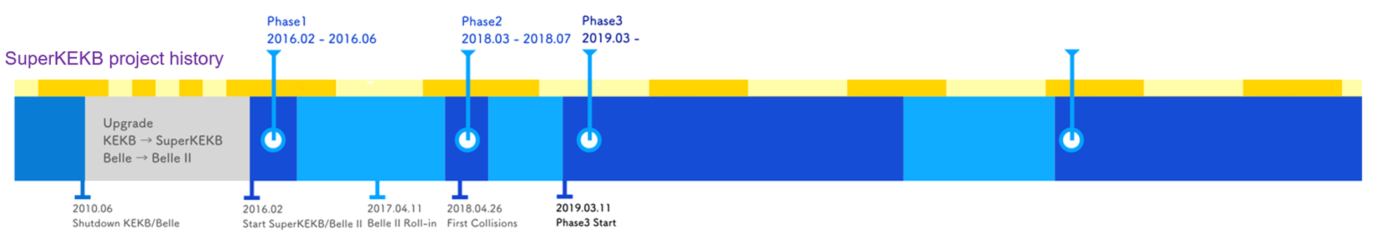
SuperKEKB
SuperKEKB;
  Asymmetric-energy electron-positron collider operating at KEK Tsukuba site
    An upgrade of KEKB B-factory (KEKB)
    High-luminosity machine in search of new physics in the B-meson regime.
  Accelerator complex consisting of;
    Injector (Linac), Positron Damping Ring (DR), Beam Transport Lines (BT), Main Ring (MR) with Belle II Detector
      MR : High Energy Ring (7.0 GeV e-, HER), Low Energy Ring (4.0 GeV e+, LER)
  The world’s first practical implementation of the “nano-beam scheme”
    The only operating collider employing the nano-beam collision scheme envisioned for future Higgs factories.
  Operation started in 2016.
    Physics run with fully instrumented detector (Phase 3 operation) started from 2019.
    Currently we are conducting Phase-3 Run-2 operation.
    Long Shutdown 2 is planned in 2032 for the upgrade.
Mt. Tsukuba
～1 km
SuperKEKB
～1.5 km
Beam Transport Line (BT)
Main Ring (MR)
Linac
KEK Tsukuba site
Damping Ring (DR)
Nano-beam collision scheme (design)
100 nm
Phase1
2016.02-2016.06
Phase2
2018.03-2018.07
Phase3 Run1
2019.03-2022.06
Phase3 Run2
2024.01-
Crossing angle : 83 mrad
https://sndj-web.jp/news/001123.php
2010
2016
2017
2018
2019
2020
2021
2022
2023
2024
2025
2026
1 μm
50 nm
Long Shutdown 1
LS2
5 mm
We are here now.
100 μm

Slide 5
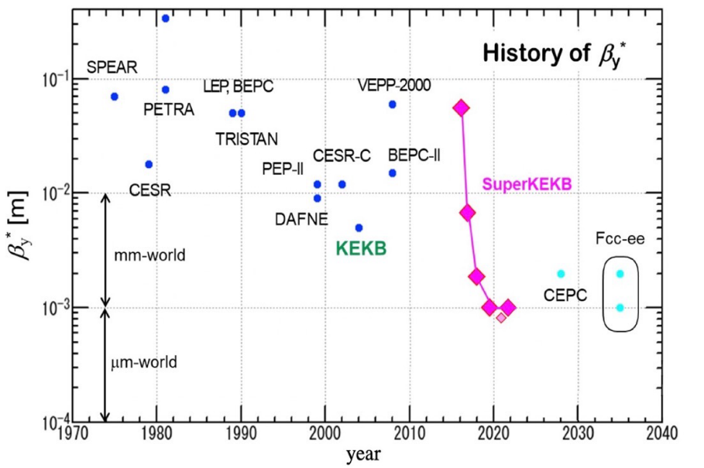
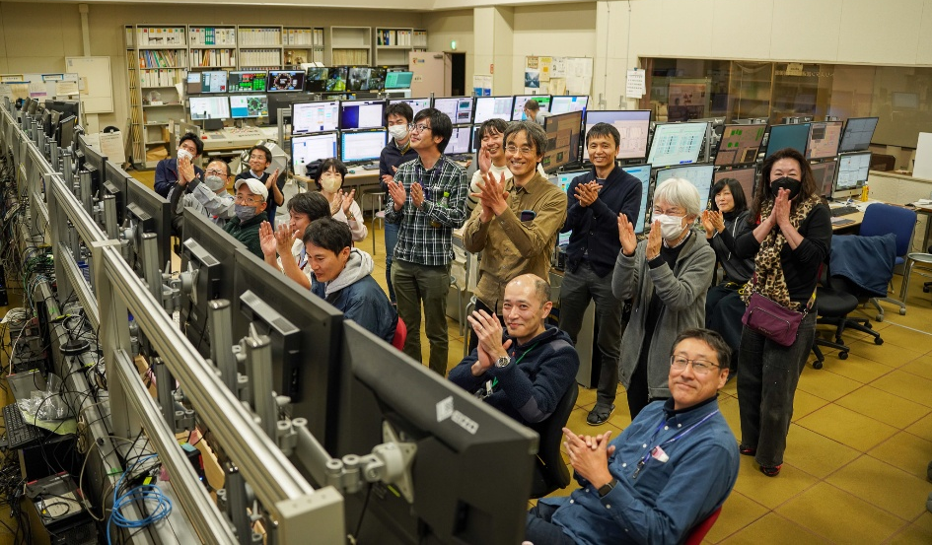
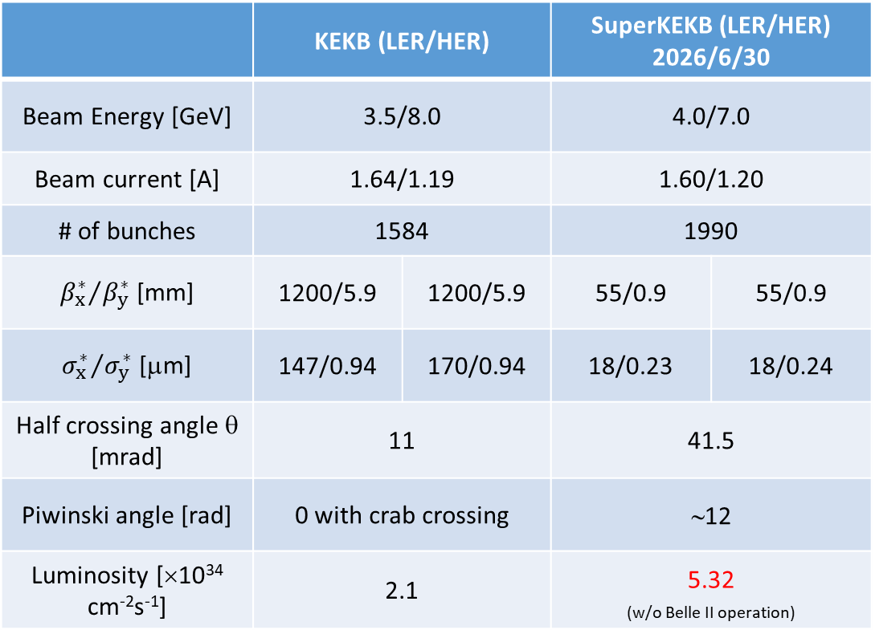
Machine parameters
 | KEKB (LER/HER) |  | SuperKEKB (LER/HER) 2026/6/30
Beam Energy [GeV] | 3.5/8.0 |  | 4.0/7.0
Beam current [A] | 1.64/1.19 |  | 1.60/1.20
# of bunches | 1584 |  | 1990
${β_{x}^{∗}}/{β_{y}^{∗}}$ [mm] | 1200/5.9 | 1200/5.9 | 55/0.9 | 55/0.9
${σ_{x}^{∗}}/{σ_{y}^{∗}}$ [μm] | 147/0.94 | 170/0.94 | 18/0.23 | 18/0.24
Half crossing angle θ [mrad] | 11 |  | 41.5
Piwinski angle [rad] | 0 with crab crossing |  | ∼12
Luminosity [×10³⁴ cm⁻²s⁻¹] | 2.1 |  | 5.32 _{(w/o Belle II operation)}
Design value
5.28 × 10³⁴ cm⁻²s⁻¹
(with Belle II operation)
Control room at the moment of the Lumi. record update!!

Slide 6
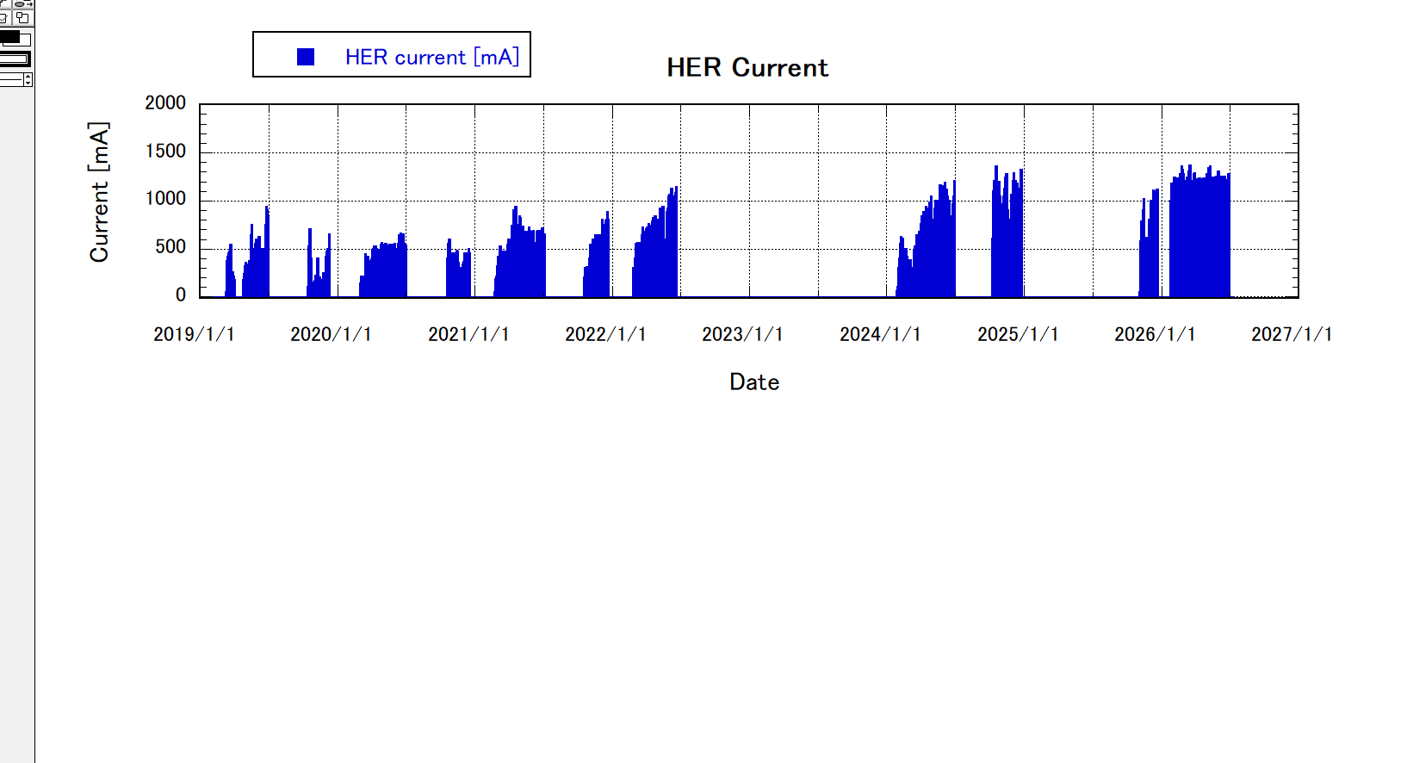
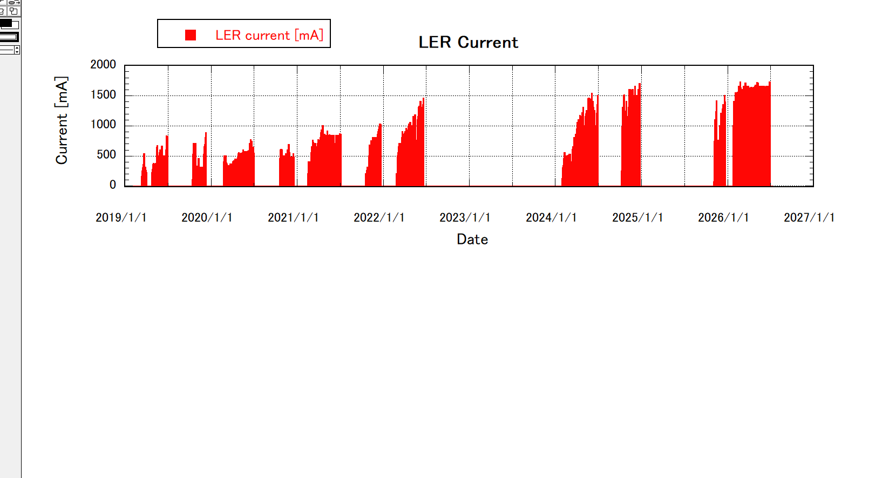
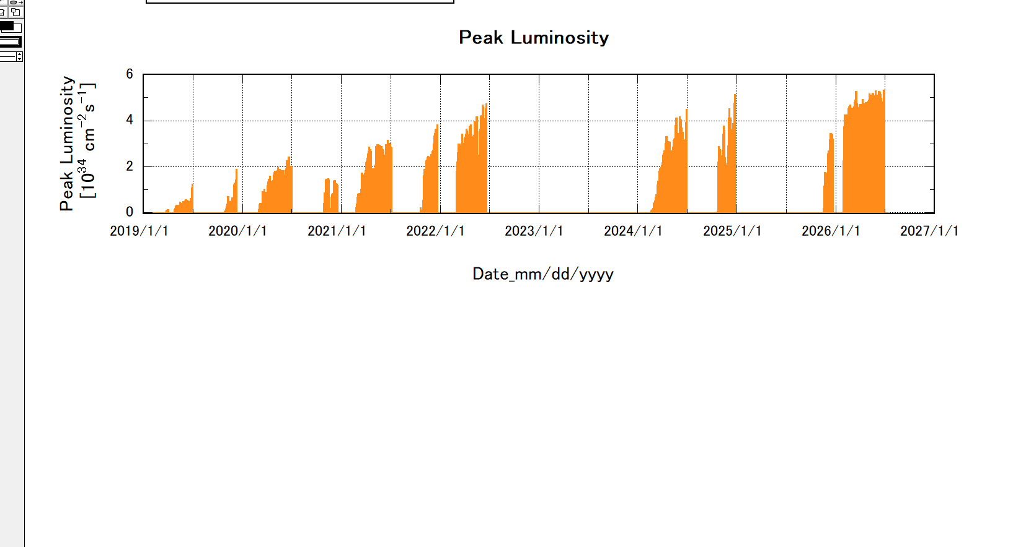
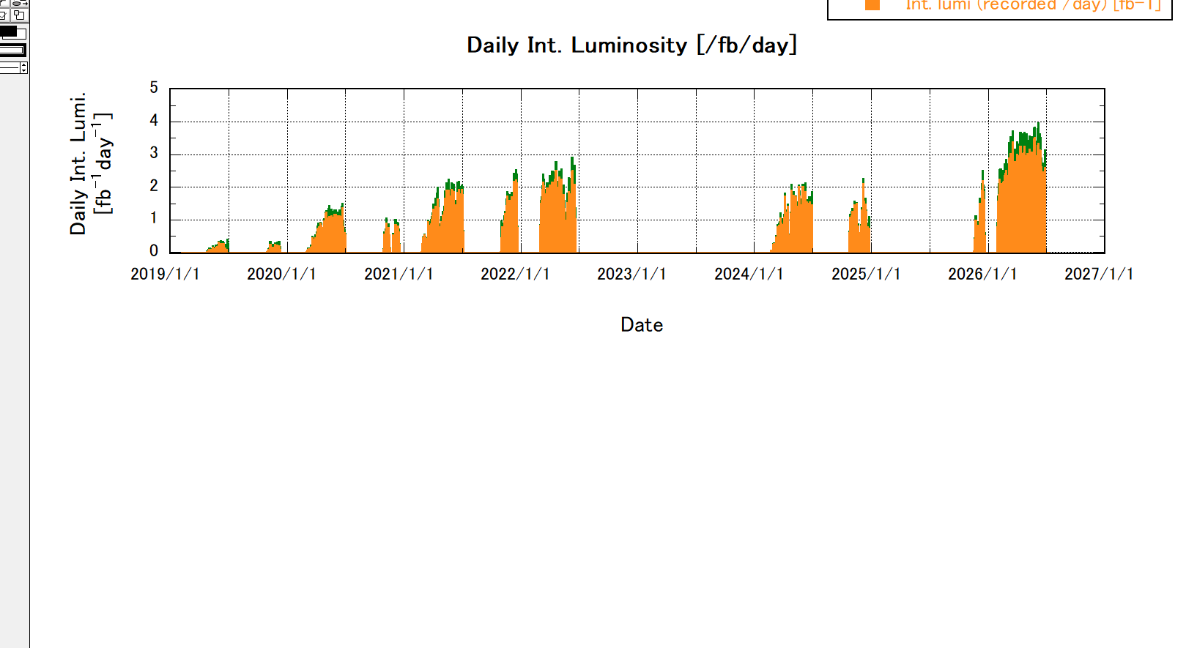
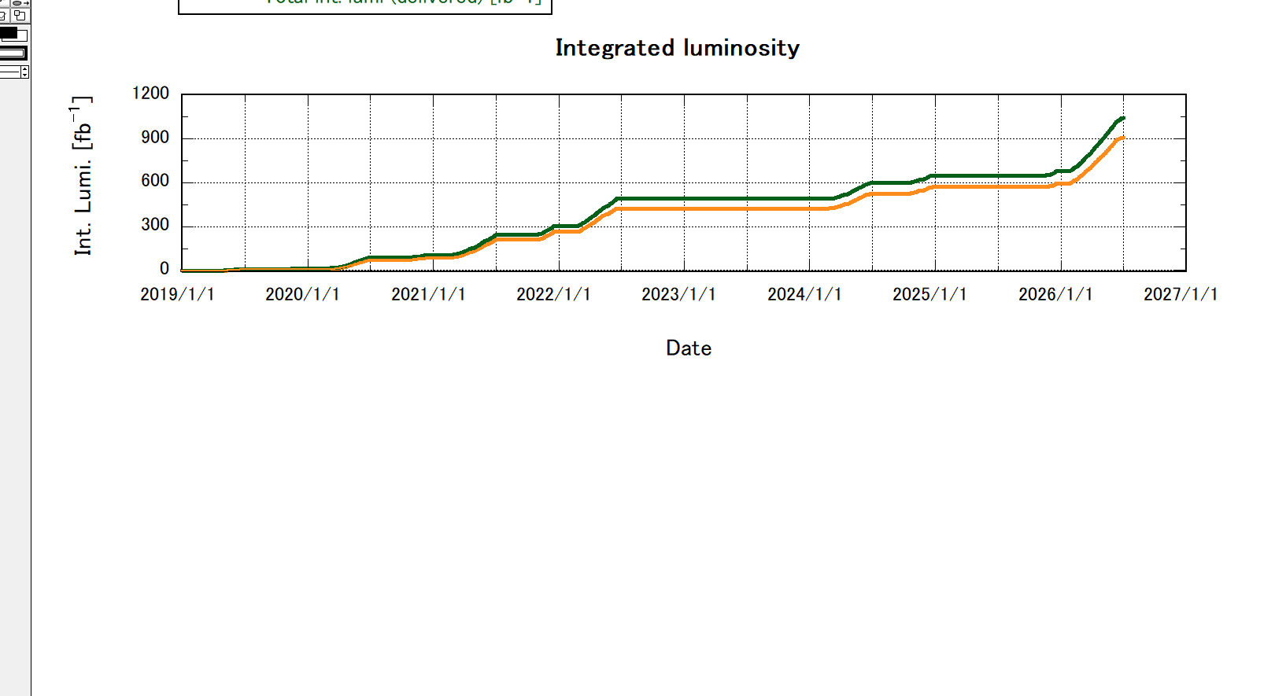
Phase 3 commissioning history
Phase 3
Phase3 operation (2019.March∼);
  Naming rule of Phase3 operation
    “YYYYxx run”
  Scheduling policy
    Concentrating the operation period to improve operational efficiency
      Shortening the winter shutdown (Minimize vacuum work)
      Starting the summer shutdown earlier (Avoid operation in June due to high temp.)
  After last KEKB Review in Feb. 2025:
    Shutdown btw 2024c – 2025c (10-month shutdown)
      2025ab run skipped due to high-voltage electrical substation upgrades.
    2025c run
    Winter shutdown
    2026ab run
    Summer shutdown
      2026c run skipped due to preparation for 2027ab run.
  2027ab will start in Jan. 2027.
Run1
LS1
Run2
2019ab
2019c
2020ab
2020c
2021ab
2021c
2022ab
2024ab
2024c
2025c
2026ab
HER current
1366 mA
ab: End of winter shutdown – Start of summer shutdown (Spring run)
a : End of winter shutdown – March (End of Japanese fiscal year)
b : April – Start of summer shutdown
c: End of Summer shutdown – Start of winter shutdown (Autumn run)
Calendar year
LER current
1726 mA
Peak Lumi.
5.3 × 10³⁴ cm⁻²s⁻¹
Daily Int. Lumi.
3.9 fb⁻¹day⁻¹
Delivered
3.5 fb⁻¹day⁻¹
Recorded
Total Int. Lumi.
1043 fb⁻¹
Delivered
914 fb⁻¹
Recorded
Last KEKB Review

Slide 7
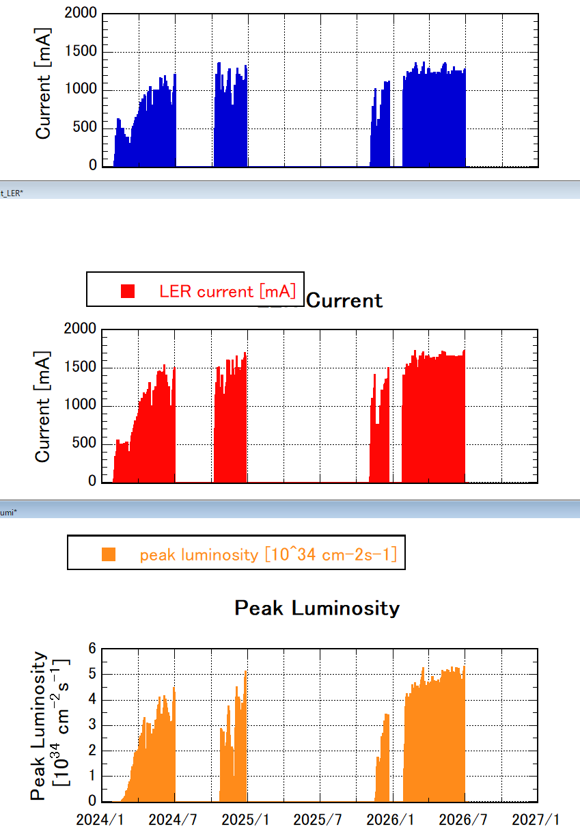
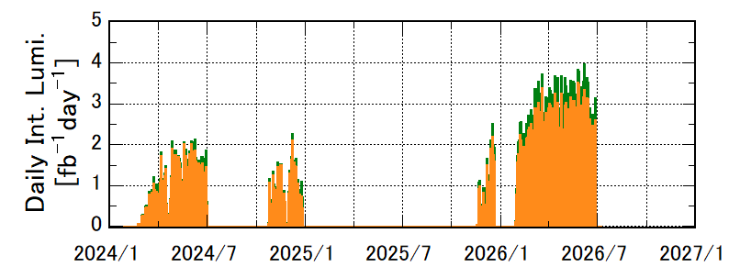
Challenges for higher luminosity
2024ab
2024c
2025c
Challenges in achieving higher peak luminosity
  Low stored beam currents
    Low injection efficiency
    Short beam lifetime
    Hardware limitations (e.g., vacuum leaks due to high beam current)
    Limitations due to radiation dose
  Low specific luminosity
    Decrease in specific luminosity with increasing beam currents
    Unexplained emittance blow-up
Challenges in achieving higher integrated luminosity
  Sudden beam loss (SBL)
    Limits beam current increases, thereby limiting peak luminosity.
  Operational interruptions due to equipment failures
  Operational interruptions due to aging equipment and infrastructure
  Reduced operation time due to rising electricity costs
2026ab
1354
1366
1210
1118
1539
1699
1726 mA
1500
4.5
5.1
5.3
3.4
3.5
2.0
2.1
2.2
Machine performance has been gradually improved by addressing these issues.
We have repeatedly achieved new peak luminosity records.

Slide 8
Contents
Introduction
  Challenges for higher luminosity
Operation status since the last KEKB Review
  Works during the shutdowns
  2025c and 2026ab runs
Preparations for the 2027ab run
  Toward 1×10³⁵ cm⁻²s⁻¹
  2027ab run schedule
Summary

Slide 9
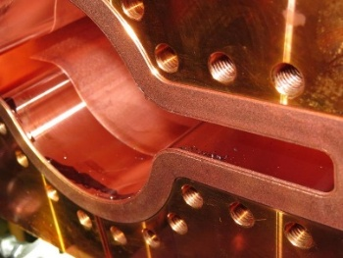
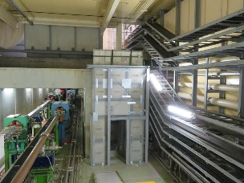
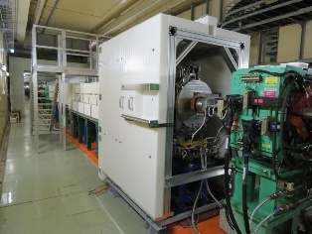
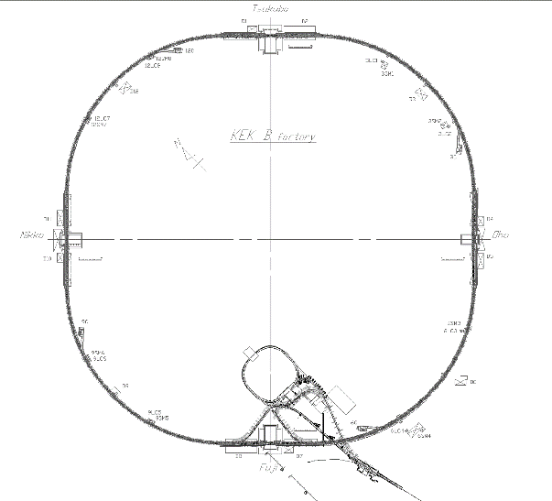
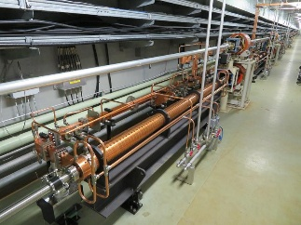
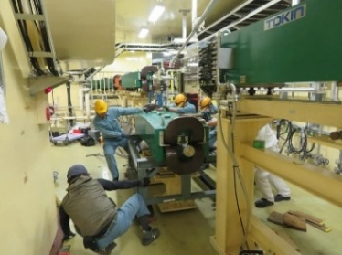
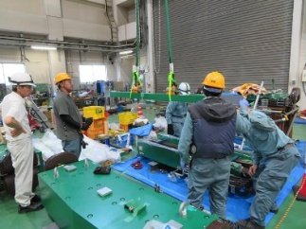
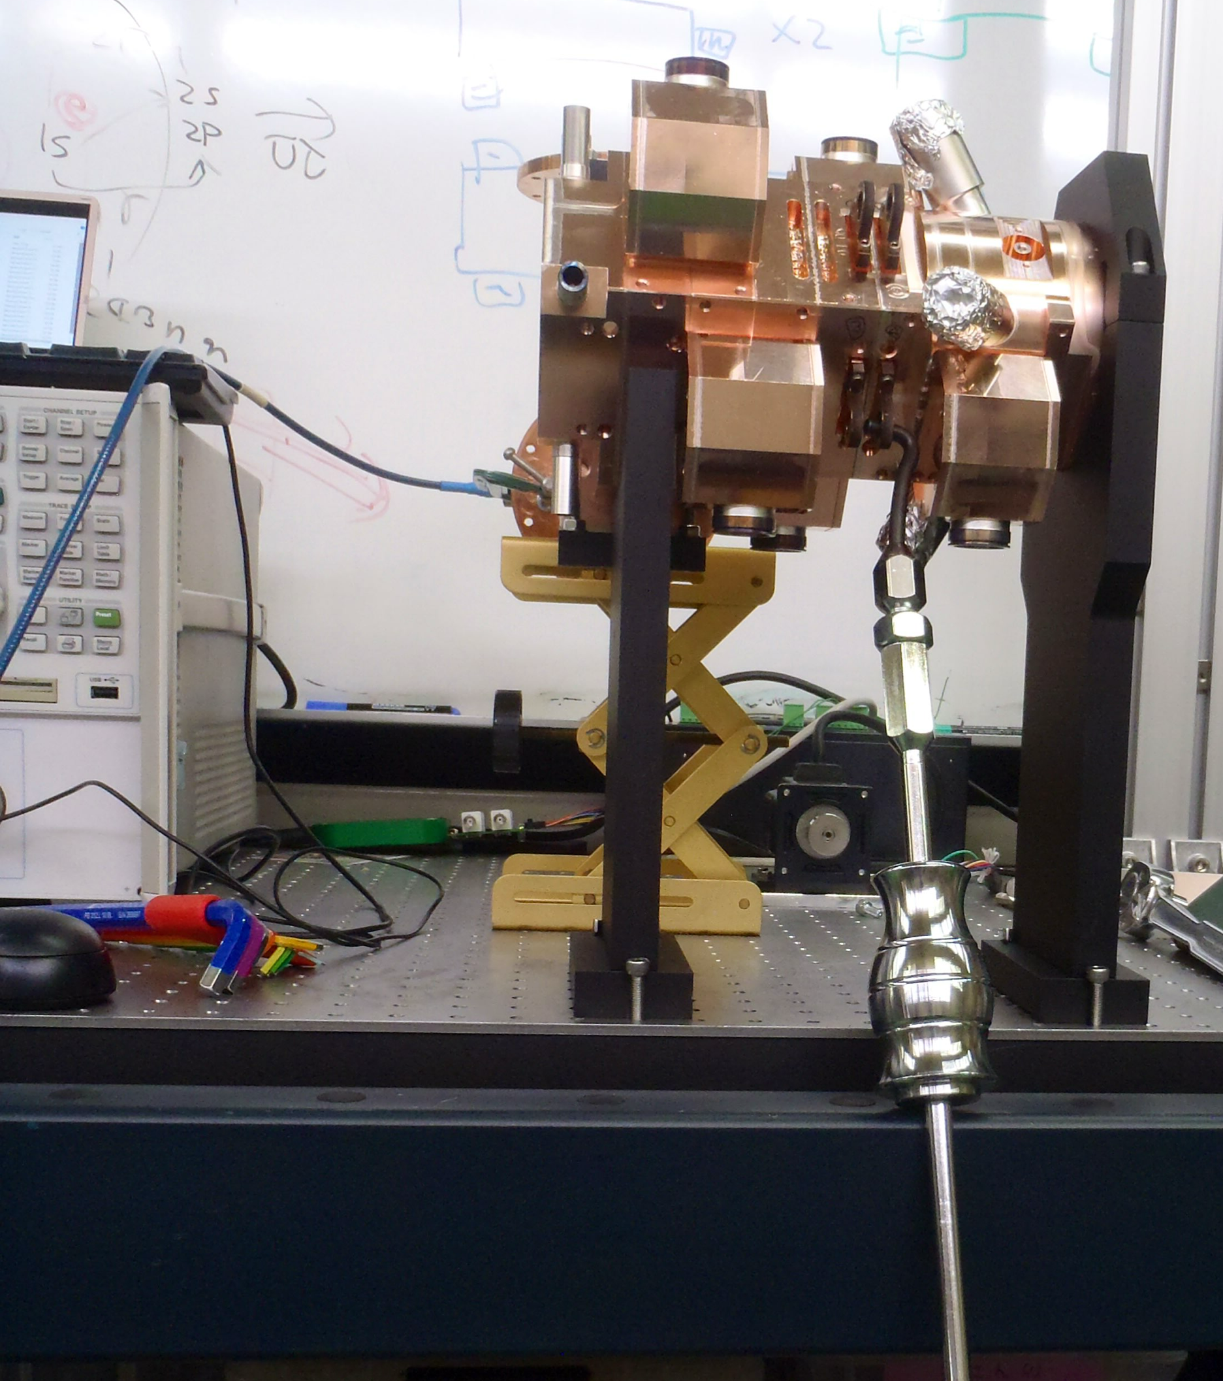
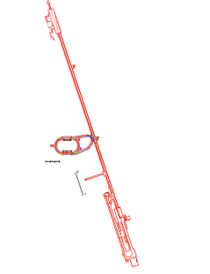
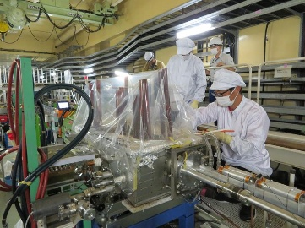
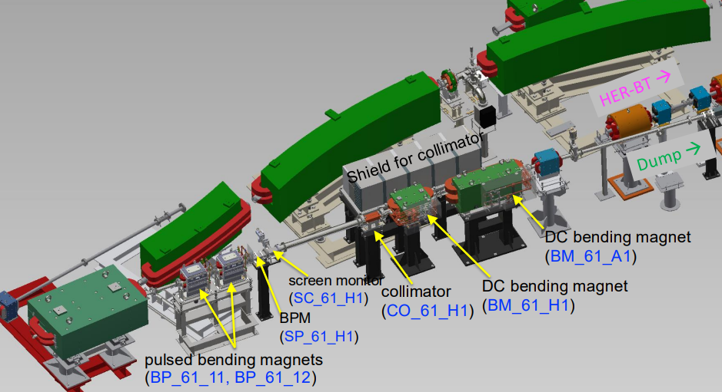
Shutdown between 2024c and 2025c
Countermeasures against SBL (highest priority)
  Extensive VACSEAL removal during the long shutdown
    The effectiveness of VACSEAL removal in reducing SBL frequency was confirmed during the 2024c run.
  Internal cleaning of beam pipes in the IR and LER wiggler sections
Countermeasures to increase beam currents
  Beam pipe realignment at the injection point
  Reinforcement of radiation shielding in the NLC section
  RF electron gun replacement
  Installation of an energy compression system (ECS) in BTe
  Magnet pole replacement in BTp
  Relocation and installation of fast kickers in Linac and BT
  Development of a new electron beam diagnostic line at Linac end
Radiation shield reinforcement
Last KEKB Review
Now
Beam pipe cleaning
New ECS (BTe)
Magnet pole replacement (BTp)
New RF gun
Beam pipe realignment at LER inj. point
New beam diagnostic line (e-)

Slide 10
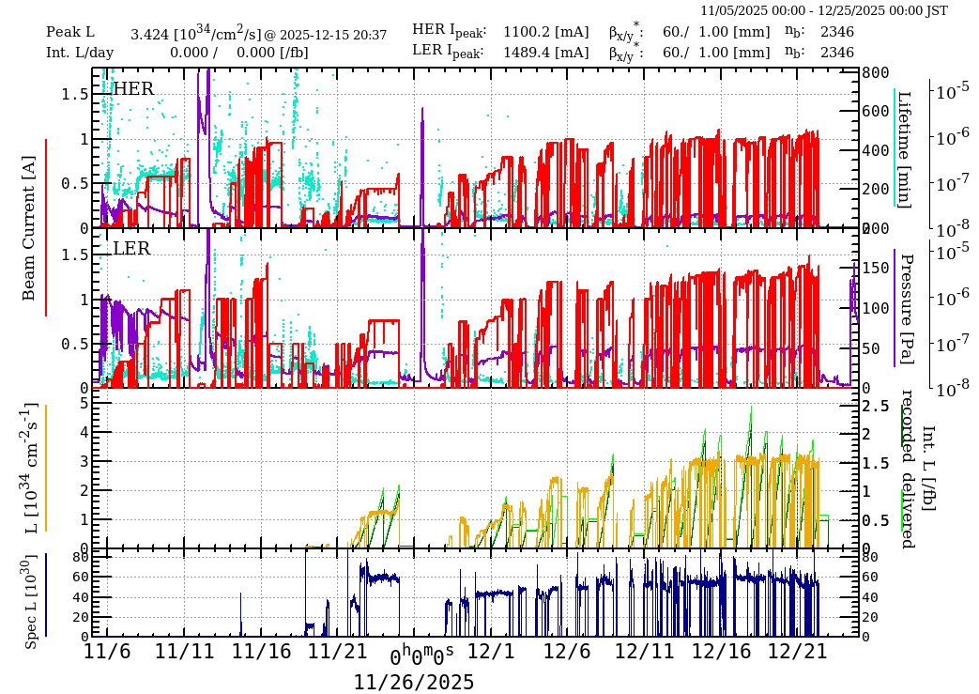
2025c run overview
Operation policy for 2025c-2026ab run
  The highest priority was integrated luminosity (recorded) > 425 fb⁻¹ (> 1 ab⁻¹ in total)
    4 days per 3-week cycle are allocated to machine tuning, development, maintenance, etc.
    The winter shutdown was initially planned to last approximately two weeks.
2025c summary
  The effectiveness of VACSEAL removal in reducing SBL was confirmed.
  Synchrotron injection was demonstrated in the HER.
  Frequent equipment problems prevented us from establishing stable operation.
    As a result of major issues, the available operation time was reduced.
      HER abort kicker malfunction
      Degradation of the QCS cryogenic system performance
      Abnormal pressure increase in the LER ARES cavity
    The winter shutdown was extended from two weeks to four weeks to address these issues.
HER synchrotron inj.
HER betatron inj.
Last KEKB Review
Now
HER abort kicker malfunction
Vacuum burst at ARES D05A
Vacuum scrubbing

Slide 11
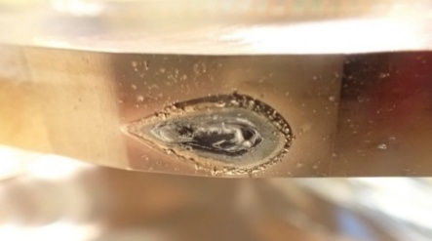
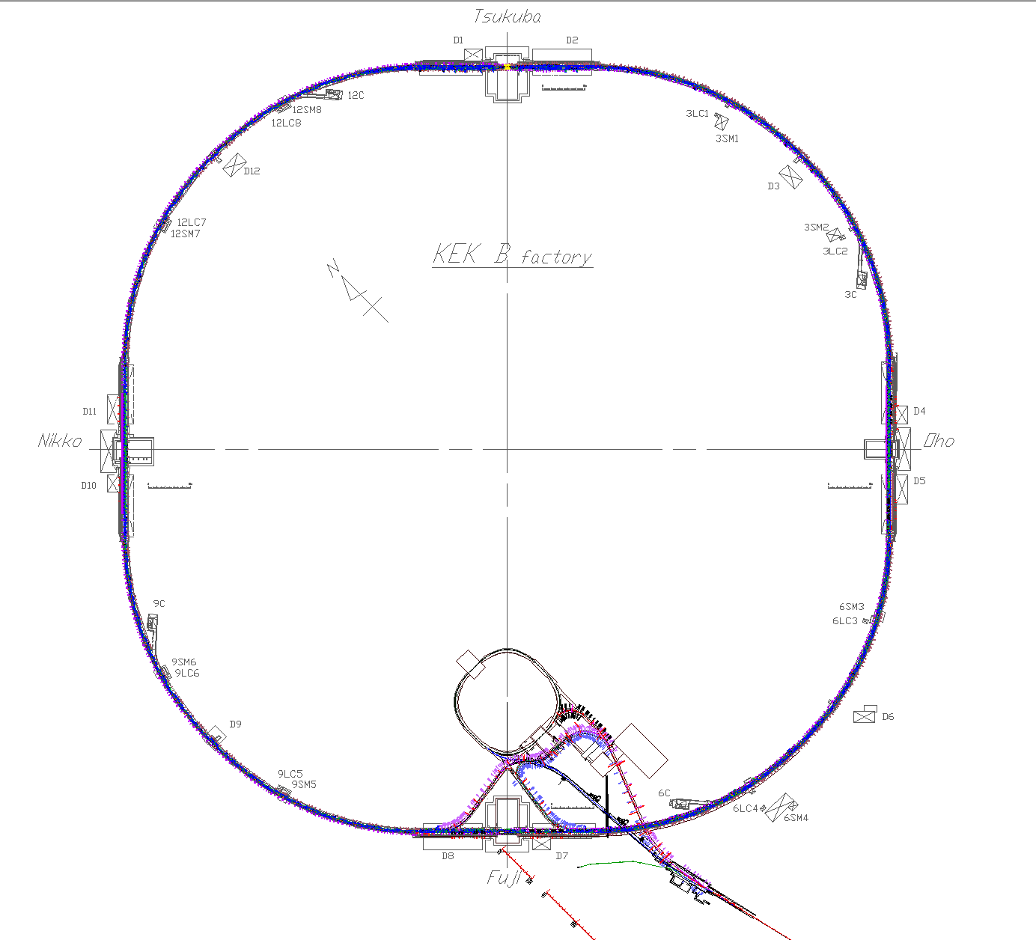
Winter shutdown btw. 2025c – 2026ab
Countermeasures against problems identified during 2025c run
  Verification of the integrity of the QCS cryogenic system and the cryostat insulation vacuum vessel
  Limiting vacuum work to the minimum necessary
    Replacement of damaged collimator jaws (HER)
      Collimator jaws were significantly damaged by Abort Kicker PS malfunction issue.
    Internal check of bellows chambers (LER)
      Vacuum spikes were observed with SBLs.
  Optical alignment of the SR monitor in the BTe
The MR startup was postponed to late January
  The cryogenic system was shut down for inspection during the winter shutdown.
The 2026ab operation schedule was revised.
  The run period was extended from the originally planned end of May to the end of June.
    From 2027 onward, the spring run is planned to end in May to avoid operation during hot weather.
Extensive injection beam tuning was carried out before the MR startup
  Machine-learning-based tools for injection beam tuning were developed and put into full-scale operation.
Last KEKB Review
Vacuum work
Collimator jaw replacement (HER)
Internal check and bellows chamber replacement (LER)
Replacement of the gasket with a vacuum leak (LER)

Slide 12
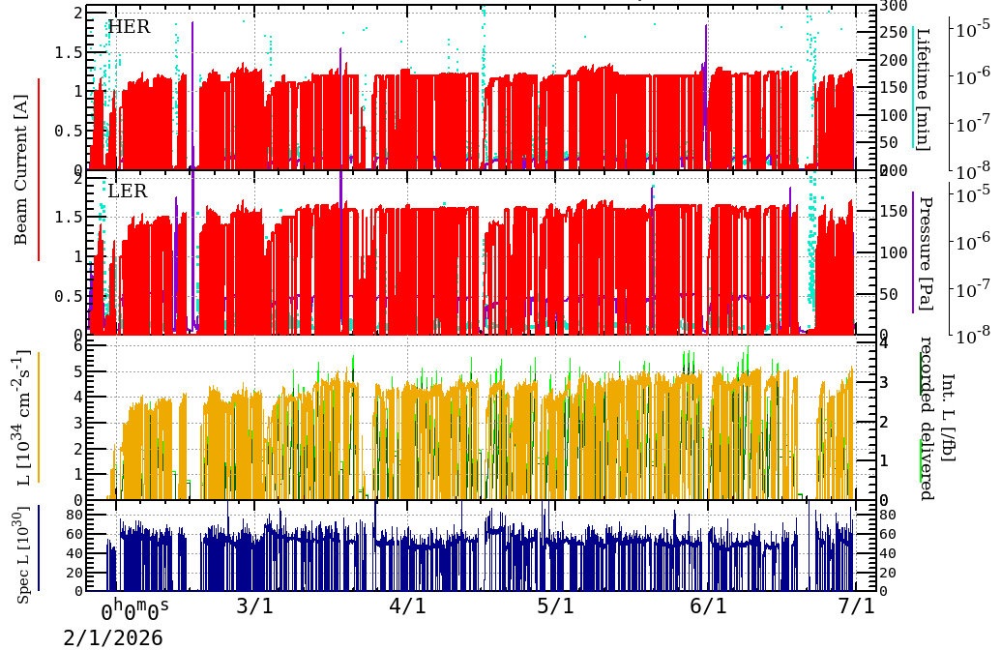
2026ab run overview
2026ab summary
  Highest priority is integrated luminosity (recorded) > 400 fb⁻¹ (> 1 ab⁻¹ in total)
    Machine study time was allocated after it became clear that 0.9 ab⁻¹ was achievable.
    However, sufficient study time could not be secured due to a campus-wide power outage.
    Further squeezing was postponed to 2027ab run.
  New records were achieved for various luminosities.
    Peak lumi :
      5.32 × 10³⁴ cm⁻²s⁻¹ (Belle II HV OFF)
      5.28 × 10³⁴ cm⁻²s⁻¹ (Belle II HV ON)
    Daily integrated lumi.:
      3.50 (recorded) / 3.95 (delivered) fb⁻¹/day
    Integrated lumi. per 7 days:
      21.8 (recorded) / 24.2 (delivered) fb⁻¹/7day
    Accumulated luminosity:
      2026ab: 314 (recorded) / 361 (delivered) fb⁻¹
      Total: 915 (recorded) / 1043 (delivered) fb⁻¹
  Stable operation was established at a peak luminosity of ∼5×10³⁴ cm⁻²s⁻¹
    Peak luminosity record was updated by reducing β_{y}* from 1.0 mm to 0.9 mm.
    New maximum beam current records were also achieved.
Last KEKB Review
Now
5.32× 10³⁴ cm⁻²s⁻¹
β*_{y} = 1 mm
12
β*_{y}-squeezing
β*_{y} = 0.9 mm

Slide 13
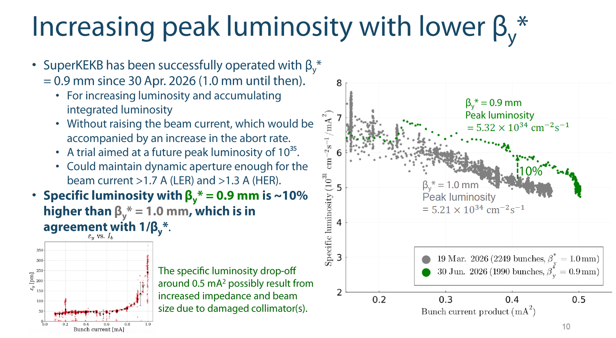
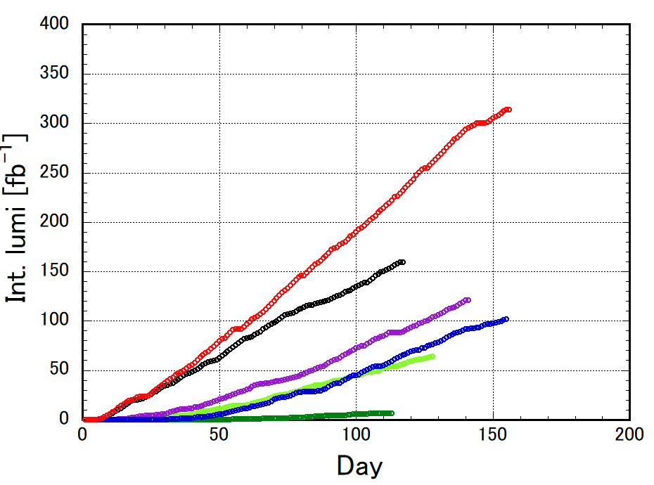
2026ab run overview
Specific luminosity gain obtained by β_{y}*-squeezing was confirmed.
  Specific luminosity increased by 10% by β_{y}*-squeezing from 1.0 mm to 0.9 mm.
The rate of integrated luminosity accumulation increased significantly.
  Higher peak luminosity and more stable operation were achieved during the 2026ab run.
  1.4 times the accumulation rate achieved in the 2022ab run.
Comparison of integrated luminosity during spring runs (2019ab – 2026ab)
G. Mitsuka
2026ab
× ∼1.4
2022ab
2021ab
2024ab
2020ab
2019ab

Slide 14
2026ab run overview
Challenges in achieving higher luminosity remained.
  Degradation of specific luminosity with increasing beam current
  Decrease in injection efficiency with increasing beam current
    Short beam lifetime and large beam-beam effect
  SBLs
    Beam currents were not aggressively increased because of frequent SBL events accompanied by QCS quenches.
    SBLs in the HER became more prominent, though the frequency of SBL in the LER decreased.
  Other concerns about increasing beam currents
    Vacuum pressure deterioration in ARES cavity, Beam pipe heating in the wiggler sections, etc.
    Addressing these issues was identified as essential for increasing beam currents and luminosity in the 2027ab run
  Hardware failures due to aging caused prolonged interruptions to operation
    Failures of the injection kicker power supply, QCS cryogenic gas line solenoid valve, air conditioner at the control room, etc.
    Reduced cooling water flow in the BT magnets also caused operation interruption
G. Mitsuka
These challenges are considered major obstacles to achieving the performance targets for the 2026ab run.
 | Plan | Achieved
Peak luminosity | 6.3 × 10³⁴ | 5.3 × 10³⁴ | cm⁻²s⁻¹
Beam current (LER/HER) | 2.00/1.60 | 1.72/1.37 | A
Total integrated luminosity | 1 | 0.92 | ab⁻¹

Slide 15
Contents
Introduction
  Challenges for higher luminosity
Operation status since the last KEKB Review
  Works during the shutdowns
  2025c and 2026ab runs
Preparations for the 2027ab run
  Toward 1×10³⁵ cm⁻²s⁻¹
  2027ab run schedule
Summary

Slide 16
Summer shutdown btw. 2026ab – 2027ab
Major activities
  Linac
    RF electron gun replacement
      Eliminate concerns about performance degradation due to manufacturing defects.
    Repair of fast kicker power supplies
      Repair the fast kicker power supplies that failed during the 2026ab run
    Replacement of 12 aging accelerating structures with new ones
  BT
    Improvement of cooling water quality for magnets
      Prevent operation interruptions caused by cooling water interlocks.
    Installation of additional magnet temperature sensors
      Enable monitoring of temperature increases caused by reduced cooling water flow.
    Upgrade of the beam position monitor signal readout system
      Eliminate signal overlap between the first and second bunches, enabling more precise beam control.
Last KEKB Review
Now
Expected benefits
Improved injection efficiency,
Higher beam currents,
Increased peak luminosity
Reduced downtime,
increased integrated luminosity
Improved injection efficiency,
Higher beam currents,
Increased peak luminosity
・・・・・・・

Slide 17
Summer shutdown btw. 2026ab – 2027ab
Major activities
  Injection point
    Upgrade of the LER injection kicker power supplies
      Prevent beam aborts and QCS quenches caused by accidental kicker firing.
    Replacement of the LER injection beam pipe
      Restore the injection beam aperture reduced by beam pipe deformation
  MR
    Investigation and countermeasures against vacuum pressure deterioration in LER RF cavities
      Two cavities were taken out of operation due to vacuum pressure deterioration during the 2025c-2026ab runs.
      The causes of the vacuum pressure deterioration were identified.
    Installation of water-cooled bellows chambers in the LER wiggler sections
      Reduce temperature rises caused by SR downstream of the wigglers and prevent vacuum leaks.
    Installation of additional beam loss monitors to enable faster beam aborts.
    Investigation of the causes of SBLs
      Internal inspection of beam pipes by X-ray camera.
    Replacement of damaged collimator jaws and water-cooled collimators
Expected benefits
⋅⋅⋅⋅⋅⋅⋅⋅⋅⋅⋅⋅⋅⋅⋅⋅⋅⋅⋅⋅⋅⋅⋅⋅
Reduced downtime,
increased integrated luminosity
⋅⋅⋅⋅⋅⋅⋅⋅⋅⋅⋅⋅⋅⋅⋅⋅⋅⋅⋅⋅⋅⋅⋅⋅
Improved injection efficiency,
Higher beam currents,
Increased peak luminosity
Higher beam currents,
Increased peak luminosity
More stable operation,
Reduced beam background,
Higher beam currents,
Faster beam aborts,
increased peak and integrated luminosity

Slide 18
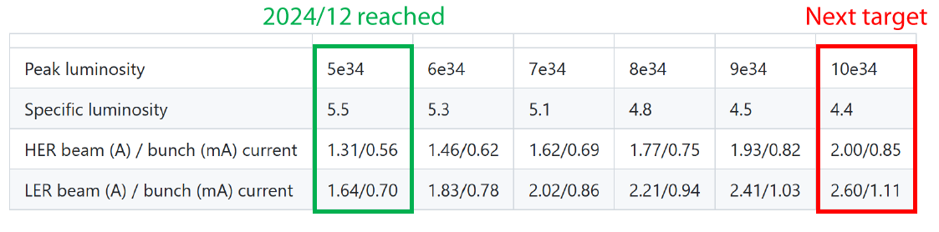
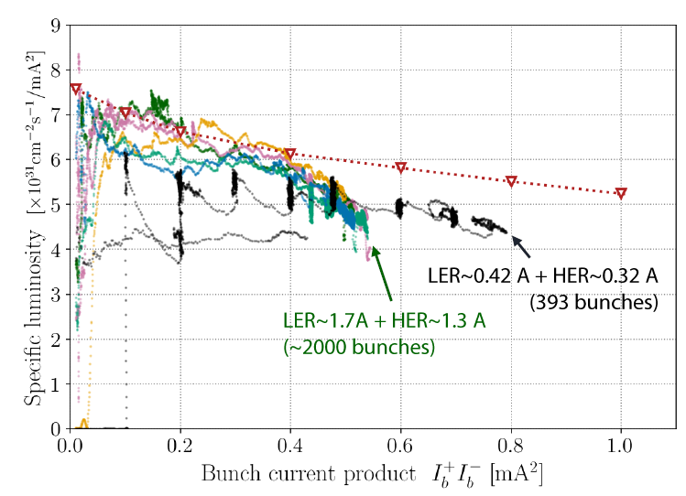
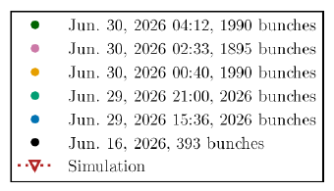
Toward 1 × 10³⁵ cm⁻²s⁻¹
Target operating point:
  Specific luminosity : 4.4 × 10³¹ cm⁻²s⁻¹mA⁻²
    β_{y}* : 0.8 ∼ 0.9 mm
  LER current : 1726 -> 2600 mA
  HER current : 1366 -> 2000 mA
  Strategy will be presented by Mitsuka-san at the SuperKEKB Project Advisory Committee review on the afternoon of October 28.
Key Challenges
  Achieving higher beam currents
    Improve injection efficiency at high currents
    Increase lifetime and dynamic aperture
    Mitigate beam-beam related injection losses
    Mitigate hardware limitations
  Mitigating specific luminosity degradation
    Understand and mitigate emittance blow-up
  Improving operational stability
    Reduce SBL and QCS quenches
    Minimize beam losses and Belle II backgrounds
  Prevent equipment failures and operational interruptions
    Address aging equipment and infrastructure
G. Mitsuka
Toward 1 × 10³⁵ cm⁻²s⁻¹
Countermeasures and action plans are being developed by hardware groups and task forces
Hardware groups:
  Magnet, Vacuum, RF, Control/Monitor, Gun, Cryogenics, Facility
Commissioning task forces:
  Current/Injection, Beam-beam, ML/AI beam tuning, SBL
Countermeasures and action plans will be presented by the respective groups and task forces.

Slide 19
2027 run schedule
2026c
December
Sun | Mon | Tue | Wed | Thu | Fri | Sat
29 | 30 | 1 | 2 | 3 | 4 | 5
6 | 7 | 8 | 9 | 10 | 11 | 12
13 | 14 | 15 | 16 | 17 | 18 | 19
20 | 21 | 22 | 23 | 24 | 25 | 26
27 | 28 | 29 | 30 | 31 | 1 | 2
The 2027 spring run (2027ab run) will start in January 2027.
  Extensive injection beam tuning will be carried out before the 2027ab run.
    Linac operation started on September 14.
    BT/DR operation is scheduled to start on November 30.
    Linac, BT, and DR operation for injection beam study and tuning will continue in parallel with MR start-up activities.
  MR operation will start on Jan. 25.
    Operation will stop on May 31.
    126 days of MR operation.
    A detailed plan for the 2027ab run will be presented by Mitsuka-san at the SuperKEKB Project Advisory Committee review on the afternoon of October 28.
The 2027 autumn run may start in November.
  7-month run (April, May, Nov., Dec., Jan, Feb, March.) in JFY2027.
  Subject to budget availability and electricity costs.
    The JFY2027 budget is expected to be finalized in December.
Linac
Linac+BT/DR
Fuji mode
Linac+BT/DR
Fuji mode
Linac+BT/DR
Fuji mode
Fuji mode
Linac+BT/DR
Linac/BT/DR
Study&Tuning
2027a
January
Sun | Mon | Tue | Wed | Thu | Fri | Sat
27 | 28 | 29 | 30 | 31 | 1 | 2
3 | 4 | 5 | 6 | 7 | 8 | 9
10 | 11 | 12 | 13 | 14 | 15 | 16
17 | 18 | 19 | 20 | 21 | 22 | 23
24 | 25 | 26 | 27 | 28 | 29 | 30
31 | 1 | 2 | 3 | 4 | 5 | 6
Linac
Linac+BT/DR
Beam Shutter mode
Linac+BT/DR
Beam Shutter mode
Linac+BT/DR
Beam Shutter mode
MR
MR
MR operation
2027b
End of May
Sun | Mon | Tue | Wed | Thu | Fri | Sat
23 | 24 | 25 | 26 | 27 | 28 | 29
30 | 31 | 1 | 2 | 3 | 4 | 5
126 days
MR
MR
Linac+BT/DR

Slide 20
Contents
Introduction
  Challenges for higher luminosity
Operation status since the last KEKB Review
  Works during the shutdowns
  2025c and 2026ab runs
Preparations for the 2027ab run
  Toward 1×10³⁵ cm⁻²s⁻¹
  2027ab run schedule
Summary

Slide 21
Summary
Significant progress was made during the 2026ab run.
  New luminosity records were achieved, with a peak luminosity of 5.32 × 10³⁴ cm⁻²s⁻¹.
  More stable operation improved the integrated luminosity accumulation rate.
Several challenges remain for further luminosity improvement.
  Higher beam currents and improved specific luminosity are essential.
  SBLs, QCS quenches, injection limitations, and equipment failures remain major concerns.
Preparations are underway for the 2027ab run.
  Countermeasures are being implemented to improve beam performance and operational stability.
  Further studies are needed to understand the present performance limitations.
We would particularly appreciate the ARC’s technical review and recommendations on our understanding of the present performance limitations, and our plans to overcome them.

Slide 22
Fin.
Thank you for your attention.
Inter-University Research Institute Corporation High Energy Accelerator Research Organization (KEK)
大学共同利用機関法人 高エネルギー加速器研究機構 (KEK)

Slide 23
Back up
Inter-University Research Institute Corporation High Energy Accelerator Research Organization (KEK)
大学共同利用機関法人 高エネルギー加速器研究機構 (KEK)

Slide 24
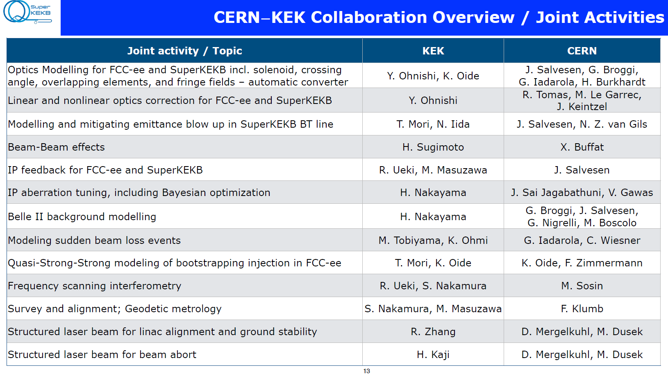
International collaboration
A beam-beam TF is currently active with participation from CERN, China, and KEK
Joint R&D on the QCS upgrade is being conducted with FNAL and BNL.
Joint R&D on the dithering system with SLAC.

Slide 25
****
***

