Slide 1






Overview and status of the
Future Circular Collider Study
M. Benedikt, F. Zimmermann
gratefully acknowledging input from FCC coordination group,
global FCC design study team and all other contributors
PS
LHC
SPS
FCC
HE-LHC
Work supported by the European Commission under the HORIZON 2020 projects EuroCirCol, grant agreement 654305; EASITrain, grant agreement no. 764879; ARIES, grant agreement 730871; and E-JADE, contract no. 645479

Slide 2

Contents
Introduction to FCC study goals and organisation
Results of FCC phase 1 conceptual design study and input to European Particle Physics Strategy Update (EPPSU)
Next steps and outlook 2019 – 2026

Slide 3
Summary: European Strategy Update 2013
Design studies and R&D at the energy frontier
….“to propose an ambitious post-LHC accelerator project at CERN by the time of the next Strategy update”:
d) CERN should undertake design studies for accelerator projects in a global context,
with emphasis on proton-proton and electron-positron high-energy frontier machines.
These design studies should be coupled to a vigorous accelerator R&D programme, including high-field magnets and high-gradient accelerating structures,
in collaboration with national institutes, laboratories and universities worldwide.
http://cds.cern.ch/record/1567258/files/esc-e-106.pdf

Slide 4
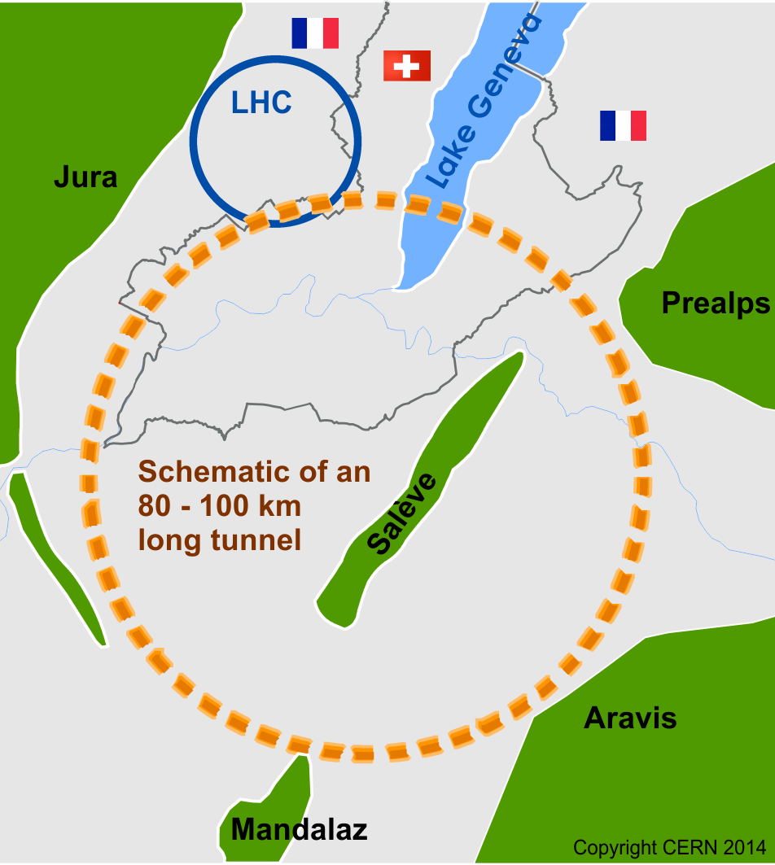

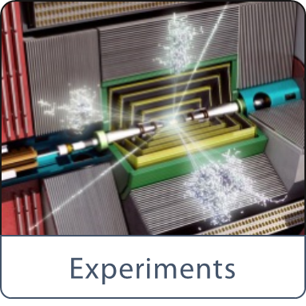
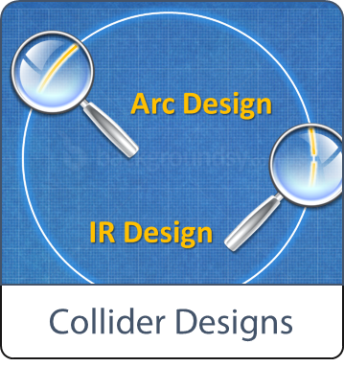
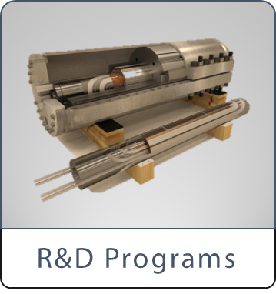


Future Circular Collider Study - Scope
International FCC collaboration with CERN as host lab to study:
~100 km tunnel infrastructure in Geneva area, linked to CERN
e⁺e⁻ collider (FCC-ee), → potential first step
pp-collider (FCC-hh) → long-term goal, defining infrastructure requirements
HE-LHC with FCC-hh technology
Ions and lepton-hadron options with hadron colliders
HE-LHC
~16 T ⇒ 100 TeV pp in 100 km

Slide 5
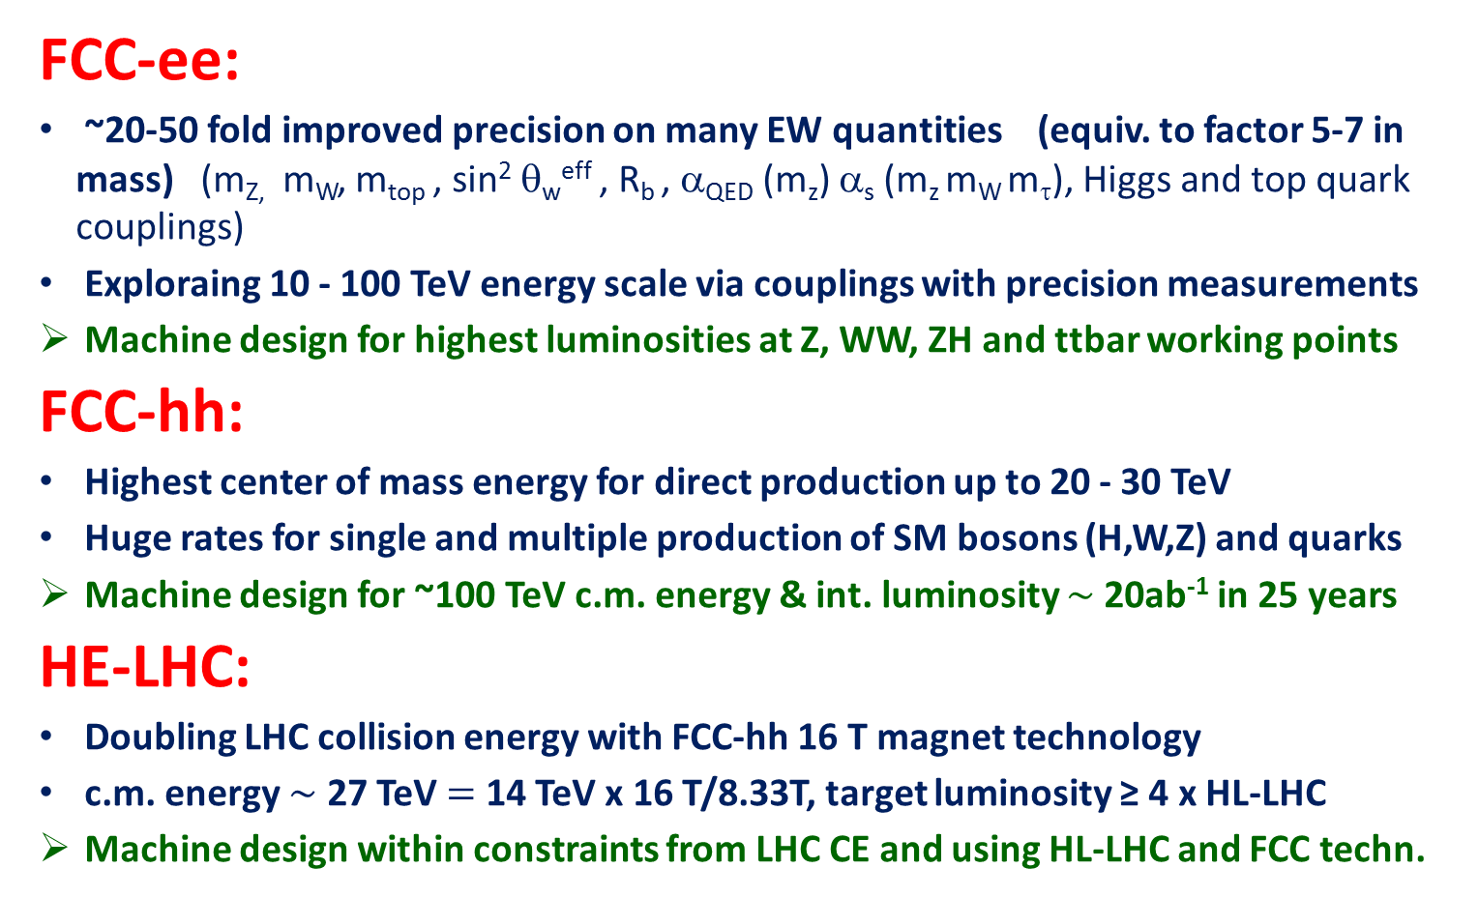
FCC : physics and performance targets
FCC-ee:
~20-50 fold improved precision on many EW quantities (equiv. to factor 5-7 in mass) (m_{Z,} m_{W}, m_{top} , sin² θ_{w}^{eff} , R_{b} , α_{QED} (m_{z}) α_{s} (m_{z} m_{W} m_{τ}), Higgs and top quark couplings)
Exploraing 10 - 100 TeV energy scale via couplings with precision measurements
Machine design for highest luminosities at Z, WW, ZH and ttbar working points
FCC-hh:
Highest center of mass energy for direct production up to 20 - 30 TeV
Huge rates for single and multiple production of SM bosons (H,W,Z) and quarks
Machine design for ~100 TeV c.m. energy & int. luminosity $\sim$20ab⁻¹ in 25 years
HE-LHC:
Doubling LHC collision energy with FCC-hh 16 T magnet technology
c.m. energy $\sim$ 27 TeV $=$ 14 TeV x 16 T/8.33T, target luminosity ≥ 4 x HL-LHC
Machine design within constraints from LHC CE and using HL-LHC and FCC techn.

Slide 6
FCC study organization and governance
CERN COUNCIL
EPPSU
CERN DG
Collaboration Board
1 person/inst.
Chairs:
L. Rivkin (2014-17)
P. Chomaz (2018 -)
Steering Committee
2-3 persons/region
Chairs & ECFA repres.:
M. Krammer (2014-16)
P. Campana (2017 -)
Advisory Committee
1-2 experts/field
Chair:
G. Dissertori
FCC Study
Coordination
Hadron Collider Physics Experiments
Lepton Collider
Physics Experiments
e-p
Physics Experiments Accelerators
Hadron
Injectors
Hadron
Collider
Lepton
Injectors
Lepton
Collider
Accelerator
R&D
Technologies
Infra-structures
Operation
Costing Planning

Slide 7


CDR Study Time Line (from 2014)
2014 |  |  |  | 2015 |  |  |  | 2016 |  |  |  | 2017 |  |  |  | 2018
Q1 | Q2 | Q3 | Q4 | Q1 | Q2 | Q3 | Q4 | Q1 | Q2 | Q3 | Q4 | Q1 | Q2 | Q3 | Q4 | Q1 | Q2 | Q3 | Q4
Study plan, scope definition
Explore options
conceptual study of baseline develop baseline <|> detailed studies
FCC Week 2015:
work towards baseline
FCC Week 17 & Review
Cost model, LHC results
→ study re-scoping?
FCC Week 2016
Progress review
Elaboration,
consolidation
FCC Week 2018
→ contents of CDR
Report
CDR ready

Slide 8
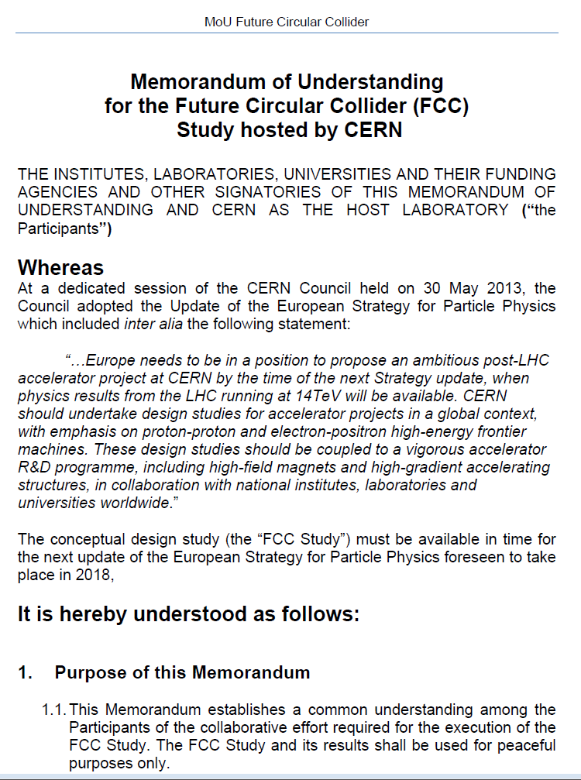

FCC collaboration framework
A consortium of partners based on a
Memorandum Of Understanding (MoU)
Working together on a best effort basis
Pursuing the same common goal
Self governed
Incremental & open to academia and industry
Light general framework, adapted to the needs during a conceptual design study
Detailed project descriptions in specific addenda

Slide 9

Status of global FCC Collaboration
136
Institutes
32
Companies
34
Countries
EC
H2020

Slide 10

EU H2020 Design Study
EuroCirCol
European Union Horizon 2020 program:
3 MEURO co-funding
Started June 2015, ends in Dec 2019
15 European beneficiaries & KEK & associated FNAL, BNL, LBL, NHFML
Covers FCC-hh key work packages:
Optics design (arc & IR)
Cryogenic beam vacuum system design including beam tests at ANKA
16 T dipole design, construction folder for demonstrator magnets
Notes:
New slide from Davide.
Showing that conductor development is launched at international level, Russia, Japan, (Korea and Europe in preparation)
Underline importance of that development as main cost driver for the hadron collider machine.

Slide 11

EU H2020 Marie Curie ITN
EASITrain
European Advanced Superconductivity Innovation and Training Network
Funding 15 Early Stage Researchers over 3 years & training in key areas
SC wires at low temperatures for magnets (Nb₃Sn, MgB₂, HTS)
Superconducting thin films for RF and beam screen (Nb₃Sn, Tl)
Electrohydraulic forming for RF structures
Turbocompressor for Nelium refrigeration
Magnet cooling architectures
started 1 October 2017
13 Beneficiaries
I-CUBE
12 Partners

Slide 12
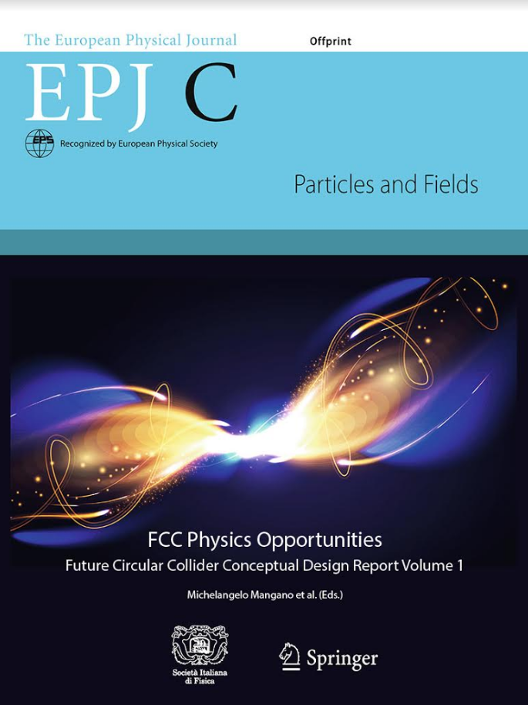
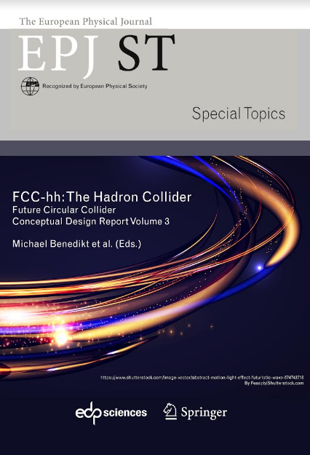
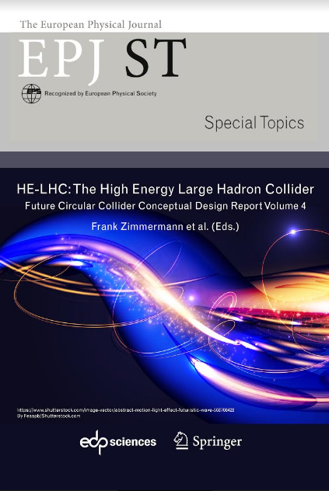
Results of FCC Conceptual Design Study
Study Documentation:
4 CDR volumes submitted to EPJ in December 2018.
  FCC Physics Opportunities
  FCC-ee
  FCC-hh
  HE-LHC
  Preprints available since 15 January 2019 http://fcc-cdr.web.cern.ch/
CDR presentation during welcome event this evening.
Paper copies can be requested at
  http://get-fcc-cdr.web.cern.ch
more than 1350 contributors from 350 institutes, a truly global collaboration and effort as suggested by the EPPSU 2013

Slide 13
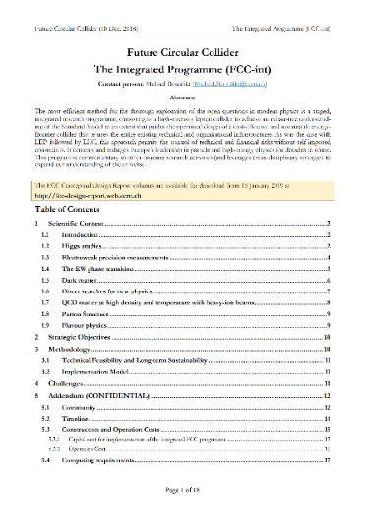
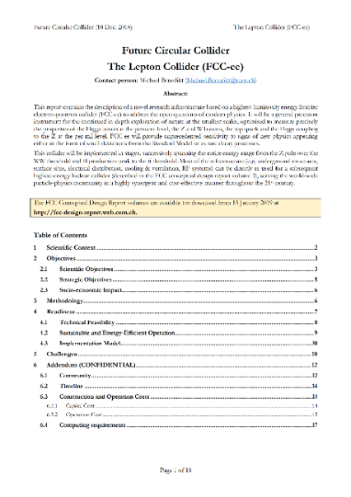
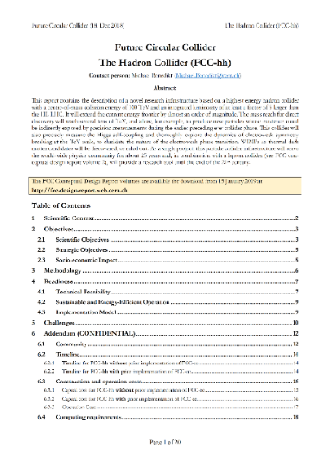
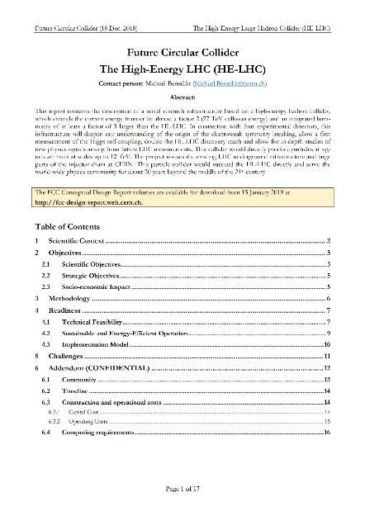
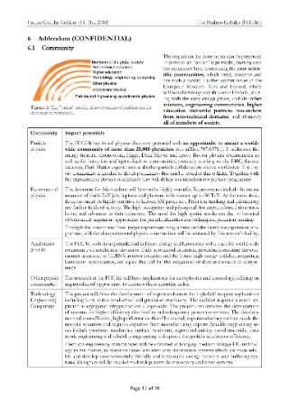
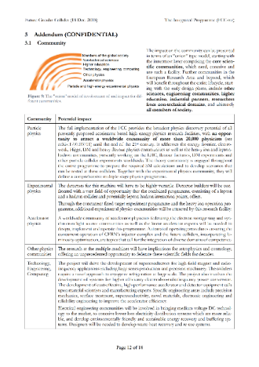
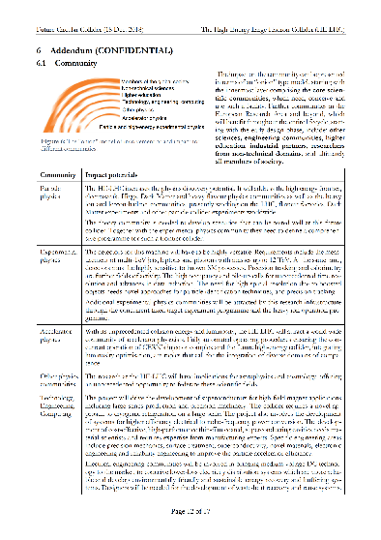
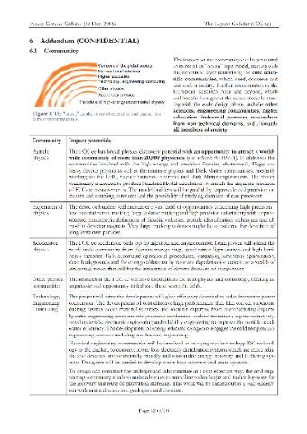
FCC Study input for EPPSU
4 ten-page strategy documents + addenda submitted to ESG in December 2018.
  The FCC integrated program
  Individual documents for FCC-ee and FC C-hh and HE-LHC
  Preprints available since 15 January 2019 on
  http://fcc-cdr.web.cern.ch/

Slide 14
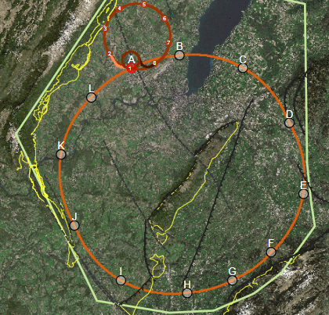
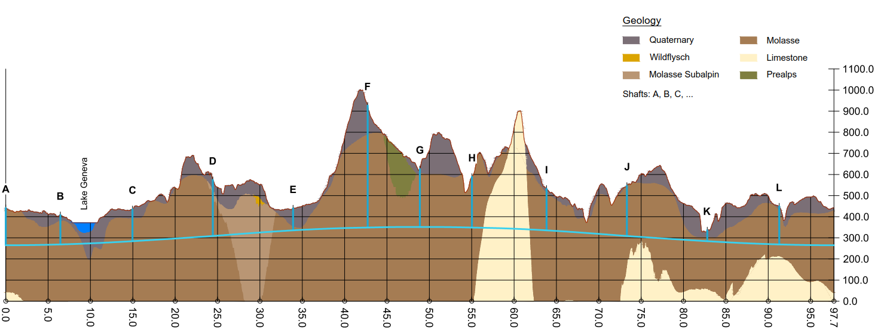
The FCC integral program
Comprehensive cost-effective program maximizing physics opportunities
Stage 1: FCC-ee (Z, W, H, tt) as first generation Higgs factory, EW and top factory at highest luminosities.
Stage 2: FCC-hh (~100 TeV) as natural continuation at energy frontier, with ion and eh options.
Complementary physics
Integrating an ambitious high-field magnet R&D program
Common civil engineering and technical infrastructures
Building on and reusing CERN’s existing infrastructure.
FCC integrated project plan is fully integrated with HL-LHC exploitation and provides for seamless continuation of HEP in Europe.

Slide 15
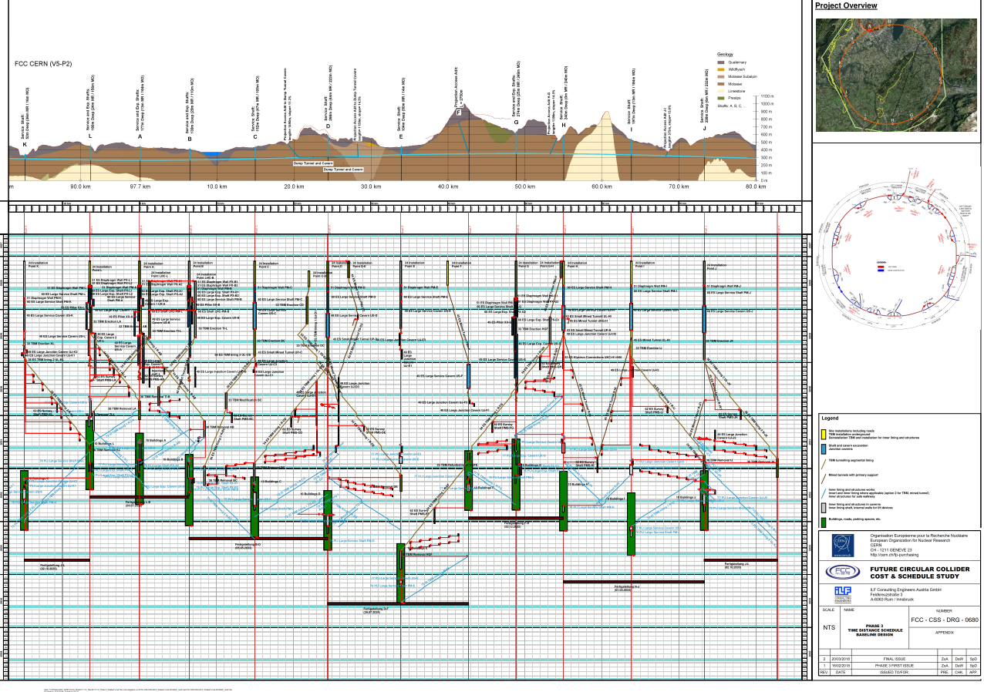
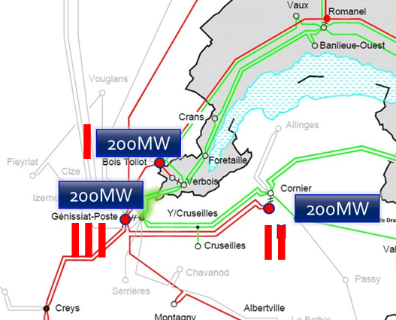
Implementation studies
Additional 200 MW available for FCC
at each of the three 400 kV sources from European grid
4.5yrs
6.5yrs
Total construction duration 7 years
First sectors ready after 4.5 years
---- 400 kV ---- 230 kV

Slide 16
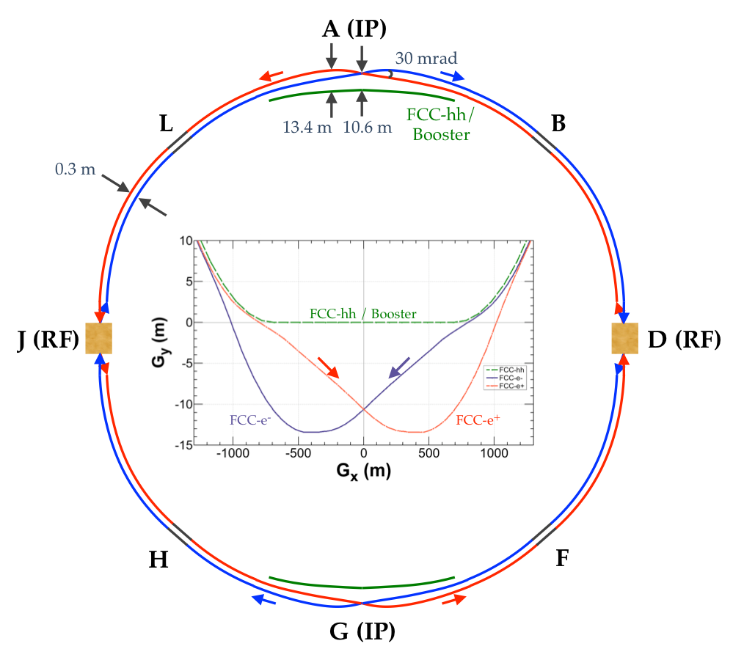
Common layouts for hh & ee
Two main IPs in A, G for both machines.
Common footprint except around IPs.
FCC-ee asymmetric IR layout to limit synchrotron radiation
FCC-ee
FCC-hh

Slide 17
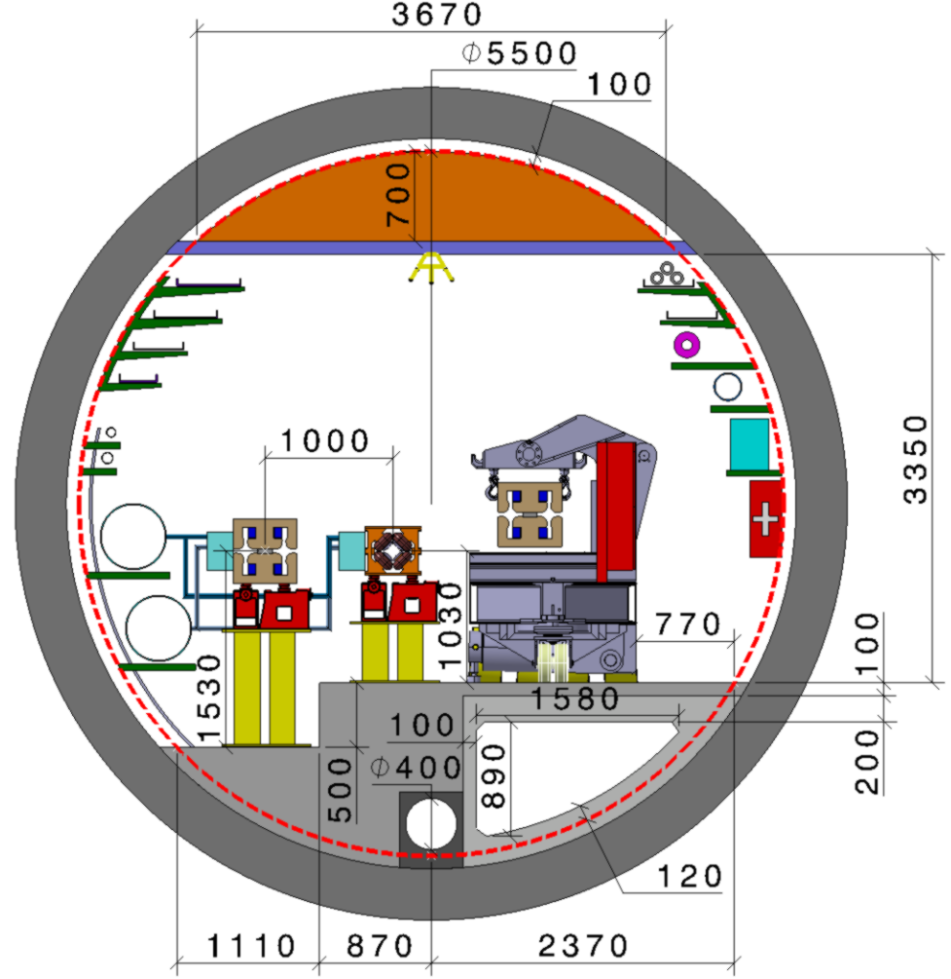
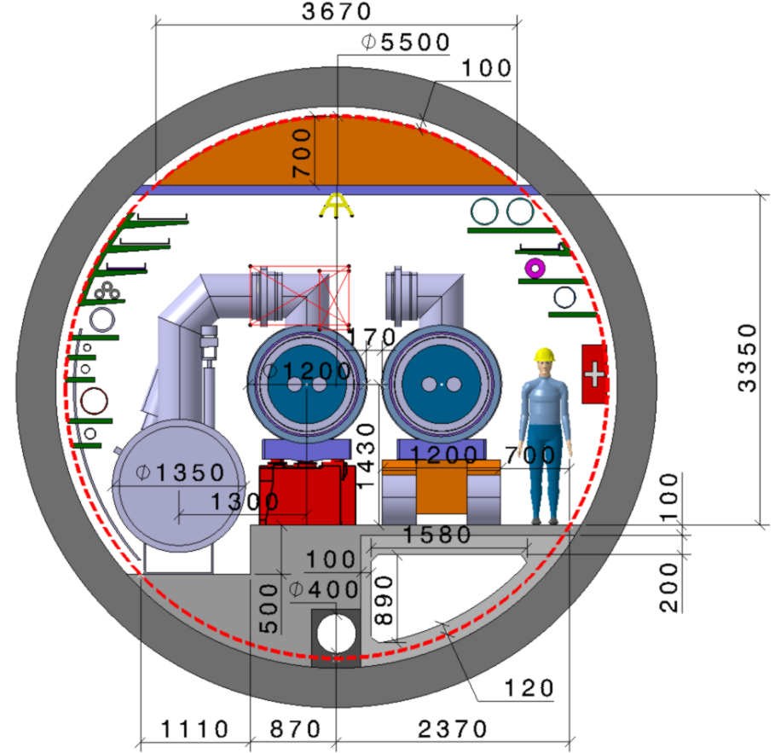
Tunnel integration in arcs
  FCC-ee FCC-hh
  5.5 m inner diameter

Slide 18
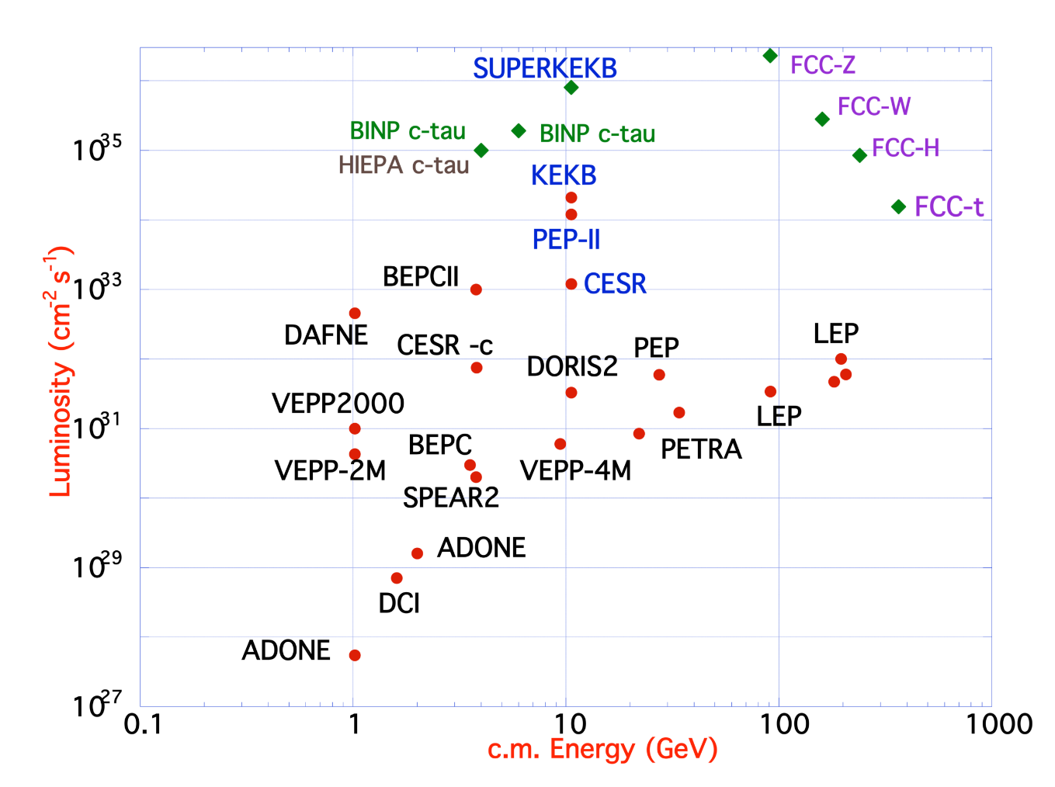
FCC-ee – EW factory: performance
FCC-ee reaches highest luminosities & energies
by combining ingredients and well-proven concepts of several recent colliders:
B-factories: KEKB & PEP-II:
double-ring lepton colliders,
high beam currents,
top-up injection
DAFNE: crab waist, double ring
Super B-fact., S-KEKB: low β_{y}*
LEP high energy, SR effects
VEPP-4M, LEP: precision E calibration
KEKB: e⁺ source
HERA, LEP, RHIC: spin gymnastics
L/IP
Marica Biagini

Slide 19
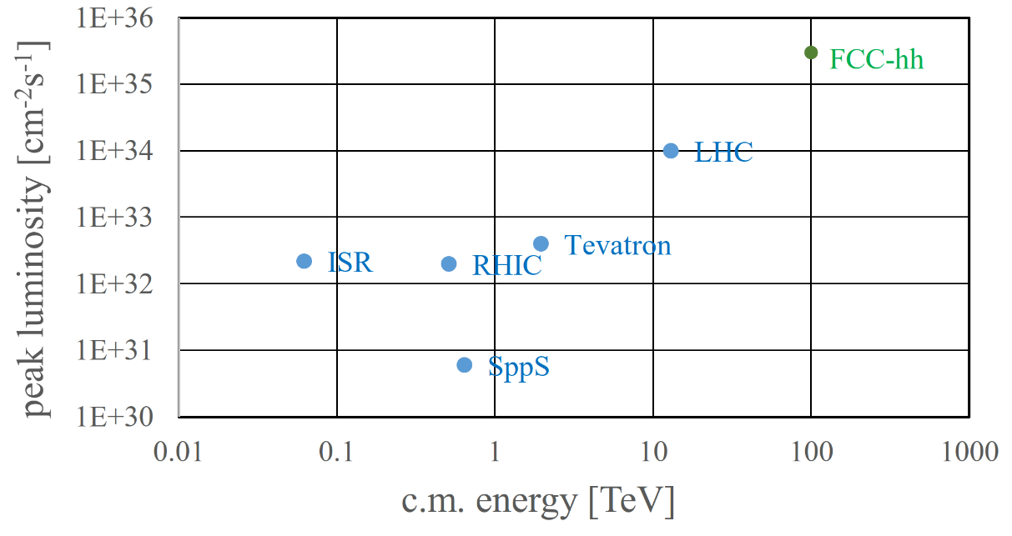
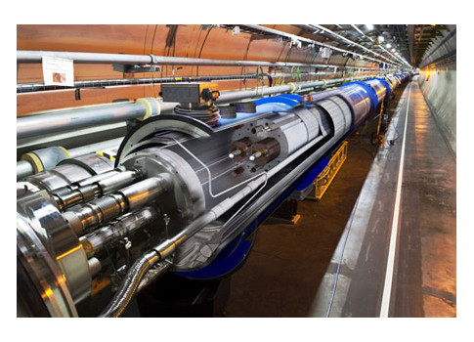
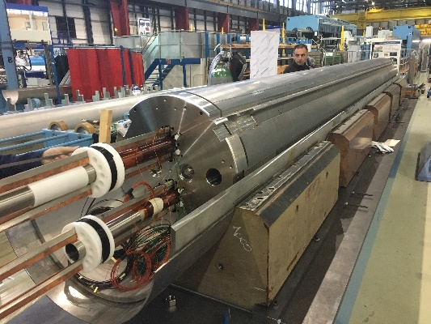
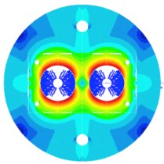
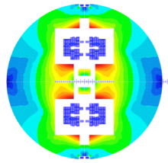
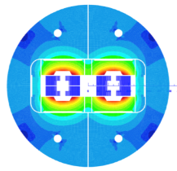
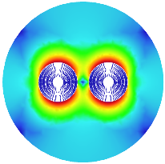
FCC-hh: performance
Aim at ~one order of magnitude performance increase in both energy and luminosity w.r.t LHC
100+ TeV cm collision energy (vs 14 TeV for LHC)
20 ab⁻¹ per experiment collected over 25 years of operation time (vs 3 ab⁻¹ for LHC).
Similar performance increase as from Tevatron to LHC.
Key technology: High-field magnets
From LHC technology
8.3 T NbTi
via HL-LHC technology
11 T Nb₃Sn
to 16 T Nb₃Sn
EuroCirCol, Chart, US MDP

Slide 20
FCC integrated project technical schedule
FCC integrated project plan is fully integrated with HL-LHC exploitation
provides for seamless further continuation of HEP in Europe.

Slide 21
FCC integrated project cost estimate
Construction cost phase1 (FCC-ee) is 11,6 BCHF
5,4 BCHF for civil engineering (47%)
2,2 BCHF for technical infrastructure (19%)
4,0 BCHF accelerator and injector (34%)
Construction cost phase 2 (FCC-hh) is 17,0 BCHF.
13,6 BCHF accelerator and injector (57%)
  Major part for4,700 Nb₃Sn 16 T main dipole magnets, totalling 9,4 BCHF, targeting 2 MCHF/magnet.
CE and TI from FCC-ee re-used, 0,6 BCHF for adaptation
- 2,8 BCHF for additional TI, driven by cryogenics
(Cost FCC-hh stand alone would be 24,0 BCHF.)

Slide 22
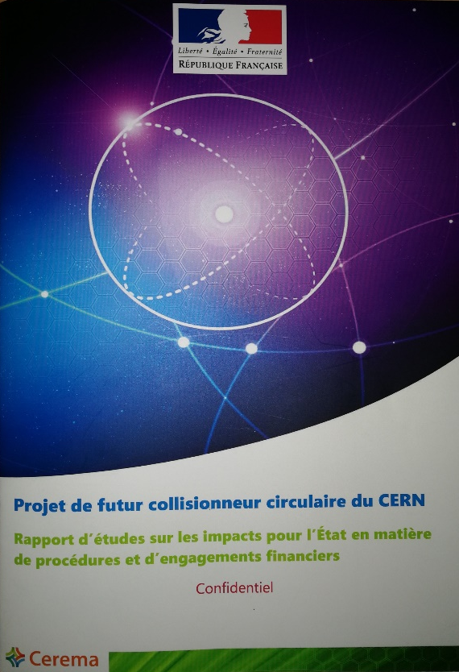



FCC work with host states
General secretariat of the region Auvergne-Rhône-Alpes and notified body “Centre d'études et d'expertise sur les risques, l'environnement, la mobilité et l'aménagement”
Working group with representatives of federation, canton and state of Geneva and representation of Switzerland at the international organisations and consultancy companies
Administrative processes for project preparatory phase developed.
Requirements for urbanistic, environmental, economic impact, land acquisition and construction permit related processes defined.
Common review of tunnel and surface site placement ongoing.

Slide 23
Conclusions from HE LHC studies
Performance
26 - 27 TeV cm collision energy
~10 ab⁻¹ per experiment collected over 20 years
Key technology: high-field magnets FCC-hh
Very challenging option due to existing boundary conditions:
Machine integration due to space limitations (tunnel cross section, straight section length, caverns) of existing underground infrastructures
Compatibility with safety requirements
Increased cryogenics requirements
Injector requirements
  LHC tunnel diameter 3.8 m
8 additional 1.8 K refrigeration units
8 new higher-power 4.5 K cryoplants

Slide 24
ESG request for parameters of a
lower-energy hadron collider
parameter | FCC-hh |  | FCC-hh-6T | HE-LHC | HL-LHC | LHC
collision energy cms [TeV] | 100 |  | 37.5 | 27 | 14 | 14
dipole field [T] | 16 |  | 6 | 16 | 8.33 | 8.33
beam current [A] | 0.5 |  | 0.6 | 1.1 | 1.1 | 0.58
synchr. rad. power/ring [kW] | 2400 |  | 57 | 101 | 7.3 | 3.6
peak luminosity [10³⁴ cm⁻²s⁻¹] | 5 | 30 | 10 (lev.) | 16 | 5 (lev.) | 1
events/bunch crossing | 170 | 1000 | ~300 | 460 | 132 | 27
stored energy/beam [GJ] | 8.4 |  | 3.75 | 1.4 | 0.7 | 0.36
NbTi technology from LHC, magnet with single-layer coil providing 6 T at 1.9 K:
  Corresponding beam energy 18.75 TeV or 37.5 TeV c.m.
  Significant reduction of synchrotron radiation wrt FCC-hh (factor 50) and corresponding cryogenic system requirements.
Luminosity goal 10 ab⁻¹ over 20 years or 0.5 ab⁻¹ annual luminosity:
  Beam current 0.6 A or 20% higher than for FCC-hh, 1.2E11 ppb (FCC-hh: 1.0 ppb).
  Stored beam energy 3.75 GJ vs 8.4 GJ for FCC-hh.
Analysis of physics potential, technology requirements and cost ongoing.

Slide 25
Next steps 2019 - 2020
Iteration of tunnel and surface structures layout and implementation with host states.
Adaptation of CE, machine designs, etc. according to implementation optimisation.
Following Integral Project proposal, presently focus on FCC-ee as potential first step (awaiting strategy recommendation).
  Review and more detailed design for FCC-ee injector concept
  Detailed design of technical infrastructure for FCC-ee
Preparation of EU H2020 DS project (INFRADEV call November 2019), focused on preparations for infrastructure implementation.

Slide 26
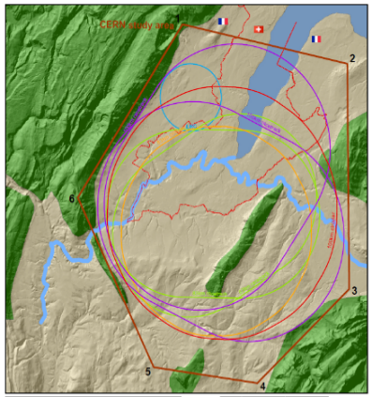

Preparation of EU H2020 DS project
Goal: Carry out technical design study for a 100 km long frontier circular collider infrastructure at CERN that will extend Europe’s leadership in the domain of fundamental physics research until the end of the 21st century. Focus on priority topics, to prepare construction project by 2026, in line with call scope:
Site Selection
Resources &
Environment
Governance Organisation Construction Operation
Scientific User Collaboration
Coherently Integrate Europe
Optimization of collider designs, site selection, placement and implementation, work with host states
Plans for construction and operation including resource efficiency & environmental impacts.
Development of governance structure,
construction & operation budget and funding strategy
Ensure that a scientific user community is built up to exploit the facility from the start on
Coherently integrate the infra-structure in the European research landscape

Slide 27
Next steps 2020 - 2026
2020/21 – 2025/26 project preparation phase (if supported by EPPSU and CERN Council)
Project preparatory activities with host states (landplot identification and acquisition plan, sector plan, EIA, “debat publique”, and study management
Civil engineering site investigations and construction tender planning
Technical design towards CDR++/TDR (ATS) (Accelerators, technology, technical infrastructure)
Development of financing and governance models for project and operation phases including international in-kind contributions (CERN Council and Directorate).
All 4 activities aim at reaching a level by 2025/26 allowing a definitive project decision.

Slide 28
Conclusions and outlook
As recommended by the ESU 2013, the FCC study was organised as an international collaboration focused on the conceptual design of high-performance energy frontier circular colliders for the post-LHC era.
The first phase of FCC conceptual design studies is completed. Baseline machine designs and associated infrastructures, with performance matching the physics requirements, were established and are documented in 4 CDRs.
A possible integrated FCC programme has been developed and submitted to the ESU, together with descriptions of the individual machines.
The next steps, in parallel to ESU process and in harmony with its recommendations, will develop a concrete local/regional implementation scenario in collaboration with host state authorities, accompanied by machine optimization, physics studies and technology R&D.

Slide 29
The FCC Week 2019 should:
Stimulate exchange between participants of all study areas
Strengthen the collaboration network
Develop plans for upcoming study phase while awaiting EPPSU.
Have a great and productive week!

