Slide 1
A few Evolutions in SAD
V1.1k64
Jan. 10, 2017
K. Oide @ SAD Seminar

Slide 2
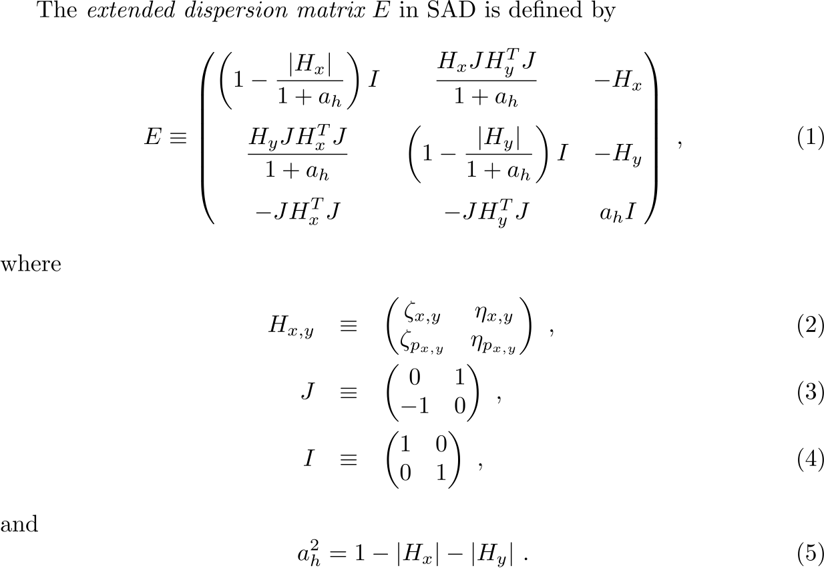
Extended dispersion for 6D optics

Slide 3
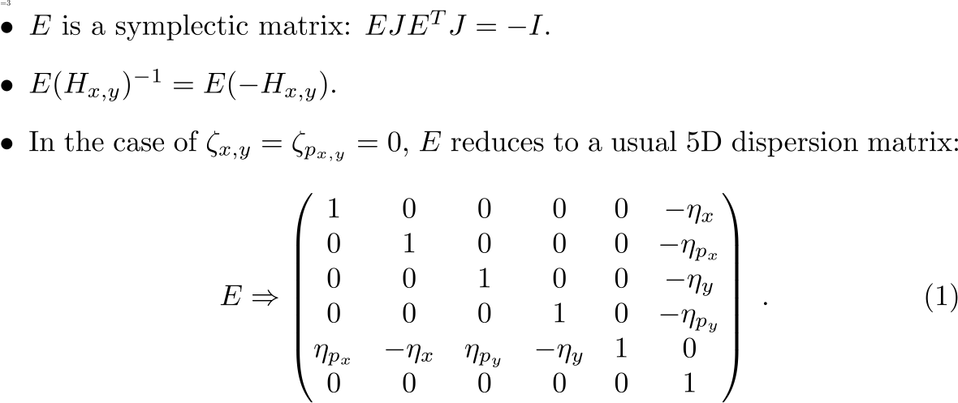
Some characteristics of E

Slide 4
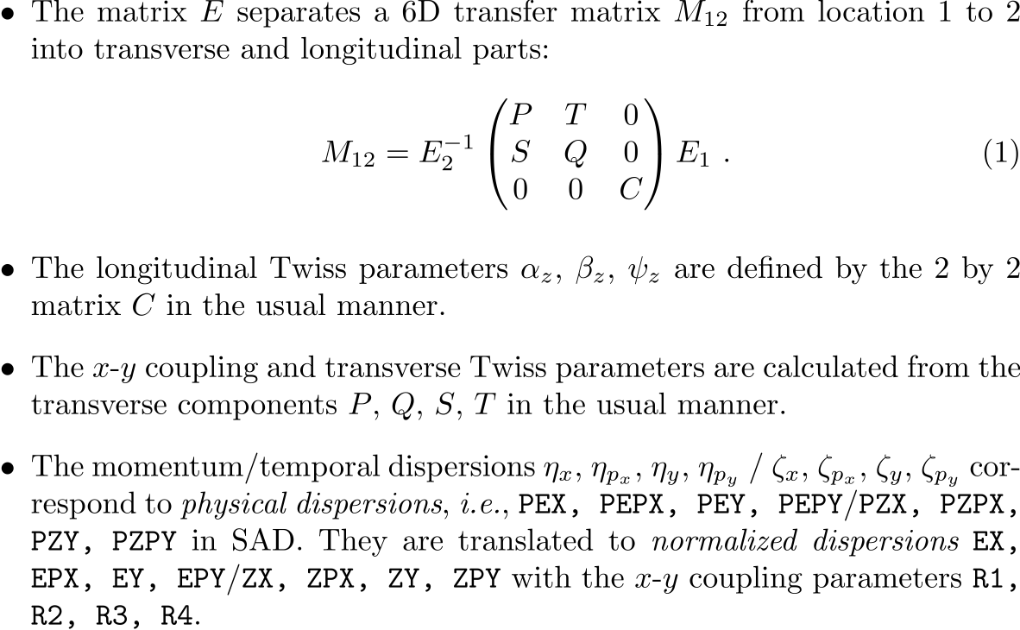
Separation of Longitudinal Coordinate
Remark: the separation above does not work when x-z or y-z coupling is too strong, where exchange of coordinates is necessary (not implemented in SAD yet).

Slide 5
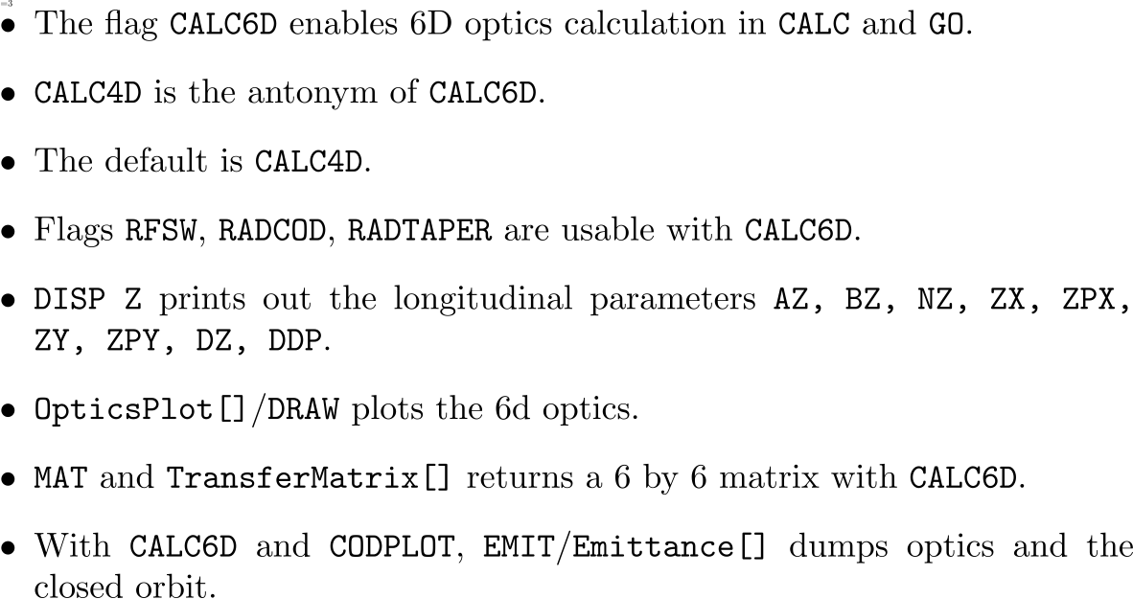
Usage
Remark: The off-momentum matching & finite amplitude matching have not been implemented yet,

Slide 6
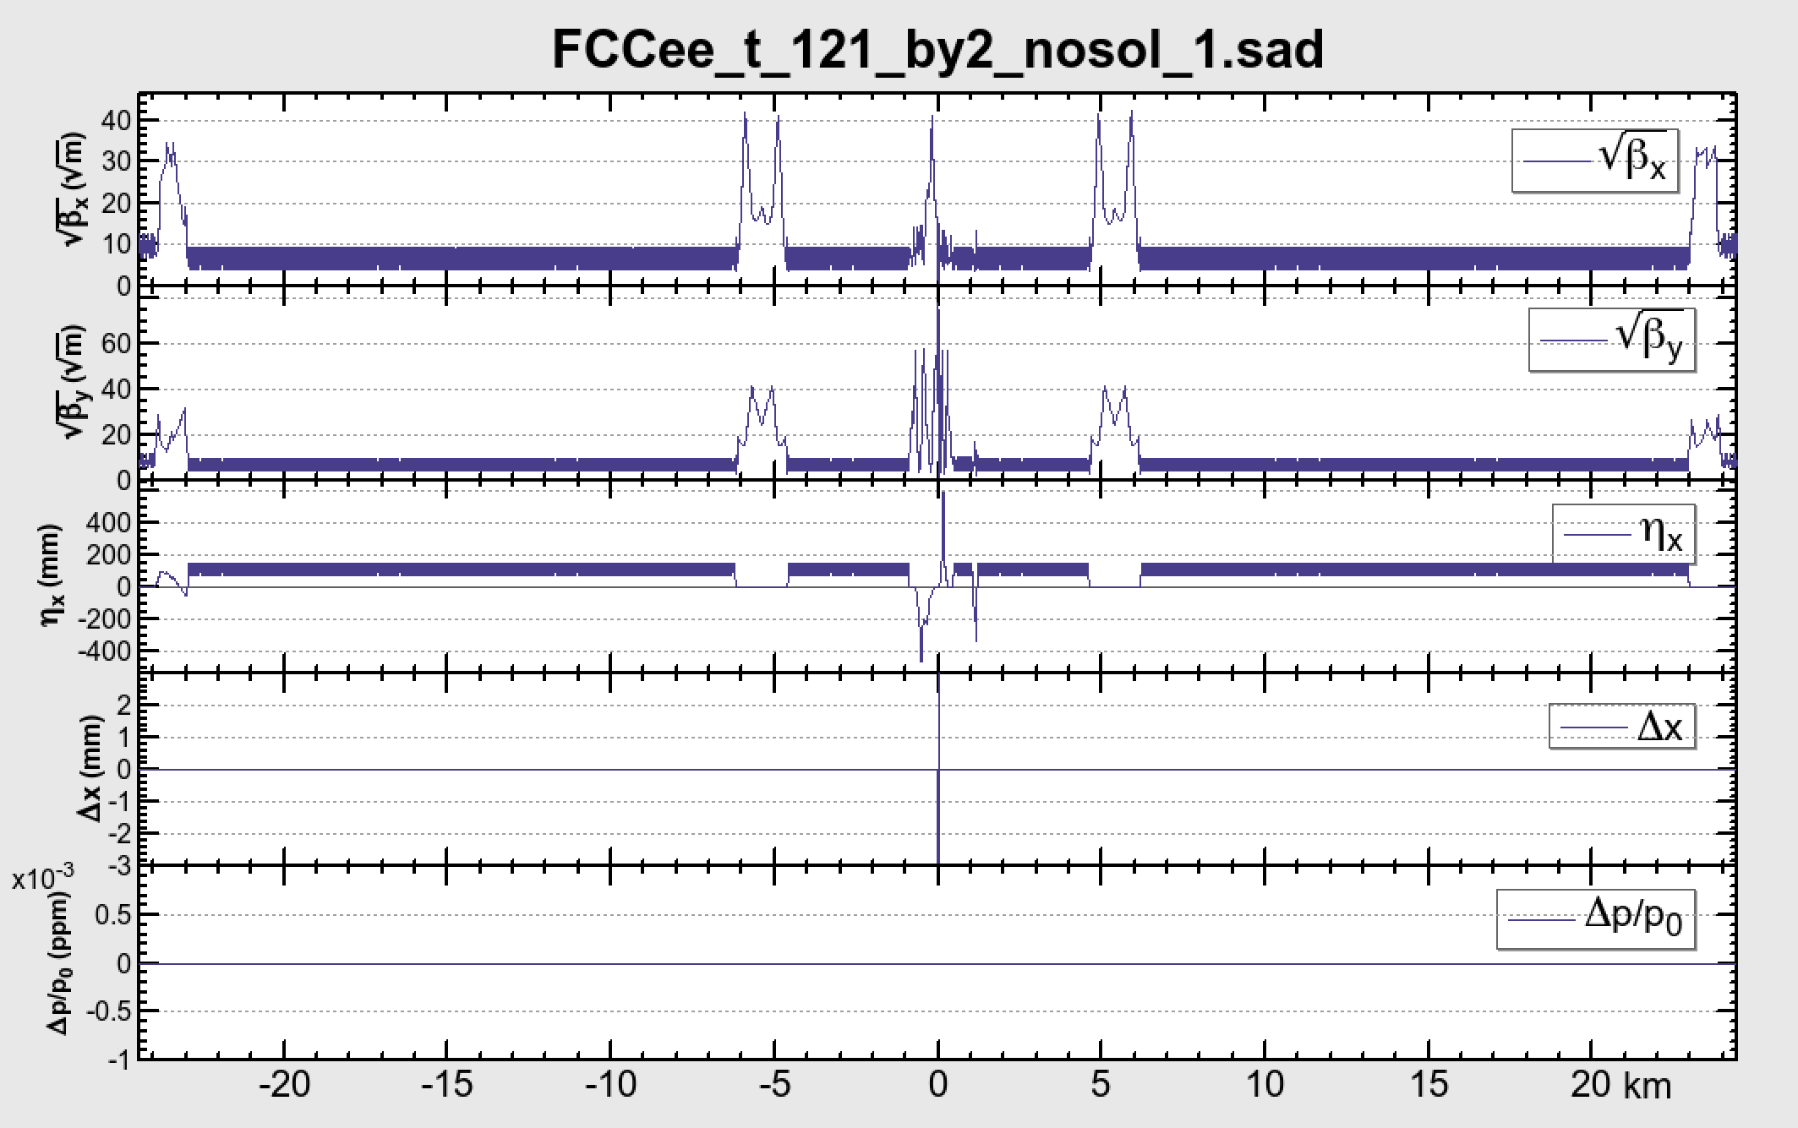
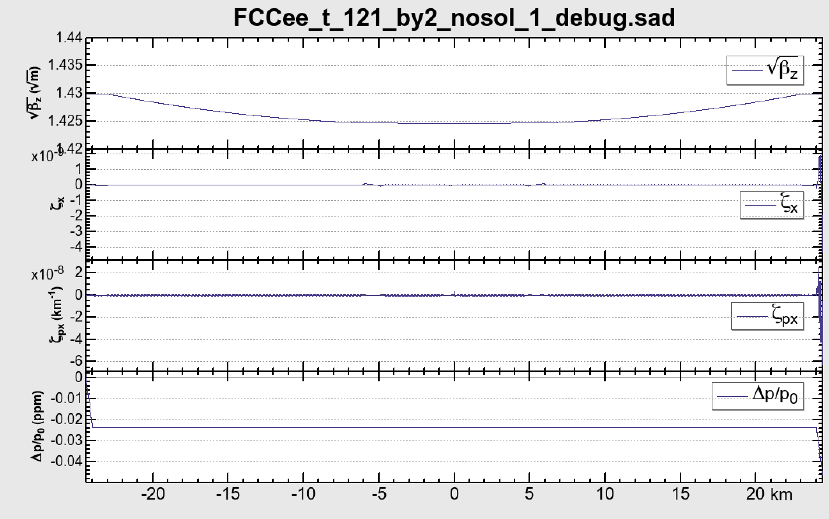
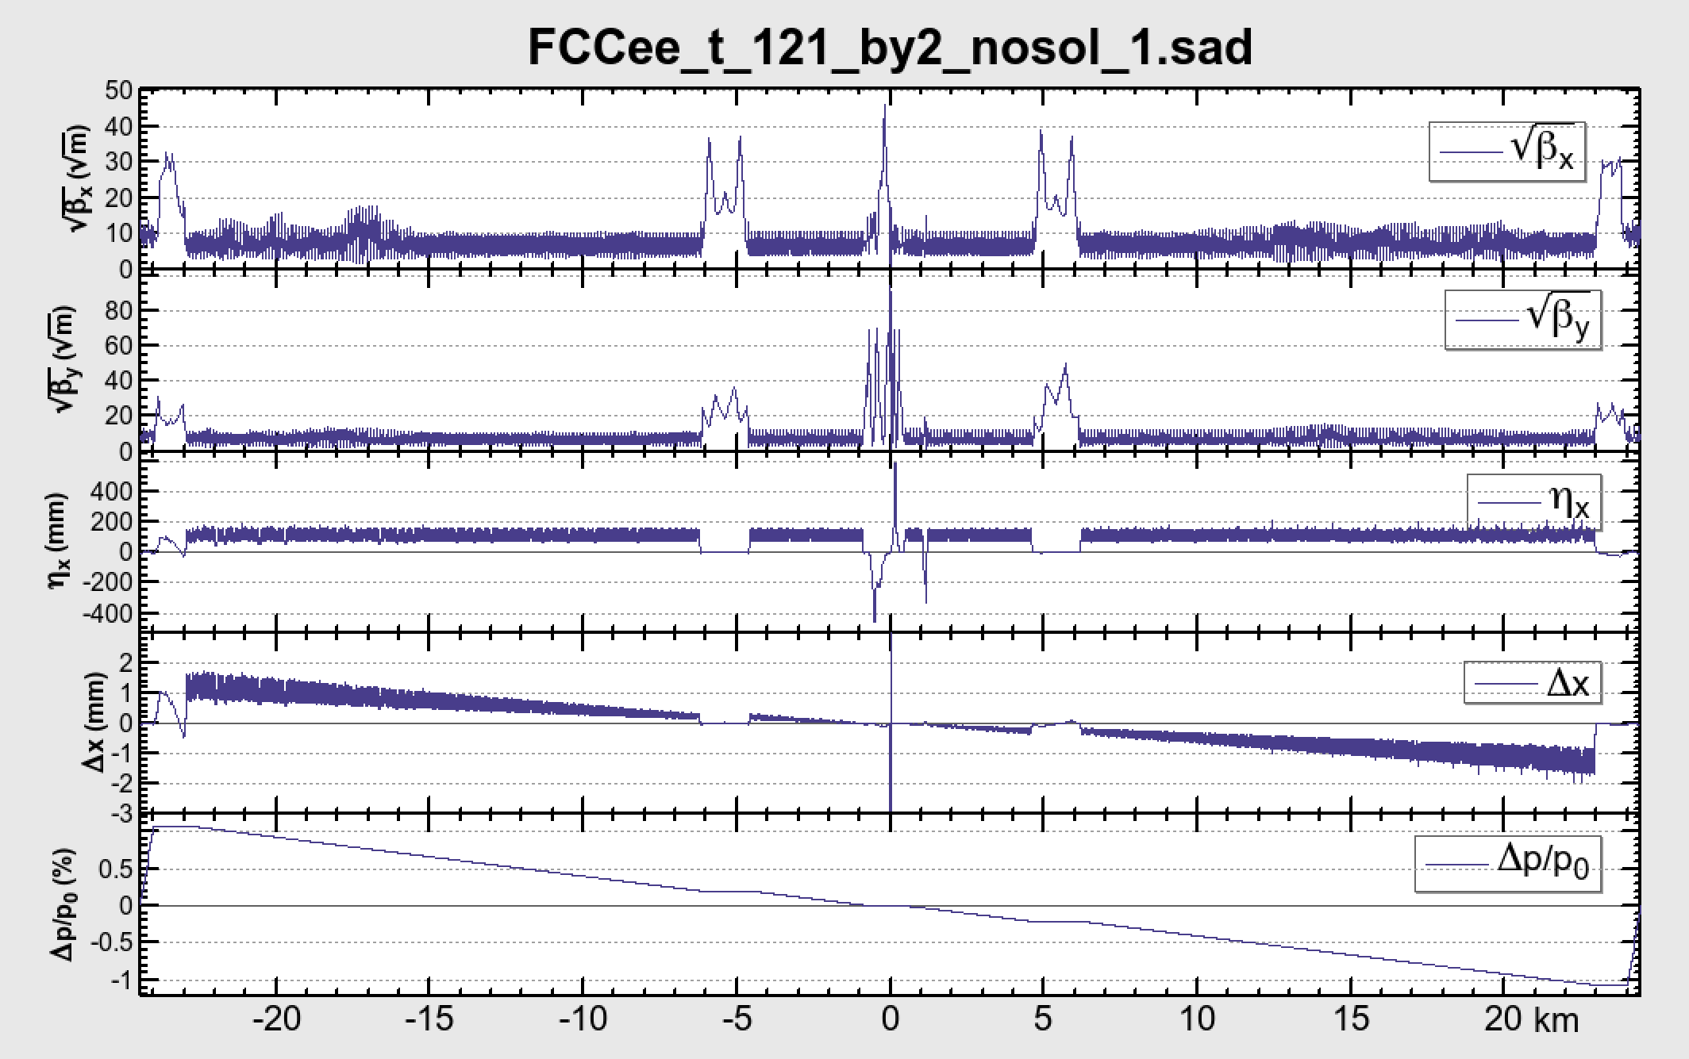
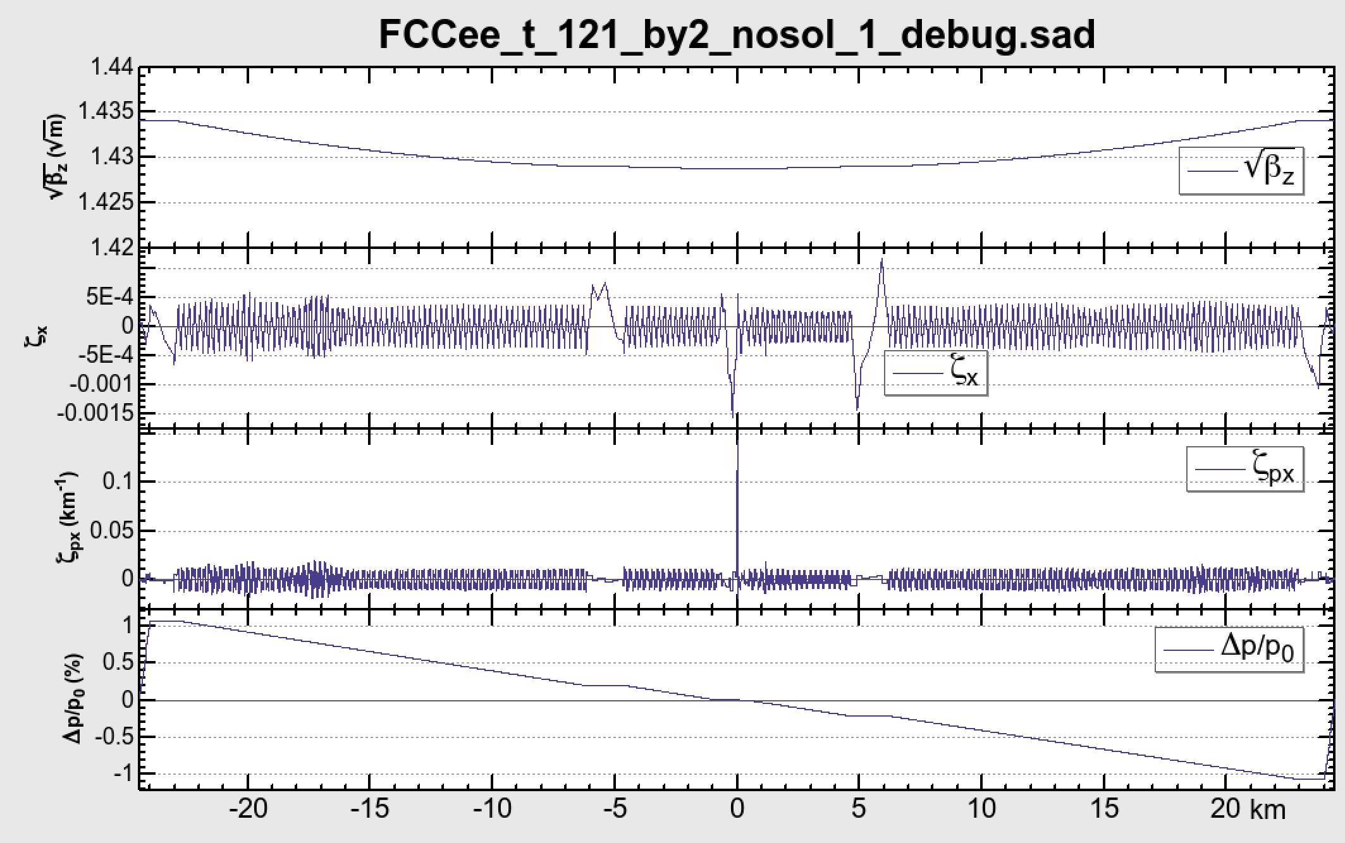
Example 1: Sawtooth effect
CALC6D;CALC;
NORADCOD
NORADCOD
RADCOD
RADCOD

Slide 7
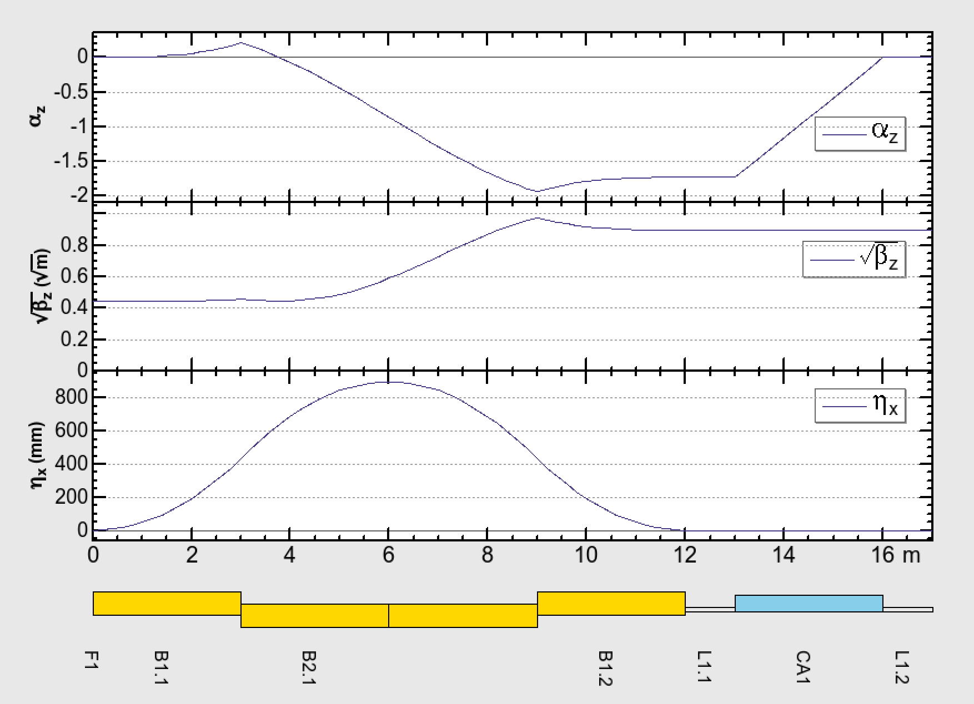
Example 2: Energy compressor
rfsw;trpt;ins;calc6d;
fit az 0;
fit ^^^ $$$ bz 4;
coup b2 b1 -1;
free ca1 b*;
???-FFS-Info-Component B2.1 is coupled to B1.1
???-FFS-Info-Component B2.2 is coupled to B1.1
go;
Iterations Residual Method Reduction Variables
3 1.337 (NEWTON) 6.2500E-02 3
4 0.4571 (NEWTON) 0.2500 3
5 0.3421 (NEWTON) 1.000 3
6 5.0679E-03 (NEWTON) 1.000 3
7 6.1154E-07 (NEWTON) 1.000 3
Matched. ( 2.6648E-15) DP = 0.01000 DP0 = 0.00000 ExponentOfResidual = 2.0 OffMomentumWeight = 1.000
F1/$$$ f BZ 4 1 4.000000 $$$ AX ####### # -1.734642 $$$ BX ####### # 40.089797
$$$ NX ####### # .166770 $$$ AY ####### # -.504477 $$$ BY ####### # 12.055708
$$$ NY ####### # .265221 $$$ AZ 0 1 3.6437E-8 $$$ LENG ####### # 17.000000
draw az & bz & ex lat;
Remarks:
- FitValue is not applicable to the longitudinal functions and temporal dispersions, so far.

Slide 8
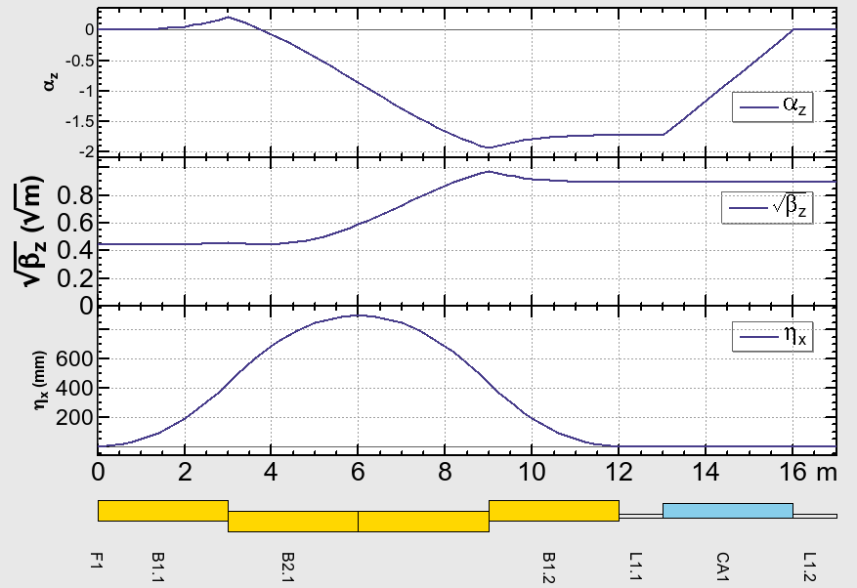
More options for Graphics
OpticsPlot[{{"AZ"},{"BZ",FontScale->1.6},{"EX",TickFontScale->1.3}},Names->"*",Thickness->2]
The legend box searches a location to avoid collision with the contents.
Tick labels hide if collide to each other.
FontScale -> 1.6
TickFontScale -> 1.3
UnitLabel
The component labels in OpticsPlot automatically thin out to avoid collisions.
Now the graphics of SAD comply with PRAB’s standard!

Slide 9
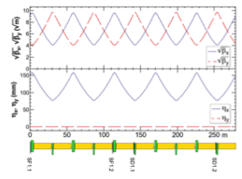
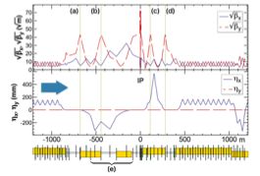
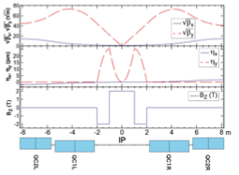
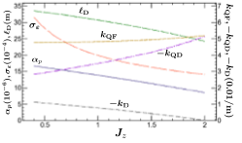
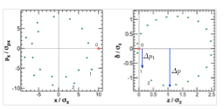
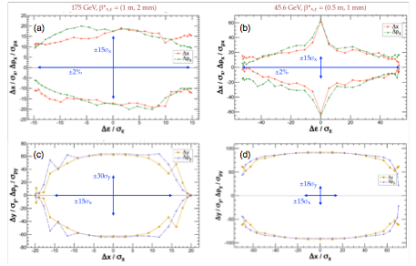
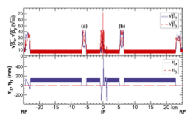
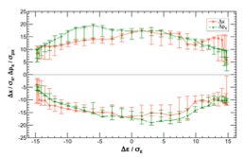
Now the graphics of SAD comply with PRAB’s standard!

Slide 10
Other changes since ∼June 2016
1. Removed almost all 32-bit memory allocations, except for a few obsolete routines.
2. The expansion of a beam line in MAIN level is rewritten using a new module with new types sad_el and sad_comp, and module routines loc_comp, loc_el, idcomp, dircomp, idcompc,idelc, idtypec, idvalc, direlc, compelc, pnamce, lpnamec.
3. Common blocks are largely replaced with modules.
4. Physical constants are updated with PDG2014 data in all .f and .c routines.
5. MULT with nonzero ANGLE was reviewed to be more consistent with BEND or QUAD. The Maxwellian fringes of K1 and higher are not yet implemented though.
6. New keywords F1K1F, F2K1F, F1K1B, F2K1B are introduced to describe asymmetric fringes at the entrance and the exit of QUAD and MULT. The traditional F1 and F2 are still valid: F1 + F1K1F(B) F1 + F2K1F(B) work at the entrance(exit) if the orientation of the element is positive, and vice versa when negative.
7. A routine to find out keywords of an element is renewed for efficiency. A new key KEYWORDS_ALL is added in Element to return all keywords including voids ('-').
8. The position of a legend in graphics now searches to avoid an overlapping with the contents of the graph. Also the size and frame are modified.
9. FindRoot is modified to handle a function that becomes invalid with non-real argument.

Slide 11
More changes
10. A wrong usage of mkstemp creating unnecessary files has been corrected.
11. The flag RADTAPER no longer needs CODPLOT.
12. Closed orbit finding with RADTAPER has been revised.
13. Accessing keys of elements with an internal table kytbl has been changed to use parameters if possible.
14. Fitting value specification with two locations treats the value as the ratio for BX, BY, BZ, and as the difference for other functions:
FIT P1 P2; BX 1.5 : BX(P2) / BX(P1) == 1.5
FIT P1 P2; EX 0.2 : EX(P2) - EX(P1) == 0.2
15. A bug was created in around Sept. 2016, and fixed in temit.f. It might have affected the value of emittances.
16. More bugs have been generated and corrected…

